Slide 1
Deep Learning with Keras
Themistoklis Diamantopoulos

Slide 2
Contents
Part 1:
Machine Learning with Python
Introduction to Deep Learning
Optical Character Recognition
Image Recognition
Part 2
Text Classification/Sentiment Analysis
Text Generation
Neural Doodle/Neural Style Transfer
AI Game Learning

Slide 3
Introduction TO Machine LEARNING

Slide 4
What is Machine Learning?
Subfield of Artificial Intelligence
Term coined in 1959 by Arthur Samuel
Progressively improve performance on a specific task with data, without being explicitly programmed

Slide 5
Types of Machine Learning tasks
Supervised Learning
Learn output based on input data
Unsupervised Learning
Find structure in given data
Reinforcement Learning
Learn from the environment

Slide 6
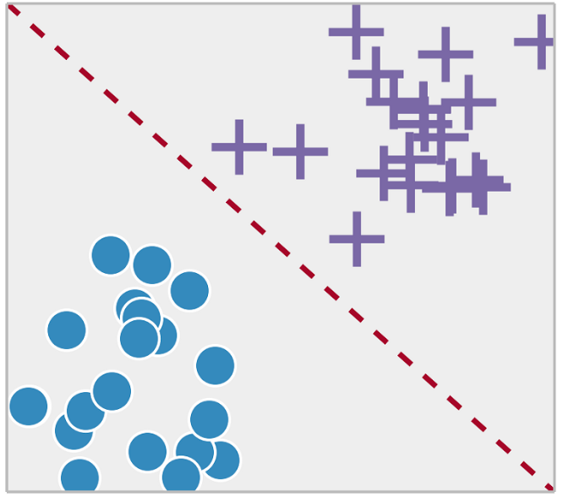
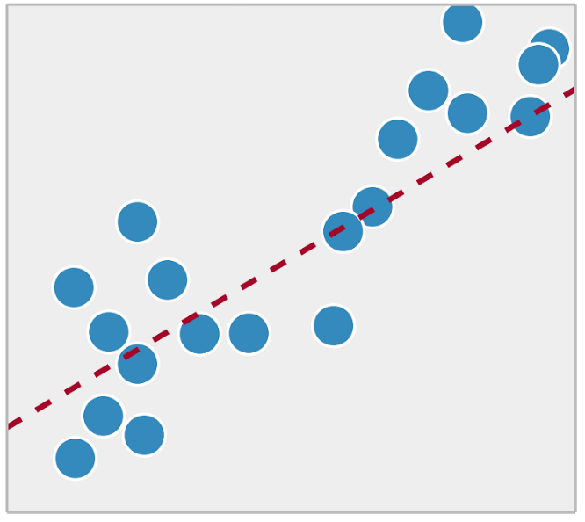
Supervised Learning tasks
Classification
Regression
Source: https://towardsdatascience.com/supervised-vs-unsupervised-learning-14f68e32ea8d

Slide 7
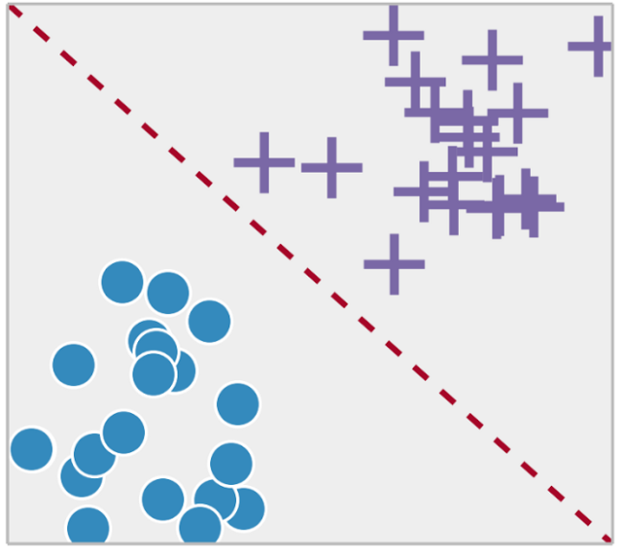
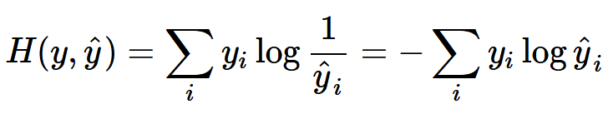
Classification
Classify data to 1, 2 or more classes
Confusion Matrix
Evaluation Metrics
Accuracy = (TP + TN) / (P + N)
Precision = TP / (TP + FP)
Recall = TP / P
Actual
Class
Predicted
Class
 | Positive | Negative
Positive | TP | FP
Negative | FN | TN
 | P = TP + FN | N = FP + TN
Bonus: Cross Entropy
Source: https://rdipietro.github.io/friendly-intro-to-cross-entropy-loss/

Slide 8

Regression
Build a model that fits the data
Actual (y_{i}) and predicted values (ŷ_{i})
Mean Absolute Error
Mean Squared Error
Coefficient of Determination
where and

Slide 9
Data Splitting
Use training data to train the model
Some data can be used to validate the model → validation set
Use folds of training data for validation → Cross-validation
Evaluate the model on test data
Test set must not overlap with training data
Training
Test
Training
Validation
Test

Slide 10
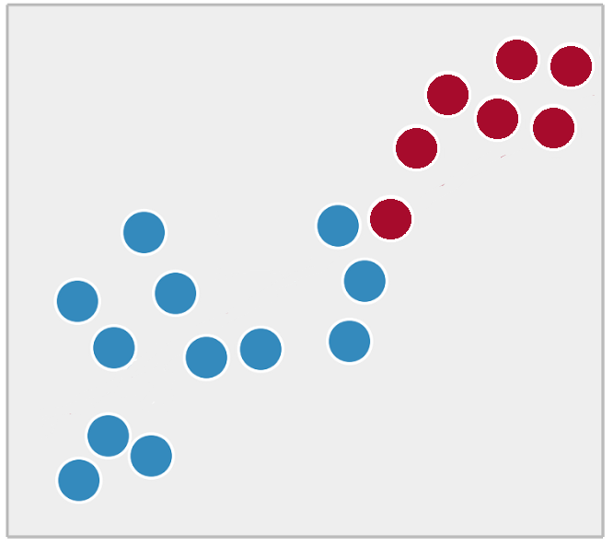
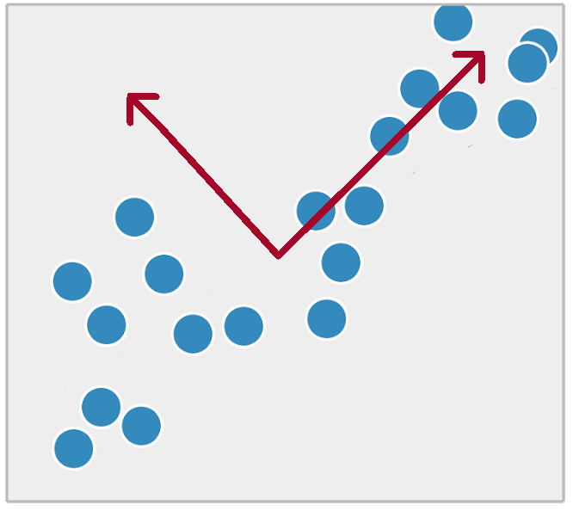
Unsupervised Learning tasks
Clustering
Dimensionality Reduction

Slide 11
Introduction TO NEURAL NETWORKS

Slide 12
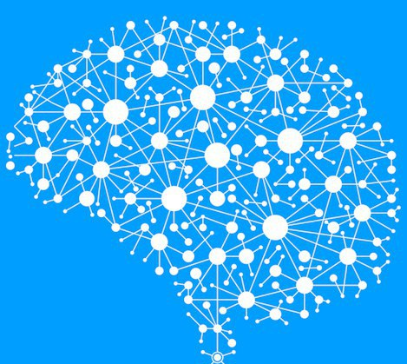
Why Neural Networks?
Cognitive features
Inspired by the brain
10¹¹ neurons
0.001 sec switching time
>10⁴ connections per neuron
0.1 sec for scene recognition

Slide 13
A brief history course
From the perceptron to deep learning
AI Winter 1969 – 1986
Convolutional NNs for Handwritten Recognition
1998
AlexNet wins ImageNet
2012
Perceptron
1959
Backpropagation
1974
Restricted Boltzmann machines
2006

Slide 14
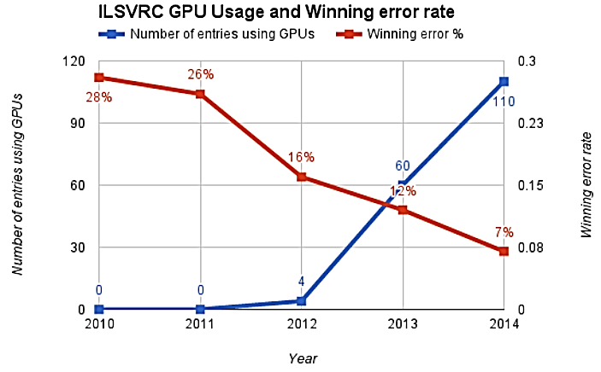
The first breakthrough
ImageNet image recognition challenge
Source: https://beamandrew.github.io/deeplearning/2017/02/23/deep_learning_101_part1.html

Slide 15
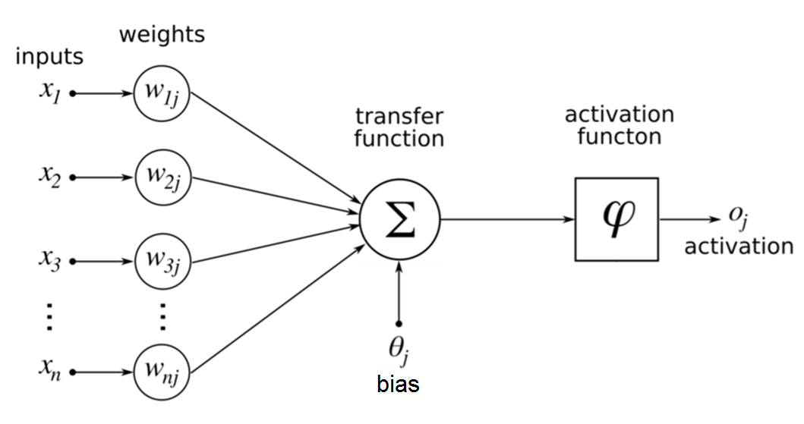
The perceptron - where it all started
Invented in 1959 by Frank Rosenblatt
Practically also the first Neural Network
Source: https://commons.wikimedia.org/wiki/File:ArtificialNeuronModel_english.png

Slide 16
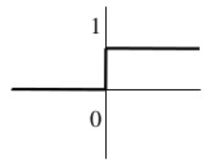
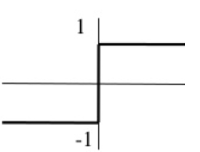
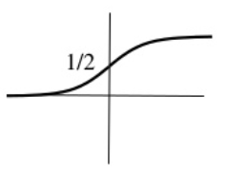
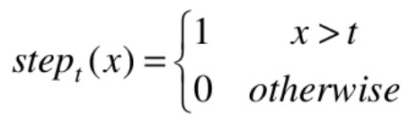
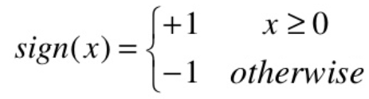
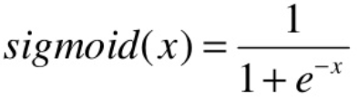
Activation functions
Different types of functions
Step function
Sign function
Sigmoid function
Useful Resource: https://en.wikipedia.org/wiki/Activation_function

Slide 17
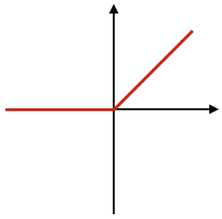
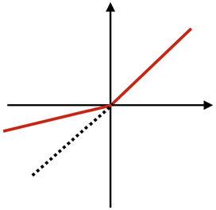


Activation functions (continued)
Different types of functions
ReLU
(Rectified Linear Unit)
PReLU
(Parametric ReLU)
Softmax
(similar to Sigmoid - generalized logistic function used for multiclass classification problems
Useful Resource: https://en.wikipedia.org/wiki/Activation_function

Slide 18
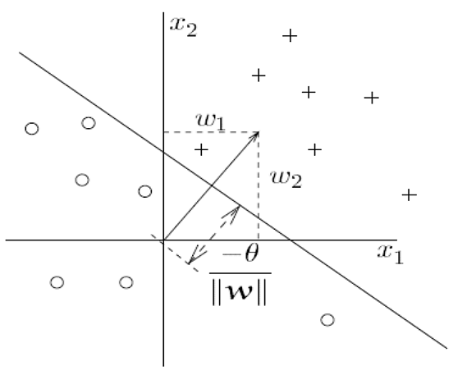
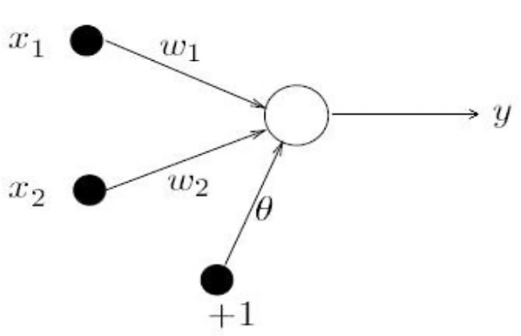

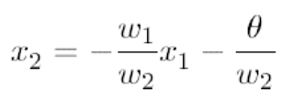
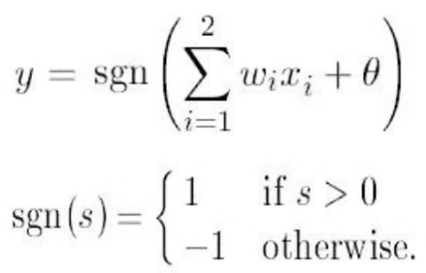
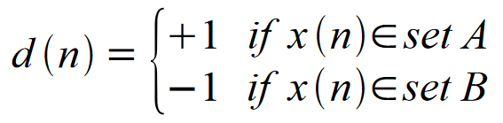

Example use of perceptron
Bias → Offset from the origin
Weights → Slope of the line
Select random sample from training set
If classification is correct, do nothing
If classification is incorrect, modify w:
REPEAT
Source: http://aass.oru.se/~lilien/ml/seminars/2007_02_01b-Janecek-Perceptron.pdf

Slide 19
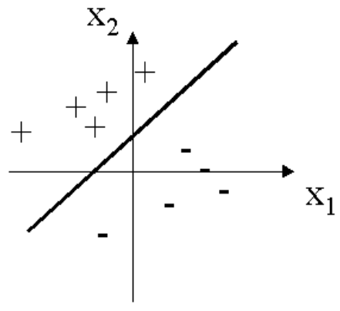
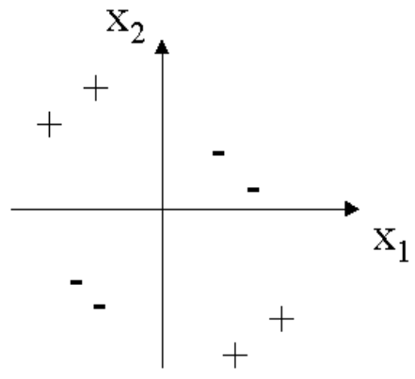
Limitations of perceptron
Can be used only for Linearly Separable Data
Linearly Separable
Not Linearly Separable
Source: http://aass.oru.se/~lilien/ml/seminars/2007_02_01b-Janecek-Perceptron.pdf

Slide 20
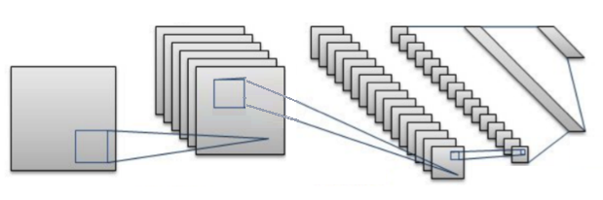
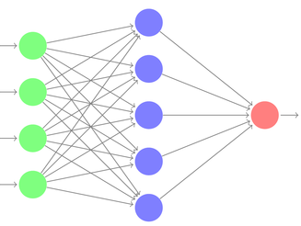

Neural Network Topologies
Used for different types of problems
Convolutional Neural Network
Multi-Layer Perceptron
Recurrent Neural Network
Useful Resource: https://towardsdatascience.com/the-mostly-complete-chart-of-neural-networks-explained-3fb6f2367464

Slide 21
Multi-Layer Perceptron

Slide 22
Training a Multi-Layer Perceptron
Gradient Descent
Start with some initial
parameters θ
Update them using:
where:
η: learning rate
E(x, θ, y): error
Continue until error is small
Hidden Layer
Input Layer
Output Layer

Slide 23
Training a Multi-Layer Perceptron
Gradient Descent
Backpropagation
Easy way to
compute
Hidden Layer
Input Layer
Output Layer

Slide 24
Training a Multi-Layer Perceptron
Sample labeled data
Forward it through the network to get predictions
Update the connection weights
Backpropagate the errors
Generate an error signal that measures the difference between the predictions of the network and the desired values and then use this error signal to change the weights so that predictions get more accurate
Source: https://www.slideshare.net/LuMa921/deep-learning-a-visual-introduction

Slide 25
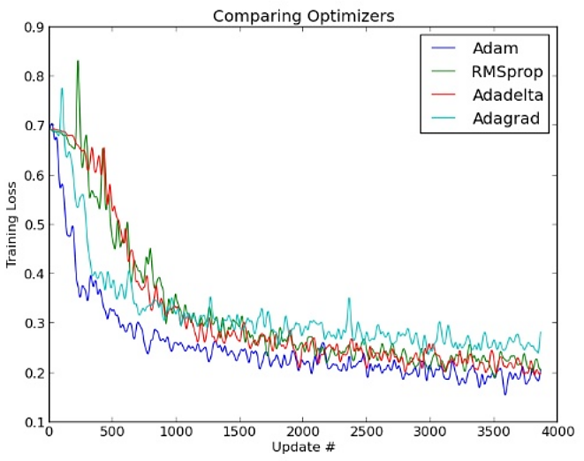
Gradient Descent Optimizers
RMSprop, Adadelta
Better later convergence
Adagrad
Early optimization speed
Adam
Combines the advantages of the above
Source: https://www.slideshare.net/indicods/general-sequence-learning-with-recurrent-neural-networks-for-next-ml

Slide 26
Introduction TO DEEP LEARNING

Slide 27
What is Deep Learning?
Subfield of Machine Learning
Practical definition:
Imitates the workings of the human brain in processing data and creating patterns for use in decision making

Slide 28
What are Deep Neural Networks?
Simple answer:
Neural Networks with many layers
Practical answer:
Neural Networks with more than one hidden layer
Elaborate answer:
Neural Networks that train on a distinct set of
features in each layer → Feature Hierarchy

Slide 29
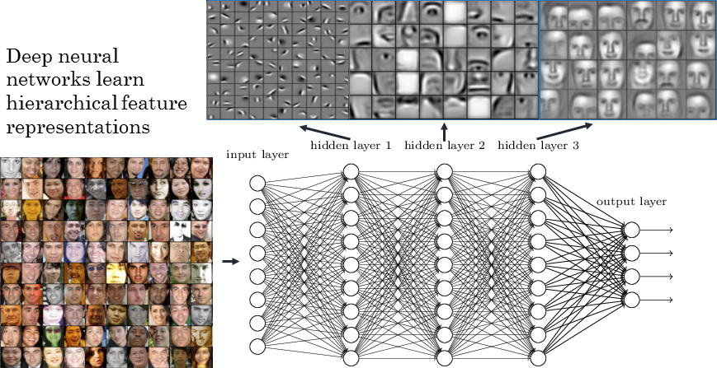
Feature Hierarchy
Source: https://www.strong.io/blog/deep-neural-networks-go-to-the-movies

Slide 30
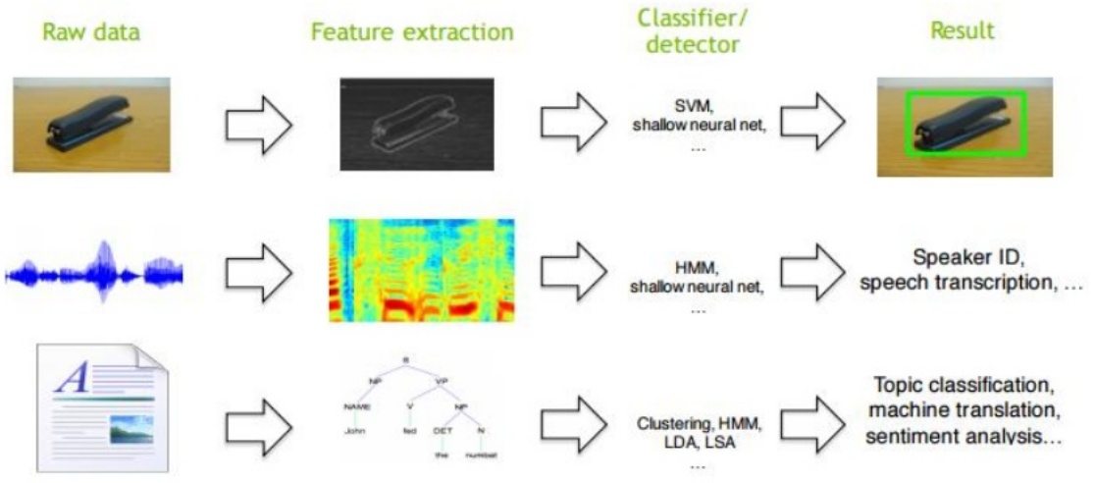
Traditional Machine Perception
Hand-crafted Feature Extraction
Source: https://www.slideshare.net/kuanhoong/big-data-malaysia-a-primer-on-deep-learning

Slide 31
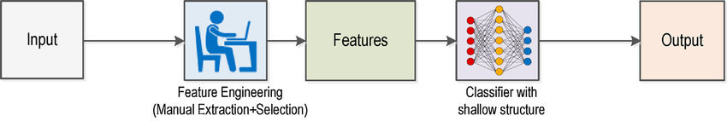
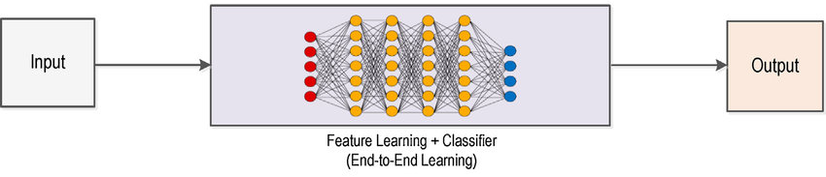
Traditional vs Deep Learning
Traditional Learning
Deep Learning
Source: https://www.researchgate.net/publication/322325843

Slide 32
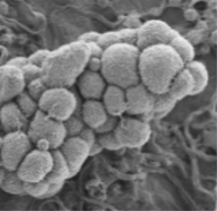
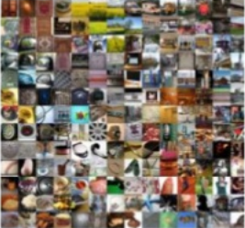
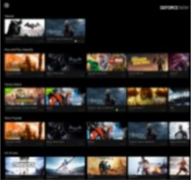
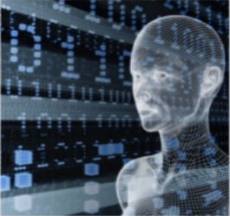
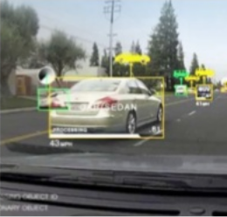
Deep Learning Applications
MEDICINE &
BIOLOGY
INTERNET &
CLOUD
MEDIA &
ENTERTAINMENT
Cancer Cell Detection
Diabetic Grading
Drug Discovery
Image Classification
Speech Recognition
Language Translation
Video Captioning
Video Search
Real Time Translation
SECURITY &
DEFENSE
AUTONOMOUS
MACHINES
Face Detection
Video Surveillance
Satellite Imagery
Pedestrian Detection
Lane Tracking
Recognize Traffic Sign
Source: https://www.slideshare.net/insideHPC/tesla-accelerated-computing-platform

Slide 33
Deep LEARNING With Python

Slide 34
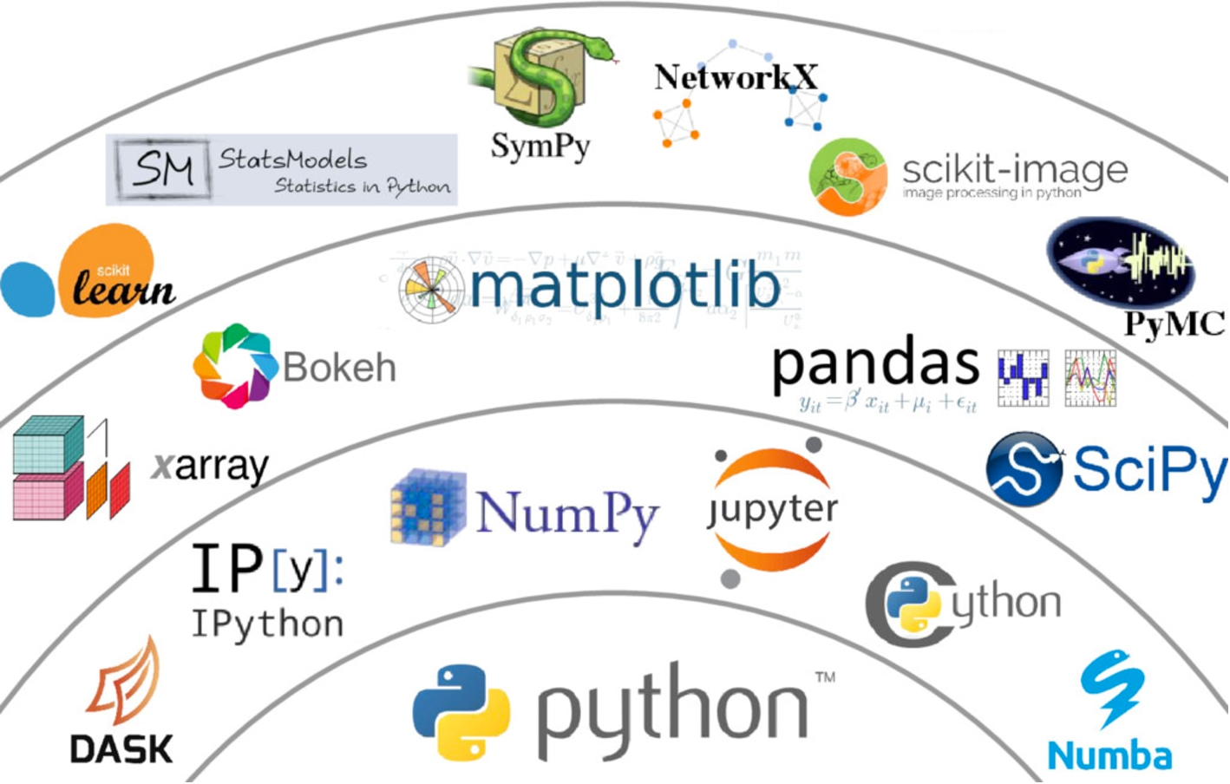
Set of Powerful Libraries
Source: https://www.datacamp.com/community/blog/python-scientific-computing-case

Slide 35
Machine Learning Libraries
numpy
Arrays: universal point of reference in the python ML world
pandas
Data manipulation made easy
scipy
Basis of scientific computing
scikit-learn
(Almost) all machine learning algorithms you will ever need
matplotlib
Plot all of the above
… and all of these are seamlessly connected!

Slide 36



Deep Learning with Python
Multiple options
All equivalent but all different
Hard to port solutions
Source: https://www.slideshare.net/kuanhoong/big-data-malaysia-a-primer-on-deep-learning

Slide 37

Deep Learning with Keras
One framework to rule them all
Easier to code and read
Can harness CPU and GPU
Source: https://www.slideshare.net/kuanhoong/big-data-malaysia-a-primer-on-deep-learning

Slide 38
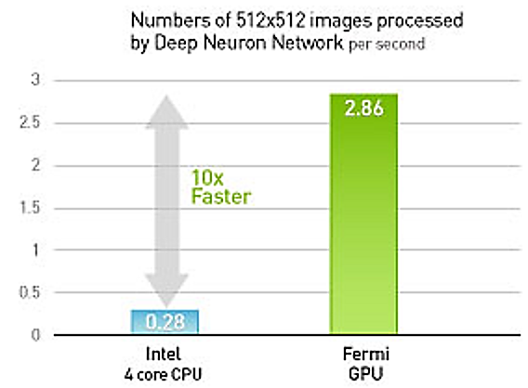
Keras Requirements
An up-to-date python distribution
The python numpy-scipy-scikit stack
A fast CPU or GPU
If possible,
use a GPU!
… although your CPU will do for simple applications!
Source: http://www.gpurendering.com/technology/learningMachinesGpuVsCpu.html

Slide 39
Neural Networks with Keras
model = Sequential()
model.add(Dense(units=64, activation='relu', input_dim=100))
model.add(Dense(units=10, activation='softmax'))
model.compile(loss='categorical_crossentropy',
optimizer='sgd', metrics=['accuracy'])
model.fit(x_train, y_train, epochs=5, batch_size=32)
metrics = model.evaluate(x_test, y_test, batch_size=128)
classes = model.predict(x_test, batch_size=128)
Create
Model
Configure
Learning
Train the model
Get metrics
Make predictions
Source: https://keras.io/

Slide 40
Time for hands-on!

