Slide 1
Deep Learning with Keras Neural Doodle and Neural Style Transfer
Themistoklis Diamantopoulos

Slide 2
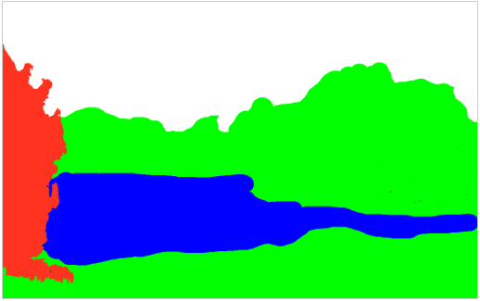
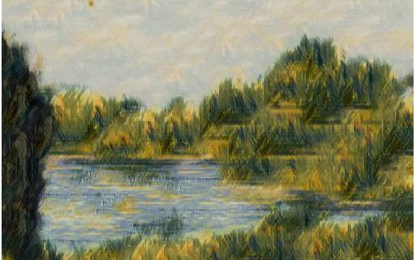
Neural Doodle
Generation problem
Keras code: https://github.com/keras-team/keras/blob/master/examples/neural_doodle.py
Online demo: https://likemo.net/

Slide 3
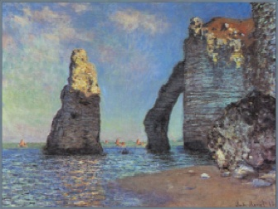
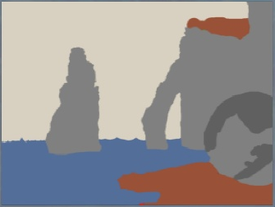
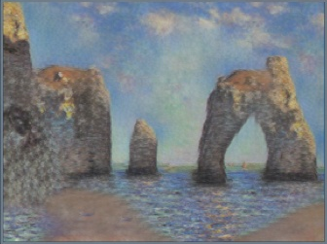
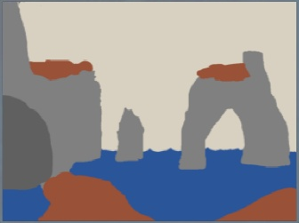
How Neural Doodle works
Image analogy
Source: https://www.slideshare.net/ckmarkohchang/neural-doodle

Slide 4
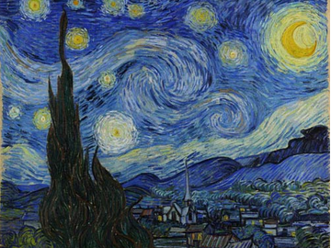
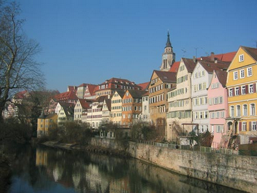
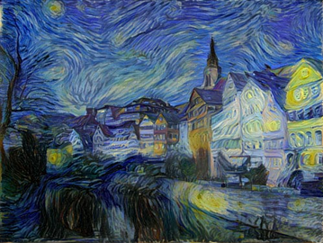
Neural Style Transfer
Keras code: https://github.com/keras-team/keras/blob/master/examples/neural_style_transfer.py
Online demo: https://demos.algorithmia.com/deep-style/
or https://deepart.io/

Slide 5
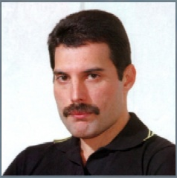
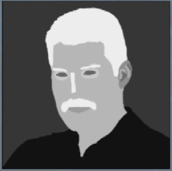
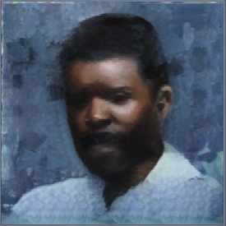
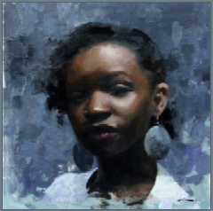
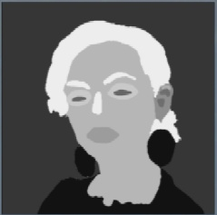
How Neural Style Transfer works
Content
Semantic maps
Artwork
Style
Source: https://www.slideshare.net/ckmarkohchang/neural-doodle

