Slide 1
Deep Learning with Keras
Themistoklis Diamantopoulos

Slide 2
What have we learned?
What is Deep Learning?
How can I train a Neural Network?
Which topology is best for what problem?
Problems outlined:
Image classification
Text classification
Text generation
Image style transfer
Game learning

Slide 3
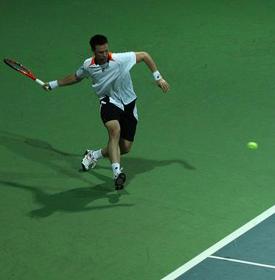
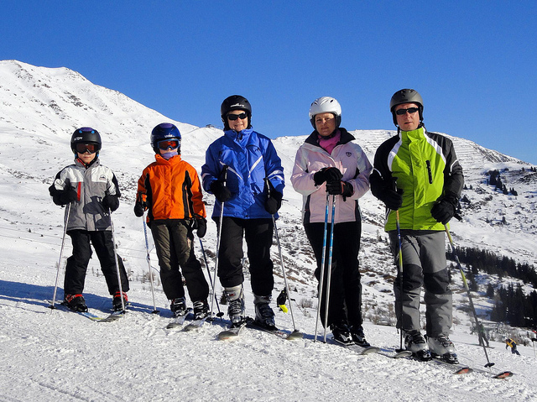
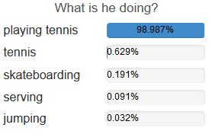
Any more applications?
Caption Generation
Visual Question Answering
…
See demo at https://cs.stanford.edu/people/karpathy/deepimagesent/generationdemo/
See demo at https://vqa.cloudcv.org/

Slide 4
Even more applications?
Restore colors in B&W photos and videos
Automatic translation
Self-driving cars
Predict earthquakes?
Create deep learning programs!?
…
Check:
- http://www.yaronhadad.com/deep-learning-most-amazing-applications/
- https://medium.com/@vratulmittal/top-15-deep-learning-applications-that-will-rule-the-world-in-2018-and-beyond-7c6130c43b01

Slide 5
So, what next?
Now you know!
Use your power for good

