Slide 1
Deep Learning with Keras Text Generation
Themistoklis Diamantopoulos

Slide 2
Text Generation Problem
Question Answering
bAbi tasks
Dataset from Facebook: https://research.fb.com/downloads/babi/
Supporting Facts
STORY
1 John moved to the bedroom. 2 Mary grabbed the football there. 3 Sandra journeyed to the bedroom. 4 Sandra went back to the hallway. 5 Mary moved to the garden. 6 Mary journeyed to the office. 7 Where is the football? office 2 6
QUESTION
Where is the football?
ANSWER
office 2 6
Source: http://smerity.com/articles/2015/keras_qa.html

Slide 3
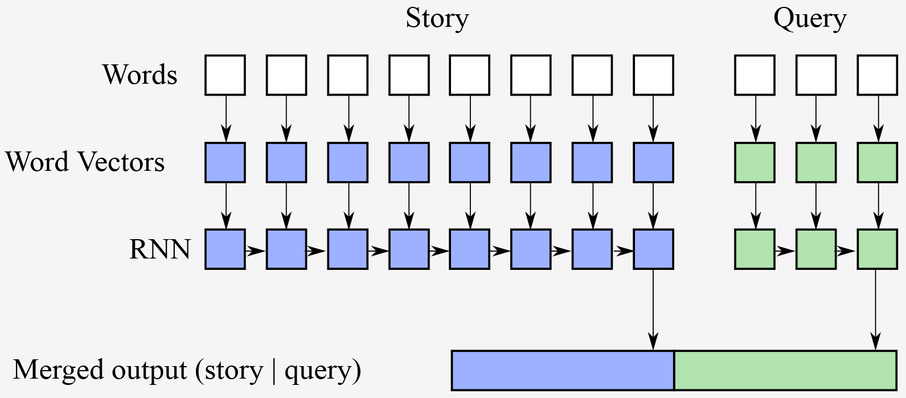
Feature Representation
Each word has an ID, so each story/query is a vector
Train two models, one for stories and one for queries
Source: http://smerity.com/articles/2015/keras_qa.html

Slide 4
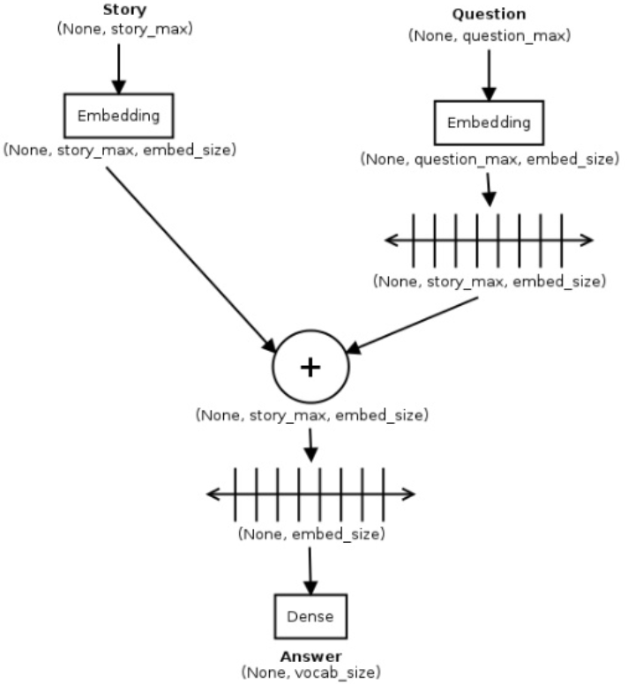
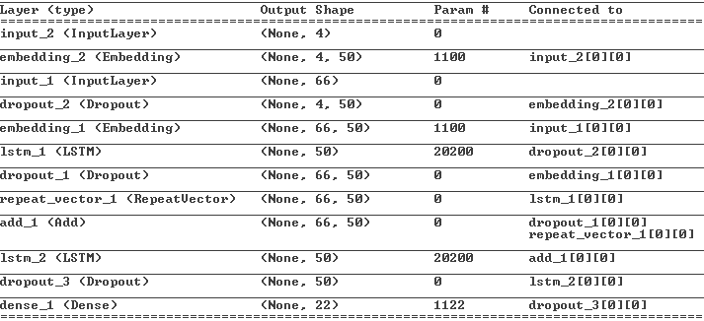
Solution using LSTM
2 Embedding layers
1 for stories
1 for questions
Merge into LSTM layer
Dense layer on output
Source: http://smerity.com/articles/2015/keras_qa.html

