Slide 1
Deep Learning with Keras Game Playing
Themistoklis Diamantopoulos

Slide 2

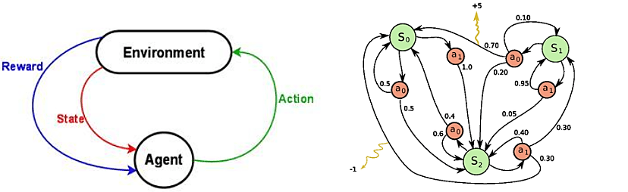
Reinforcement Learning
Game
agent situated in an environment with a certain state
agent performs actions and receives rewards
Markov Decision Process
Episode comprising states, actions, rewards
Source: https://ai.intel.com/demystifying-deep-reinforcement-learning/

Slide 3
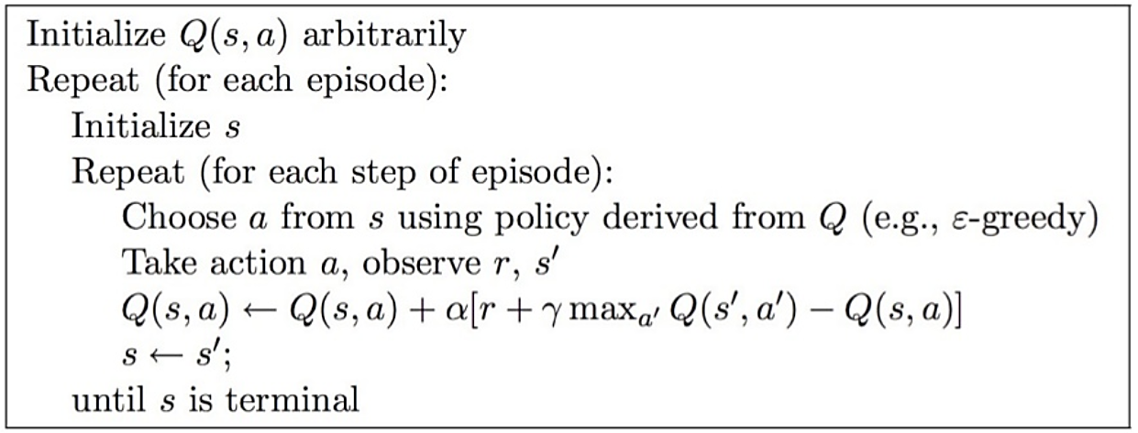
Q-learning
Update algorithm
where:
s: current state s΄: next state r: reward
a: current action a΄: next possible actions
γ: discount factor α: learning rate
Exploitation vs Exploration
Source: https://www.slideshare.net/cprakash2011/reinforcement-learning-40052403

Slide 4
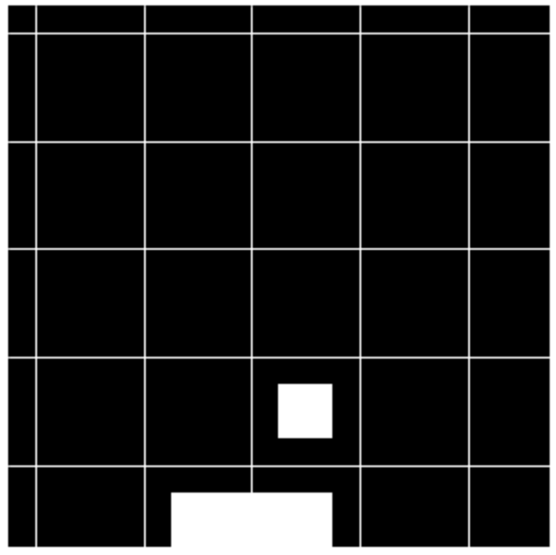
Example 1: Catch
Environment: grid
State: position of the ball
Actions: [left, stay, right]
Reward: catch the ball
1 if caught or -1 if not caught
NEURAL NETWORKS ALGORITHM (s, a, r, s΄)
1. For each a΄ (left, stay, right) predict Q(s΄, a΄) (using the neural network)
2. Choose highest max{Q(s΄, a΄)}
3. Calculate r + γ * max{Q(s’, a’)} (this is the target value)
4. Train the network using the target value (minimize distance between predicted Q(s, a) and target)
Source: https://medium.freecodecamp.org/deep-reinforcement-learning-where-to-start-291fb0058c01

Slide 5

Solution using MLP
3-layer fully connected network
Input vector equal to state (full grid)
Output layer: 3 nodes (actions)
0 | 0 | 0 | 0 | 0 | 0 | 0 | 0
0 | 0 | 0 | 0 | 0 | 0 | 0 | 0
0 | 0 | 0 | 0 | 0 | 0 | 0 | 0
0 | 0 | 0 | 0 | 0 | 0 | 0 | 0
0 | 0 | 0 | 0 | 0 | 0 | 0 | 0
0 | 0 | 0 | 0 | 1 | 0 | 0 | 0
0 | 0 | 0 | 0 | 0 | 0 | 0 | 0
0 | 0 | 1 | 1 | 1 | 0 | 0 | 0
Source: https://medium.freecodecamp.org/deep-reinforcement-learning-where-to-start-291fb0058c01

Slide 6
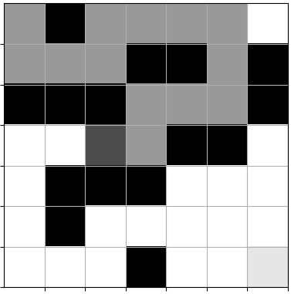




Example 2: Maze
Environment: grid, walls ( )
State: position of player ( )
Actions:
[left–0, up–1, right–2, down–3]
Rewards:
1 for catching the cheese ( )
-0.04 for each move to an open cell
-0.75 for trying to move into a wall ( )
-0.8 for trying to move outside the maze
-0.25 for moving to already visited cell ( )
Game ends if cheese is caught or if reward < –mazesize/2
Source: http://www.samyzaf.com/ML/rl/qmaze.html

Slide 7
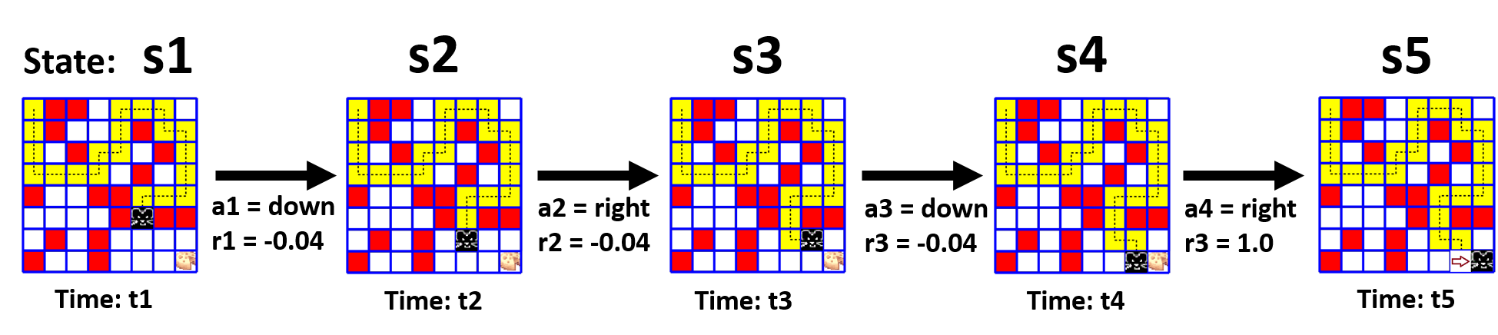
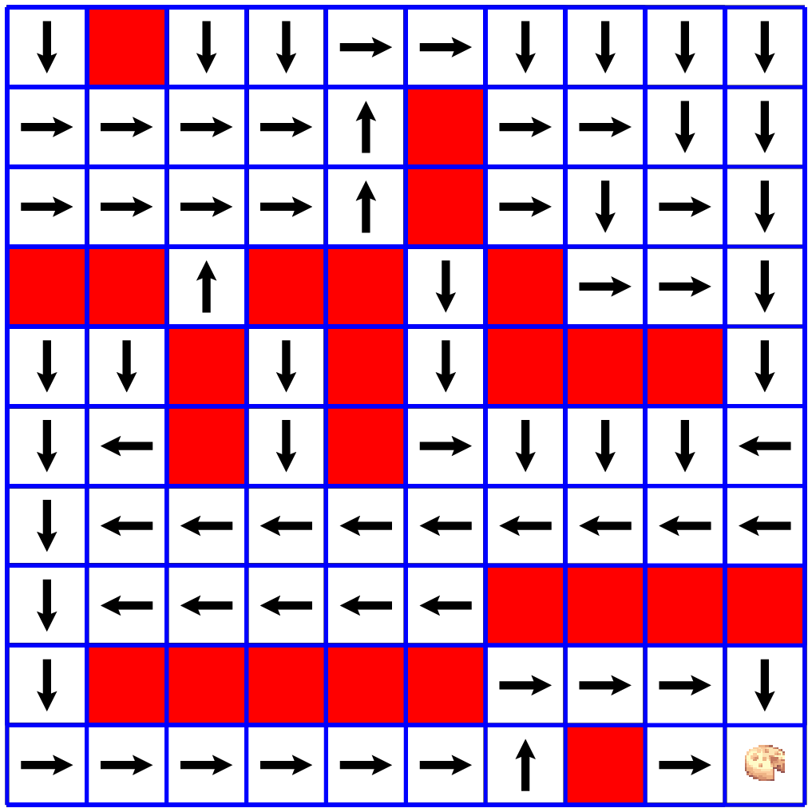
Problem Modeling
States, actions, and rewards
Try to find a policy
Policy
Source: http://www.samyzaf.com/ML/rl/qmaze.html

Slide 8
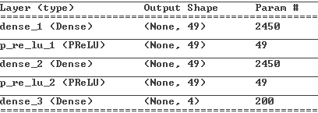
Solution using MLP
3-layer fully connected network
Input vector equal to state (full grid)
Output layer: 4 nodes (actions)
1 | 0 | 1 | 1 | 1 | 1 | 1
1 | 1 | 1 | 0 | 0 | 1 | 0
0 | 0 | 0 | 1 | 1 | 1 | 0
1 | 1 | 1 | 1 | 0 | 0 | 1
1 | 0 | 0 | 0 | 1 | 1 | 1
1 | 0 | 1 | 1 | 1 | 1 | 1
1 | 1 | 1 | 0 | 1 | 1 | 1
Source: http://www.samyzaf.com/ML/rl/qmaze.html

