Slide 1
Machine Learning with Python Support Vector Machines
Themistoklis Diamantopoulos

Slide 2
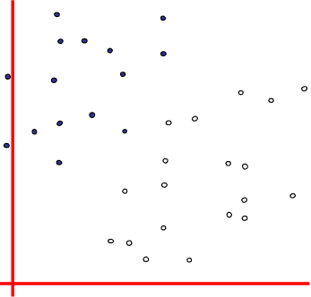
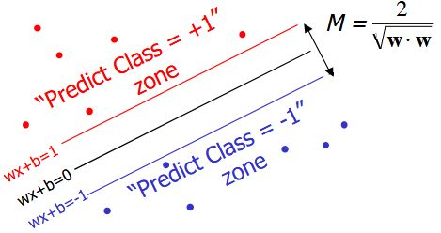
Maximum Margin
Find optimal w, b to maximize the margin
Minimize
Source: http://www.csd.uwo.ca/~dlizotte/teaching/slides/svm_1.pdf

Slide 3
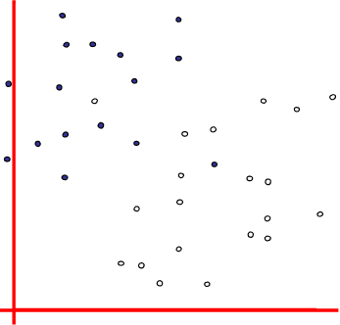
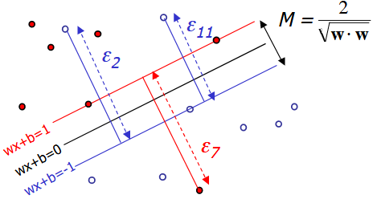
Maximum Margin with Noise
Allow misclassification errors
Minimize
controls tolerance of misclassification
Source: http://www.csd.uwo.ca/~dlizotte/teaching/slides/svm_1.pdf

Slide 4
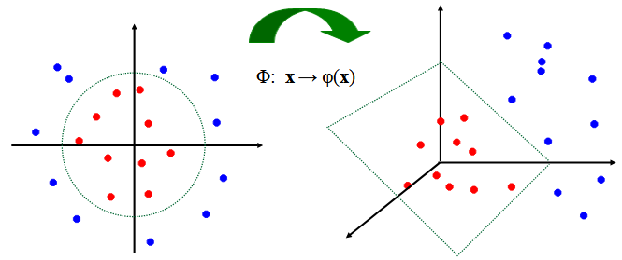
Transformation with Kernels
Non-linearly separable data → linearly separable data
Kernel trick:
Linear, Polynomial, tanh
Source: https://www.slideshare.net/pbpimpale/support-vector-machine-24419322

Slide 5
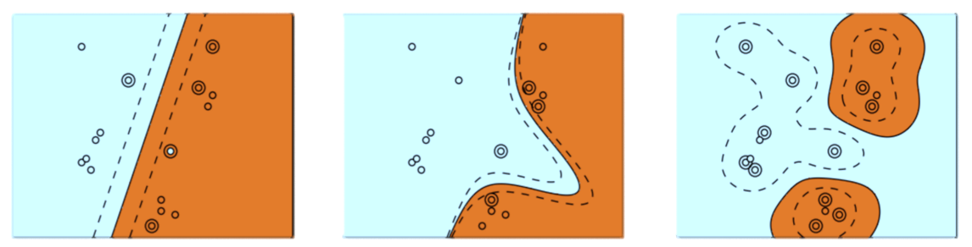
Different types of Kernels
Linear Kernel
Polynomial Kernel
RBF Kernel
1/2σ² = γ
controls the width of the RBF kernel
Source: http://beta.cambridgespark.com/courses/jpm/05-module.html

Slide 6
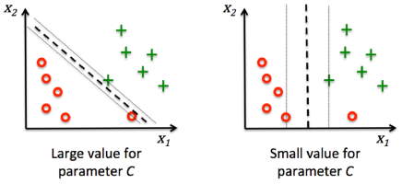
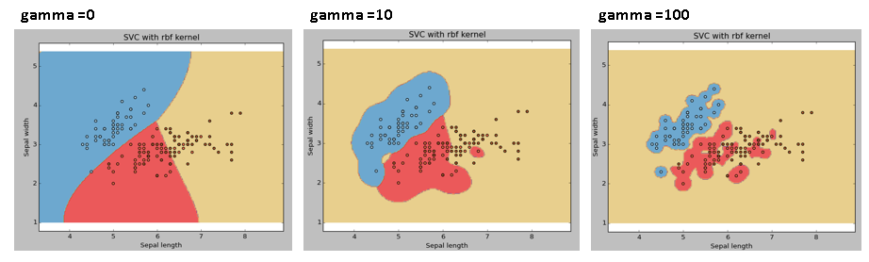
Overfitting
Parameter C
Large C → More error penalization
Small C → Allow more errors
Parameter gamma
Large gamma → Exact data fit
Small gamma → Generalization
Sources: https://www.analyticsvidhya.com/blog/2017/09/understaing-support-vector-machine-example-code/
https://www.bogotobogo.com/python/scikit-learn/scikit_machine_learning_Support_Vector_Machines_SVM.php

Slide 7
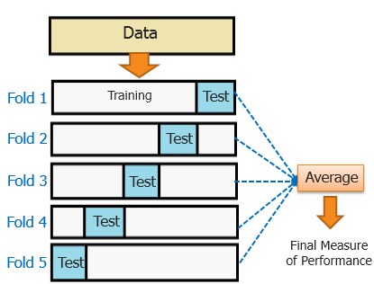
Validation
Split data in two parts
Use 1 part for training and 1 part for testing
Compare the errors
Cross-validation
Divide dataset in k-folds
Use k-1 parts for training and 1 for testing
Repeat for all folds
Determine a metric value
Training
Validation
Source: https://blog.contactsunny.com/data-science/different-types-of-validations-in-machine-learning-cross-validation

