Slide 1
Machine Learning with Python Feature Extraction
Themistoklis Diamantopoulos

Slide 2
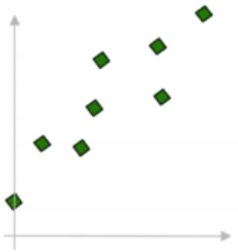
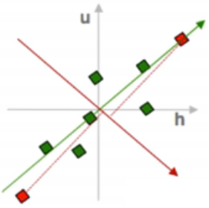
Principal Component Analysis
Step 1: Scale the data
Source: https://www.youtube.com/watch?v=QP43Iy-QQWY

Slide 3
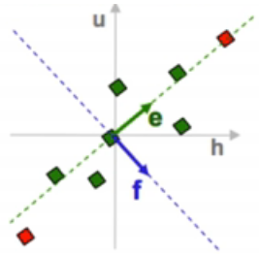

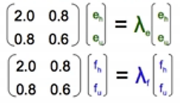
Principal Component Analysis
Step 2: Find dimensions that maximize variance
Compute covariance matrix
Get eigenvalues and eigenvectors
Source: https://www.youtube.com/watch?v=QP43Iy-QQWY

Slide 4
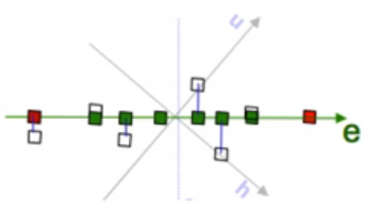
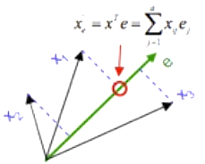
Principal Component Analysis
Step 3: Project data points to PCs
Keep less dimensions
Source: https://www.youtube.com/watch?v=QP43Iy-QQWY

