Slide 1
Machine Learning with Python k-Nearest Neighbors
Themistoklis Diamantopoulos

Slide 2
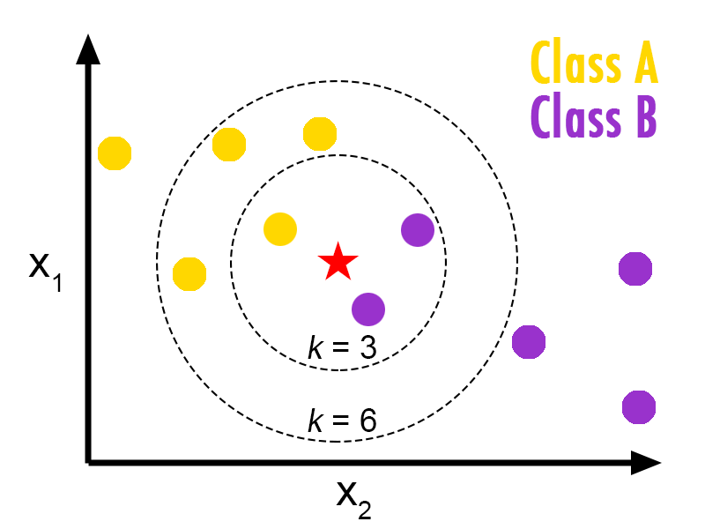



Classification using KNN
Find the k nearest neighbors of the new data point
Determine class the new point using majority vote
Distance functions used
Euclidean:
Manhattan:
Minkowski:
Source: https://helloacm.com/a-short-introduction-to-k-nearest-neighbors-algorithm/

Slide 3
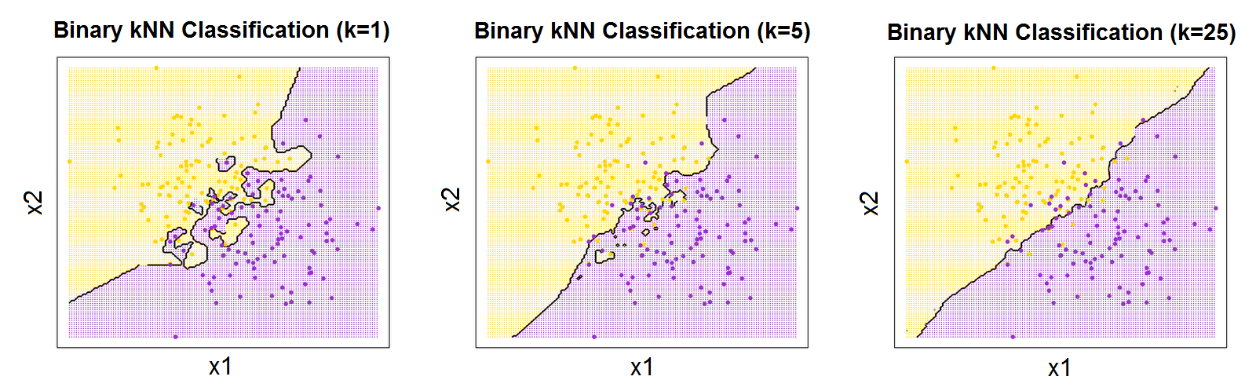
Impact of k
Small k → prone to overfitting due to locality
Larger k → smoother boundary
Very large k → looking for samples too far away
Source: http://bdewilde.github.io/blog/blogger/2012/10/26/classification-of-hand-written-digits-3/

Slide 4
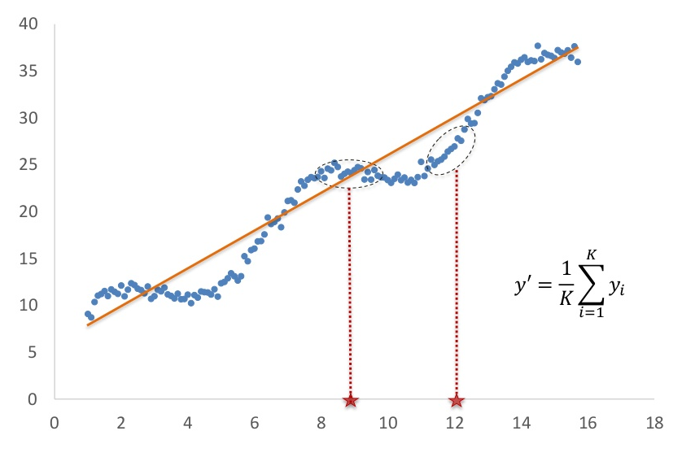
Regression using KNN
New value determined as mean of k nearest neighbors
Source: https://www.slideshare.net/amirudind/k-nearest-neighbor-presentation

Slide 5
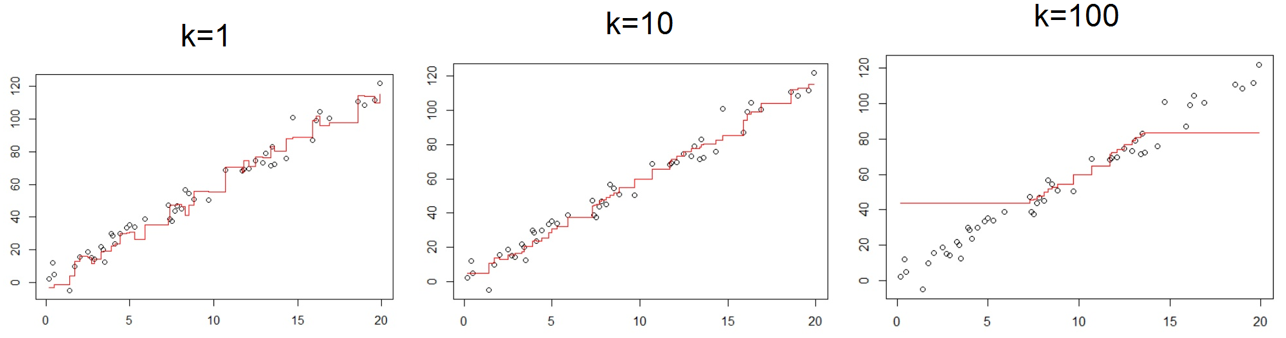
Impact of k in regression
Small k → prone to overfitting due to locality
Larger k → smoother model
Very large k → prone to data averaging
Source: http://bdewilde.github.io/blog/blogger/2012/10/26/classification-of-hand-written-digits-3/

