Slide 1
Machine Learning with Python Linear Regression
Themistoklis Diamantopoulos

Slide 2
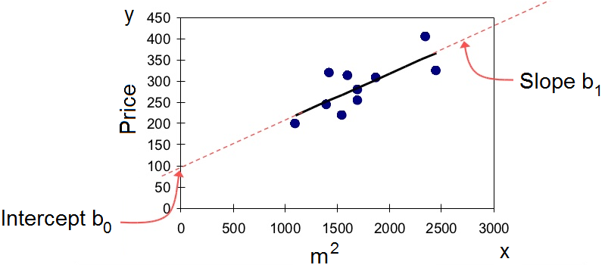
The Problem of Regression
Find model that best fits the data
Minimize squared error
Source: https://www.slideshare.net/oxygen024/regression-analysis-8672920
https://web.williams.edu/Mathematics/sjmiller/public_html/BrownClasses/54/handouts/MethodLeastSquares.pdf

Slide 3
Example Least Squares Fitting
Find model that best fits the data
Minimize squared error
Derive error w.r.t. b and solve
Source: https://www.varsitytutors.com/hotmath/hotmath_help/topics/line-of-best-fit

Slide 4
Regression Evaluation
Mean Absolute Error
Mean Squared Error and Root Mean Squared Error
Coefficient of Determination
Source: https://www.ritchieng.com/machine-learning-evaluate-linear-regression-model/

