Slide 1
Machine Learning with Python Polynomial Regression
Themistoklis Diamantopoulos

Slide 2
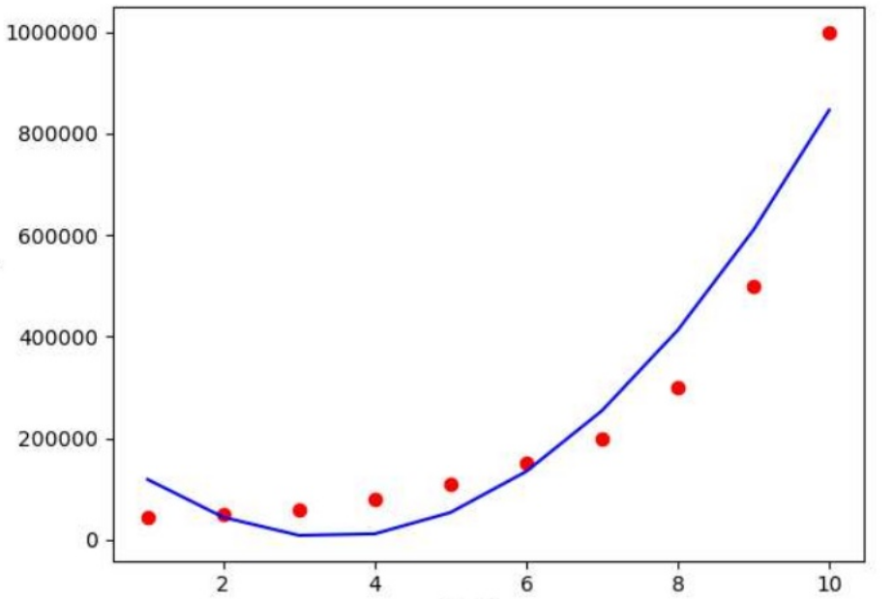
Polynomial Regression
Apply when data is not linear
Linear Regression with Polynomial Features
Source: https://www.slideshare.net/akhileshjoshi123/polynomial-linear-regression

Slide 3
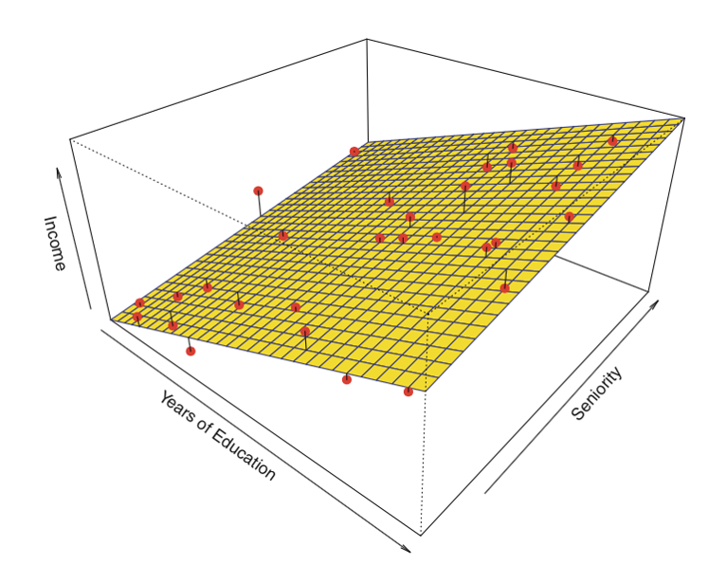
Regression in multiple dimensions
Linear Regression (1d)
Linear Regression (2d)
Source: sphweb.bumc.bu.edu/otlt/MPH-Modules/BS/R/R5_Correlation-Regression/R5_Correlation-Regression4.html

Slide 4
Polynomial Features
Linear Regression (1d)
Linear Regression (2d)
Transform to polynomial of degree 2
Source: https://www.ics.uci.edu/~jutts/201-F13/Lecture13.pdf

Slide 5
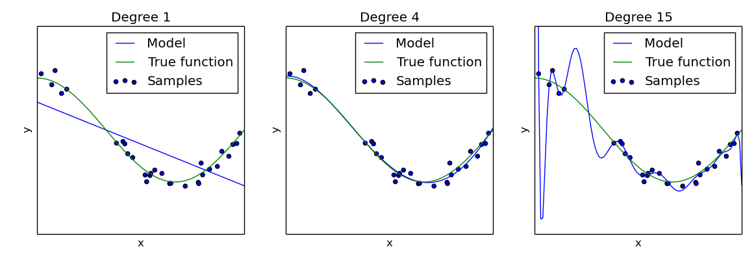
Underfitting and Overfitting
Relevant to polynomial degree
Check by visualizing data or using elbow method
Source: http://scikit-learn.org/0.15/auto_examples/plot_underfitting_overfitting.html

