Slide 1
Machine Learning with Python Naïve Bayes
Themistoklis Diamantopoulos

Slide 2
Bayes Theorem
Equation created by Thomas Bayes in 1763:
where and are events and
: likelihood of event A occurring given that B is true
: likelihood of event B occurring given that A is true

Slide 3
Categorical Problem
Decide whether the traffic is going to be high based on the weather and the day
Weather | Day | HighTraffic
Hot | Work | No
Cold | Vacation | No
Hot | Vacation | Yes
Hot | Work | Yes
Hot | Work | Yes
Cold | Vacation | No
Cold | Vacation | Yes

Slide 4

Naïve Bayes
Independent features
Bayes Theorem
When weather is Hot and day is Vacation, traffic is High (prob: 0.65/(0.65+0.51) = 0.56)
Weather | Day | HighTraffic
Hot | Work | No
Cold | Vacation | No
Hot | Vacation | Yes
Hot | Work | Yes
Hot | Work | Yes
Cold | Vacation | No
Cold | Vacation | Yes

Slide 5
Classification Evaluation
Confusion Matrix
Evaluation Metrics
Accuracy = (TP + TN) / (P + N)
Precision = TP / (TP + FP)
Recall = TP / (TP + FN)
Actual
Class
Predicted
Class
 | Positive | Negative
Positive | TP | FP
Negative | FN | TN
 | P = TP + FN | N = FP + TN

Slide 6
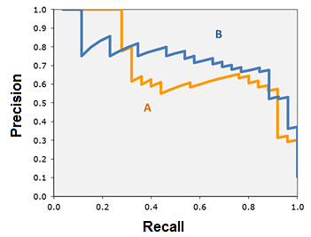
Precision and Recall
Tradeoff between Precision & Recall
Source: https://acutecaretesting.org/en/articles/precision-recall-curves-what-are-they-and-how-are-they-used

Slide 7
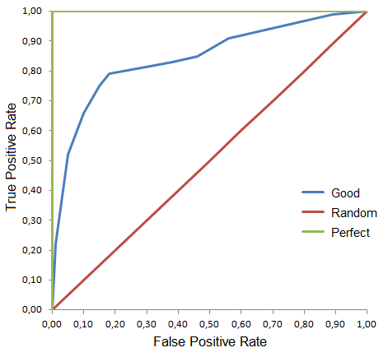
ROC Curve
True Positive Rate (also known as sensitivity or recall)
False Positive Rate (also known as specificity)
AUC (Area Under the Curve)
Source: https://en.wikipedia.org/wiki/Receiver_operating_characteristic

