Slide 1
Machine Learning with Python Hierarchical Clustering
Themistoklis Diamantopoulos

Slide 2
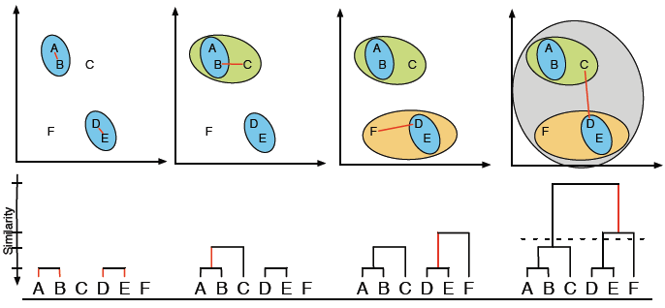
Agglomerative Hierarchical Clustering
Connect points according to their distance
Select cut-off point to split to clusters
Source: https://www.researchgate.net/figure/Example-of-hierarchical-clustering-clusters-are-consecutively-merged-with-the-most_fig3_273456906

Slide 3
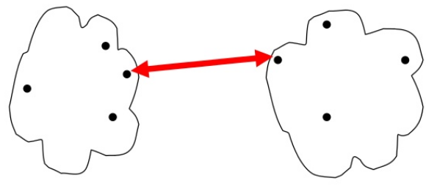
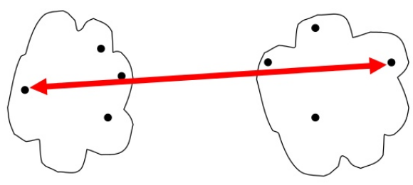
Single vs Complete Linkage
Single-link
Smallest distance between an element in one cluster and an element in the other
Produces large clusters
Sensitive to outliers
Complete-link
Largest distance between an element in one cluster and an element in the other
Produces balanced clusters
Breaks large clusters
Source: https://www.slideshare.net/pierluca.lanzi/dmtm-lecture-12-hierarchical-clustering

Slide 4
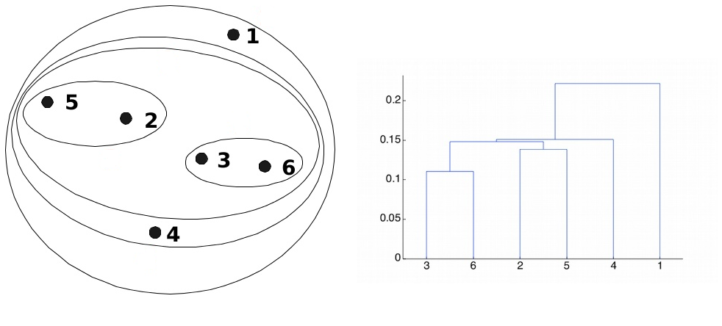
Single-link
Example
Source: https://www.slideshare.net/ChaToX/hierarchical-clustering-56364612

Slide 5
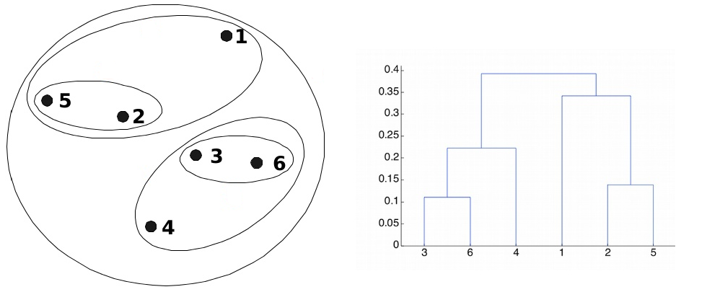
Complete-link
Example
Source: https://www.slideshare.net/ChaToX/hierarchical-clustering-56364612

