Slide 1
Machine Learning with Python k-Means Clustering
Themistoklis Diamantopoulos

Slide 2
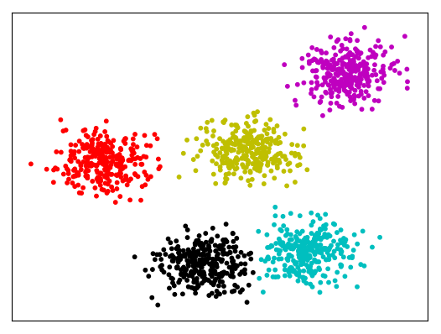

Clustering
Split data into clusters according to features
K-Means
Given the number of clusters k
Split the data into clusters
Each cluster has a centroid
Minimize sum-of-squared-errors:
where x are datapoints and i=1…k refer to clusters S_{i} with centroids μ_{i}
Euclidean distance:
Source: https://www.imperva.com/blog/2017/07/clustering-and-dimensionality-reduction-understanding-the-magic-behind-machine-learning/

Slide 3
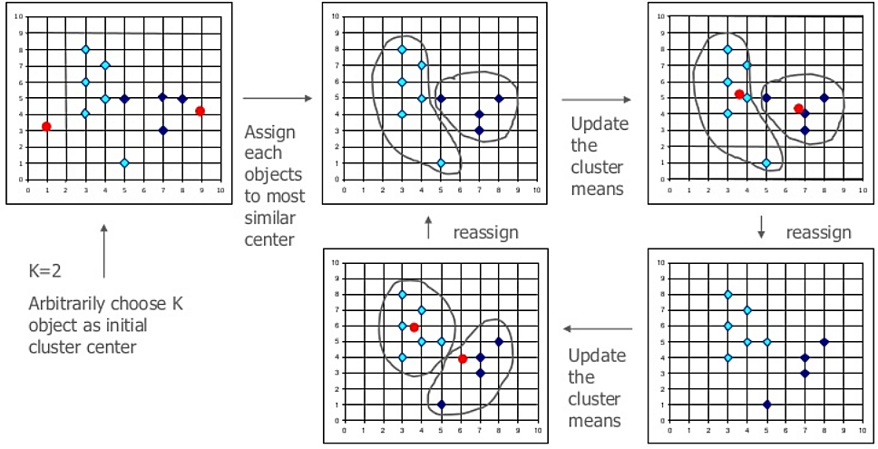
K-Means Clustering
Source: http://bdewilde.github.io/blog/blogger/2012/10/26/classification-of-hand-written-digits-3/

Slide 4


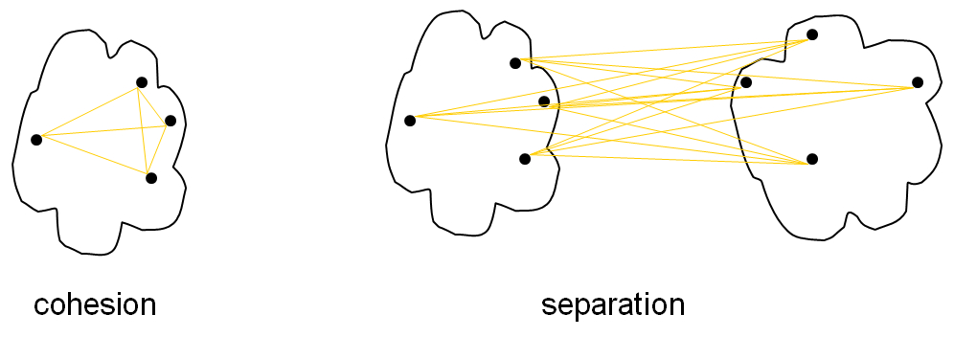
Evaluation
Cohesion (Within Cluster Sum of Squares)
Separation (Between Cluster Sum of Squares)
Source: https://codeahoy.com/2017/02/19/cluster-analysis-using-k-means-explained/

Slide 5
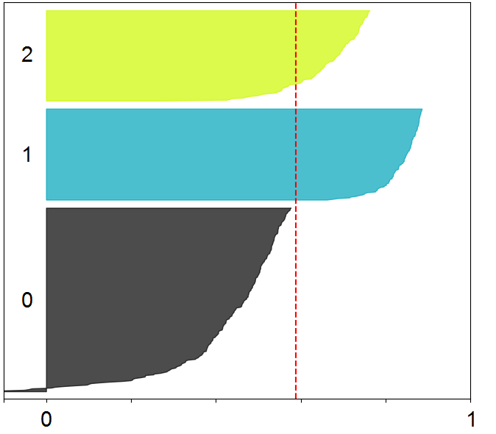

Silhouette
Silhouette value of x:
where
a = average distance of x to the points in its cluster
b = min(average distance of x to points in another cluster)
Value:
Positive/close to 1: possibly assigned to proper cluster
Negative: possibly assigned to wrong cluster
Close to 0: on border of 2 clusters
Source: http://scikit-learn.org/stable/auto_examples/cluster/plot_kmeans_silhouette_analysis.html

