Slide 1
Machine Learning with Python
Themistoklis Diamantopoulos

Slide 2
Contents
Part 1:
Introduction to Machine Learning
Classification with Decision Trees
Classification with Naïve Bayes
Classification with SVMs
Part 2
Classification and Regression with kNN
Linear and Polynomial Regression
Feature Selection and Feature Extraction
Centroid-based and Connectivity-based Clustering

Slide 3
Introduction TO Machine LEARNING

Slide 4
What is Machine Learning?
Subfield of Artificial Intelligence
Term coined in 1959 by Arthur Samuel
Progressively improve performance on a specific task with data, without being explicitly programmed

Slide 5
Types of Machine Learning tasks
Supervised Learning
Learn output based on input data
Unsupervised Learning
Find structure in given data
Reinforcement Learning
Learn from the environment

Slide 6
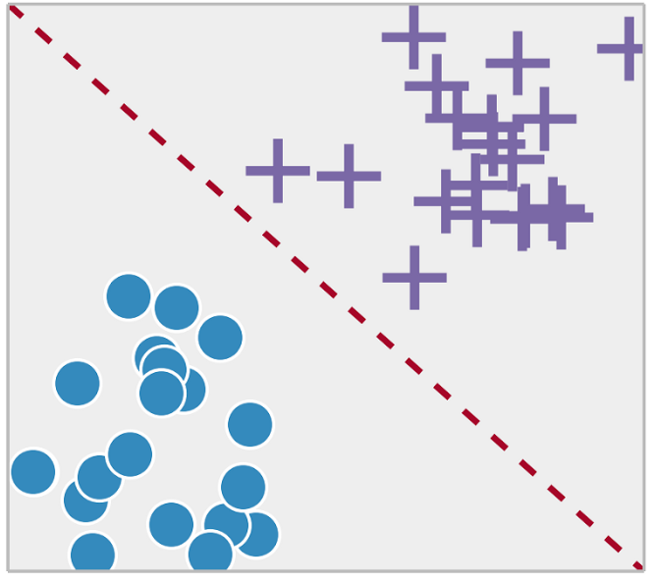
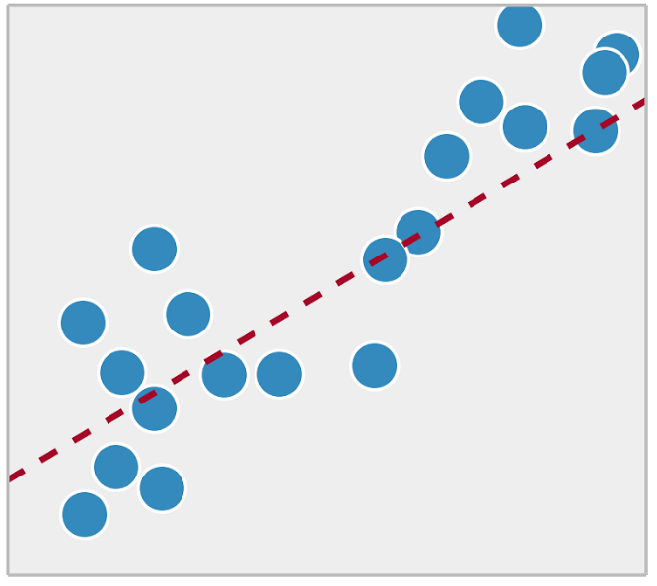
Supervised Learning tasks
Classification
Regression
Source: https://towardsdatascience.com/supervised-vs-unsupervised-learning-14f68e32ea8d

Slide 7
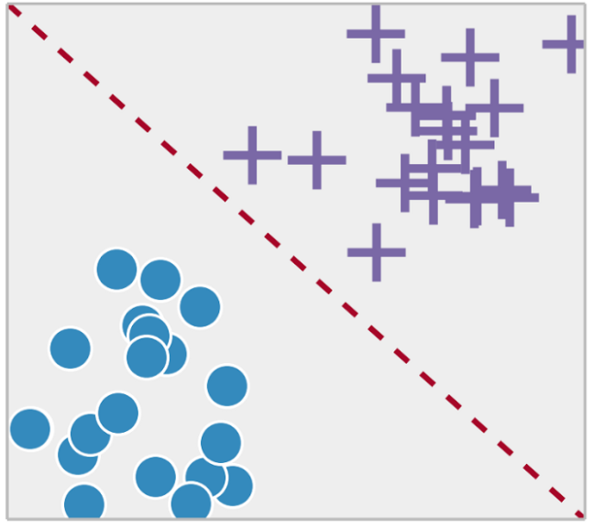
Classification
Classify data to 1, 2 or more classes
Confusion Matrix
Evaluation Metrics
Accuracy = (TP + TN) / (P + N)
Precision = TP / (TP + FP)
Recall = TP / (TP + FN)
Actual
Class
Predicted
Class
 | Positive | Negative
Positive | TP | FP
Negative | FN | TN
 | P = TP + FN | N = FP + TN

Slide 8

Regression
Build a model that fits the data
Actual (y_{i}) and predicted values (ŷ_{i})
Mean Absolute Error
Mean Squared Error
Coefficient of Determination
where and

Slide 9
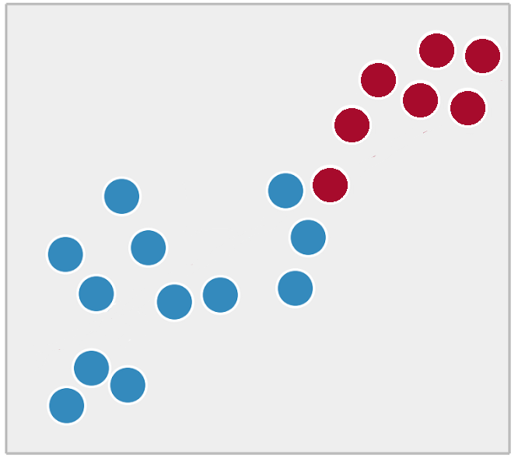
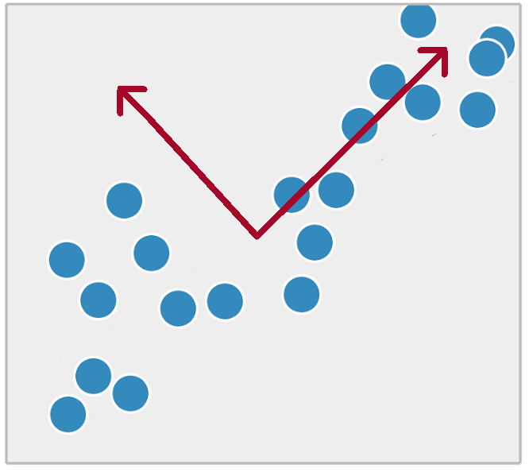
Unsupervised Learning tasks
Clustering
Dimensionality Reduction

Slide 10




Clustering
Cluster data according to their features
Evaluation Metrics
Cohesion (Within Cluster Sum of Squares)
Separation (Between Cluster Sum of Squares)
Silhouette
where a = average distance of i to the points in its cluster
b = min(average distance of i to points in another cluster)
Source: https://www-users.cs.umn.edu/~kumar001/dmbook/slides/chap7_basic_cluster_analysis.pdf

Slide 11

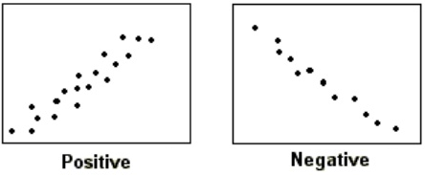
Dimensionality Reduction
Transform the data to extract useful
information
Measure correlation
Maximize variance
Evaluation Metrics
Percentage of Variance
Cumulative Percentage of Variance
Source: https://www.slideshare.net/rickwendell/principal-component-analysys

Slide 12
Machine Learning Methodology

Slide 13
Machine Learning Steps
Data cleaning and preprocessing equally important with model selection and training
Data Gathering
Data Cleaning
Data Preprocessing
Prediction
Evaluation and Tuning
Model Training

Slide 14
Data Splitting
Use training data to train the model
Some data can be used to validate the model → validation set
Use folds of training data for validation → Cross-validation
Evaluate the model on test data
Test set must not overlap with training data
Training
Test
Training
Validation
Test

Slide 15
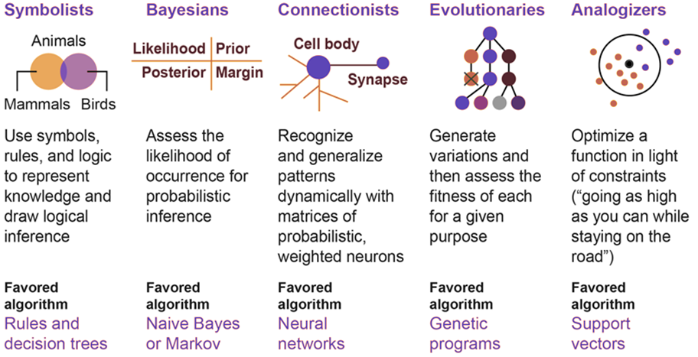
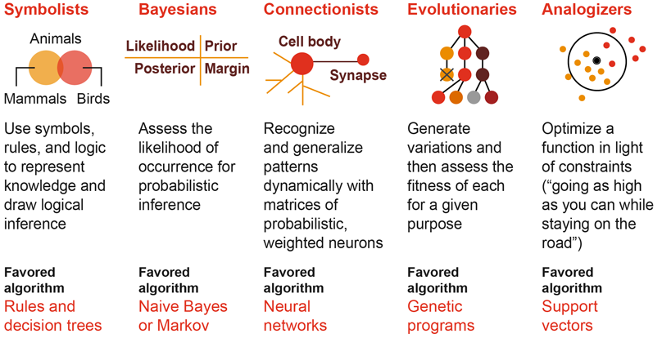
Tribes of Machine Learning
Source: http://www.franksworld.com/2018/09/05/evolution-of-machine-learning-infographic/

Slide 16
A brief history course
1960s: golden age of AI
Predictive Statistical Algorithms
Linear Regression
1805
Support Vector Machines
1963
Bayesian Networks
1985
K-Means
1957
Adaboost
2003
KNN
1951
Logistic Regression
1958
Decision Trees
1963
Random Forest
1995
Source: https://governmenttechnologyinsider.com/how-machine-learning-can-save-us-from-cybercriminals/

Slide 17
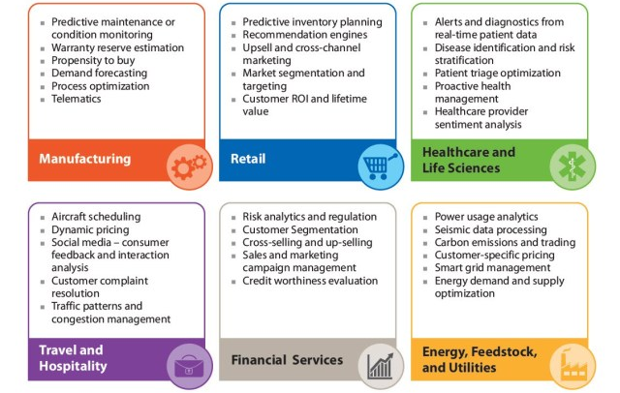
Machine Learning Applications
Source: https://whatsthebigdata.com/2016/07/22/machine-learning-applications-by-industry/

Slide 18
Machine LEARNING With Python

Slide 19
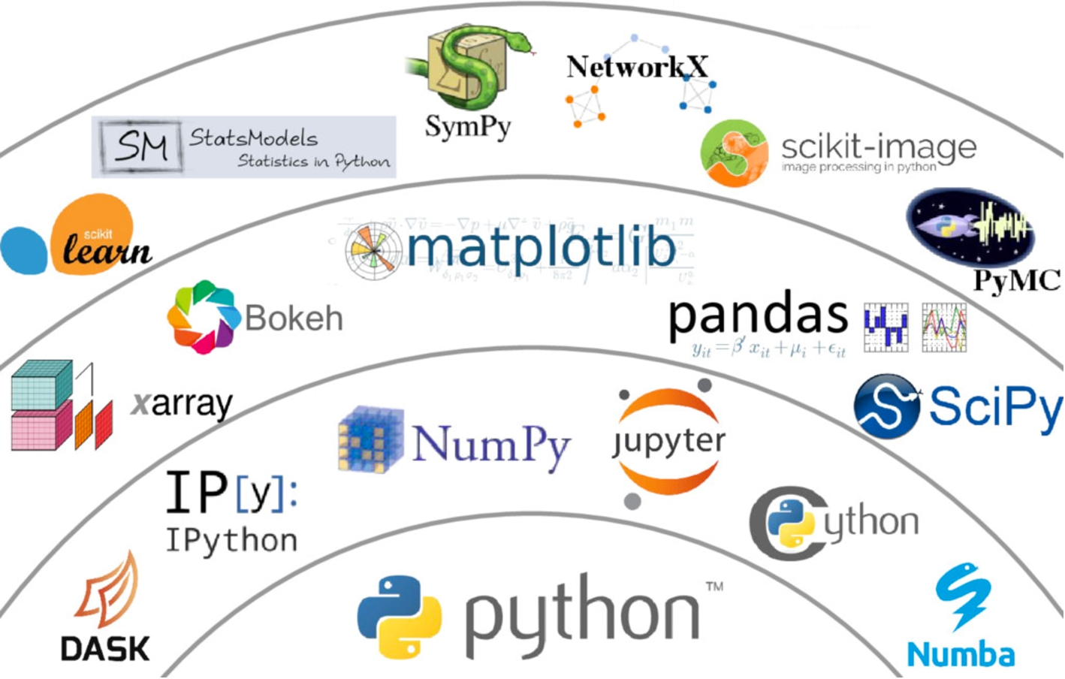
Set of Powerful Libraries
Source: https://www.datacamp.com/community/blog/python-scientific-computing-case

Slide 20
Machine Learning Libraries
numpy
Arrays: universal point of reference in the python ML world
pandas
Data manipulation made easy
scipy
Basis of scientific computing
scikit-learn
(Almost) all machine learning algorithms you will ever need
matplotlib
Plot all of the above
… and all of these are seamlessly connected!

Slide 21

The Scikit-learn Library
Almost any model you will ever need
Source: http://scikit-learn.org/stable/tutorial/machine_learning_map/index.html

Slide 22
Scikit-learn Examples
Very easy to use
Supports multiple data transformations
And multiple evaluation metrics
from sklearn.svm import SVC
model = SVC(gamma=0.1)
model.fit(x_train, y_train)
y_pred = model.predict(x_test)
Create, Train, and Run Model
from sklearn import metrics
print(metrics.classification_report(y_test, y_pred))
print(metrics.confusion_matrix(y_test, y_pred)) print(metrics.accuracy_score(y_test, y_pred))
Classification Evaluation Metrics
Source: https://www.slideshare.net/BenjaminBengfort/introduction-to-machine-learning-with-scikitlearn

Slide 23
Time for hands-on!

