Slide 1
Machine Learning with Python Decision Trees
Themistoklis Diamantopoulos

Slide 2
Categorical Classification
Decide whether to play tennis based on outlook, temperature, and humidity
Outlook | Temperature | Humidity | Play
Sunny | Hot | High | No
Sunny | Hot | Low | No
Rainy | Hot | Low | Yes
Rainy | Cool | High | Yes
Rainy | Cool | Low | Yes
Rainy | Hot | Low | No
Rainy | Cool | Low | Yes
Sunny | Hot | High | No
Sunny | Cool | Low | Yes
Rainy | Hot | Low | Yes
Sunny | Cool | Low | Yes
Rainy | Hot | High | Yes
Rainy | Cool | Low | Yes
Sunny | Cool | High | No

Slide 3
Decision Tree Learning
Decide where to split
Outlook | Temperature | Humidity | Play
Sunny | Hot | High | No
Sunny | Hot | Low | No
Rainy | Hot | Low | Yes
Rainy | Cool | High | Yes
Rainy | Cool | Low | Yes
Rainy | Hot | Low | No
Rainy | Cool | Low | Yes
Sunny | Hot | High | No
Sunny | Cool | Low | Yes
Rainy | Hot | Low | Yes
Sunny | Cool | Low | Yes
Rainy | Hot | High | Yes
Rainy | Cool | Low | Yes
Sunny | Cool | High | No
Y: 9
N: 5
TRUE
Outlook = Sunny
FALSE
Y: 2
N: 4
Y: 7
N: 1
Y: 9
N: 5
TRUE
Temperature = Hot
FALSE
Y: 3
N: 4
Y: 6
N: 1
Y: 9
N: 5
TRUE
Humidity = High
FALSE
Y: 2
N: 3
Y: 7
N: 2

Slide 4




Splitting Criteria
Decide where to split
Y: 9
N: 5
GINI Index
Information Gain
TRUE
Outlook = Sunny
FALSE
Y: 2
N: 4
Y: 7
N: 1
Y: 9
N: 5
Example using GINI Index
TRUE
Temperature = Hot
FALSE
GINI(Sunny) = 1 – (4/6)² – (2/6)² = 0.444
GINI(Rainy) = 1 – (1/8)² – (7/8)² = 0.219
GINI_{Outlook} = 0.315
…
GINI_{Temperature} = 0.367
…
GINI_{Humidity} = 0.394
Y: 3
N: 4
Y: 6
N: 1
BEST SPLIT
Y: 9
N: 5
TRUE
Humidity = High
FALSE
Y: 2
N: 3
Y: 7
N: 2

Slide 5
Feature Representation
Required for applying algorithms in scikit-learn
Outlook | Temperature | Humidity | Play
0 | 0 | 0 | 0
0 | 0 | 1 | 0
1 | 0 | 1 | 1
1 | 1 | 0 | 1
1 | 1 | 1 | 1
1 | 0 | 1 | 0
1 | 1 | 1 | 1
0 | 0 | 0 | 0
0 | 1 | 1 | 1
1 | 0 | 1 | 1
0 | 1 | 1 | 1
1 | 0 | 0 | 1
1 | 1 | 1 | 1
0 | 1 | 0 | 0

Slide 6
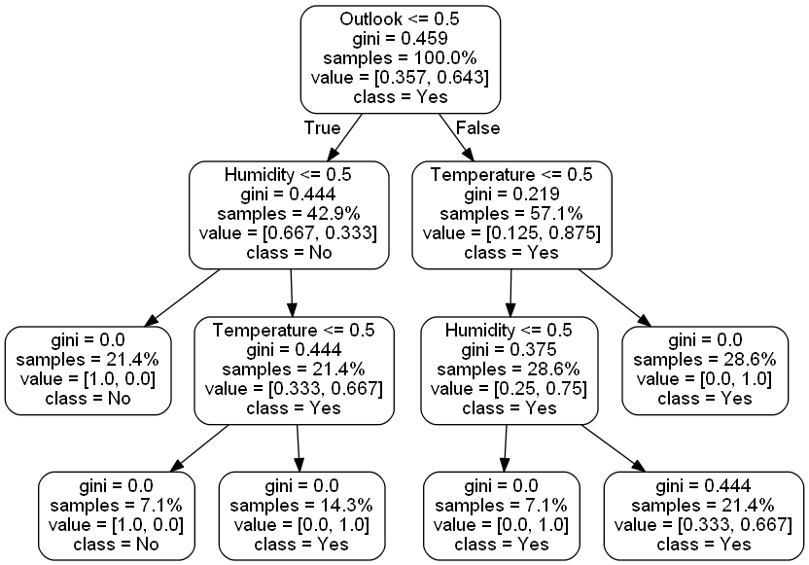
Decision Tree Building

