Slide 1
Machine Learning with Python Feature Selection
Themistoklis Diamantopoulos

Slide 2
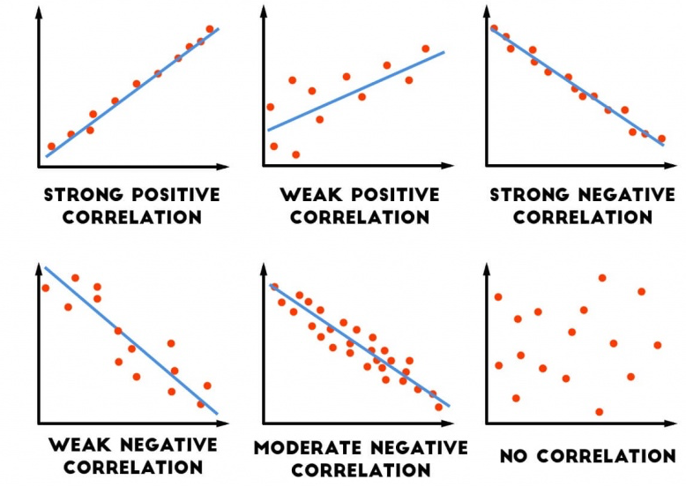
Correlation
Similar information
Source: http://danshiebler.com/2017-06-25-metrics/

Slide 3
Correlation Statistics
Variables X, Y
Variance
Covariance
Correlation
Values from [-1, +1]
+: Positive correlation
-: Negative correlation
0: No correlation
Source: https://en.wikipedia.org/wiki/Covariance

Slide 4

Mutual Information
Variables X, Y
Measures the dependence between random variables
Higher dependence → Higher mutual information
If the variables are independent then mutual information is 0
Source: https://www.slideshare.net/guo_dong/feature-selection
https://nlp.stanford.edu/IR-book/html/htmledition/mutual-information-1.html

Slide 5
Chi-Squared Statistic
 | Play Chess | Don’t Play Chess | Sum
Like Science Fiction | 250 90 | 200 360 | 450
Don’t Like Science Fiction | 50 210 | 1000 840 | 1050
Sum | 300 | 1200 | 1500
Example:
Higher dependence → Higher chi-squared
O_{i}: actual count
E_{i}: expected count
Source: https://chrisalbon.com/machine_learning/feature_selection/chi-squared_for_feature_selection/
http://www.learn4master.com/machine-learning/chi-square-test-for-feature-selection
https://www.slideshare.net/GajanandSharma1/data-preprocessing-46881206

