Slide 1
Machine Learning with Python
Themistoklis Diamantopoulos

Slide 2
What have we learned?
What is Machine Learning?
What are the main types of algorithms?
How can I train a model?
Problems outlined:
Classification
Regression
Feature Selection
Feature Extraction
Clustering

Slide 3
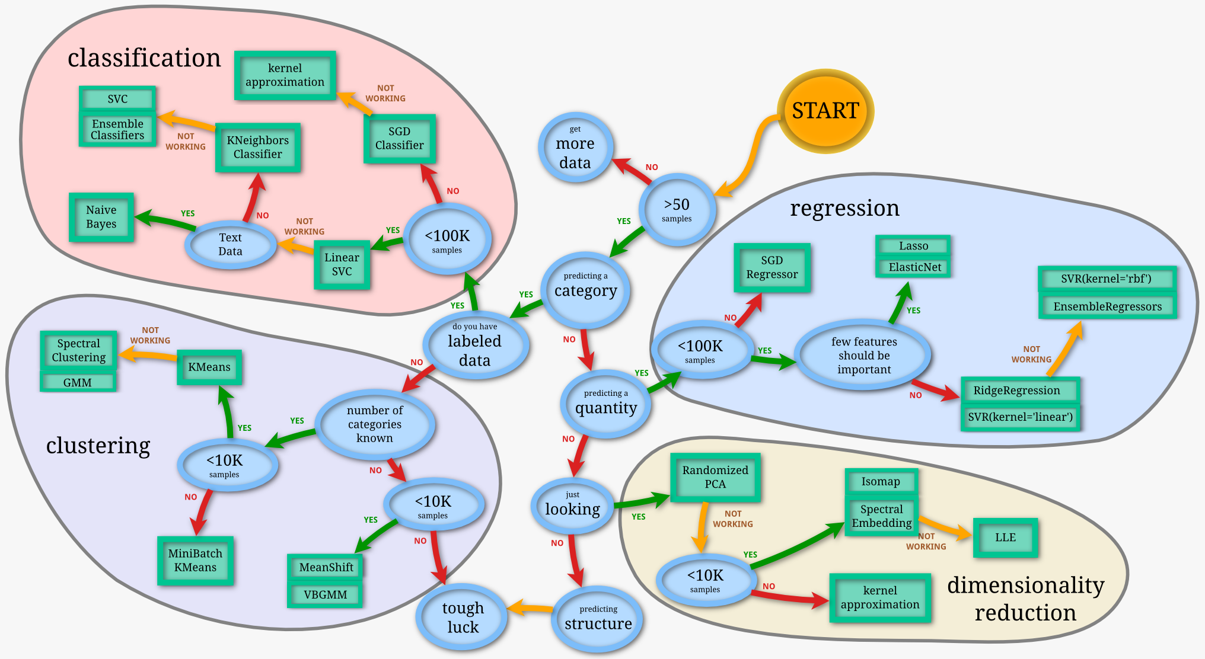
Choose a Machine Learning Algorithm
Source: http://scikit-learn.org/stable/tutorial/machine_learning_map/index.html

Slide 4
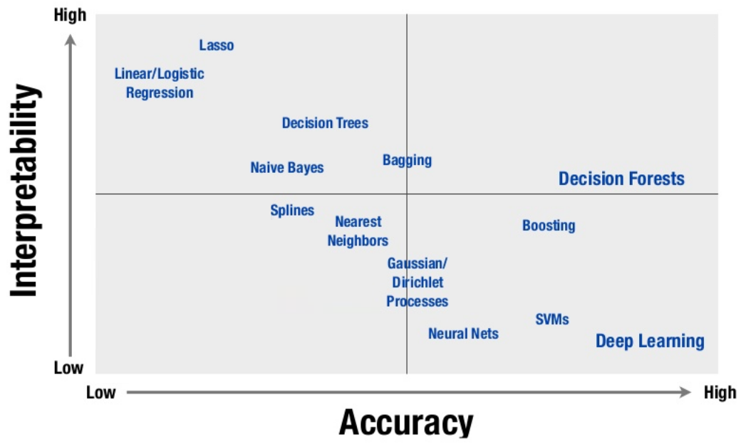
Machine Learning Algorithmic Trade-Off
Source: https://www.slideshare.net/firstmarkcap/machine-learning-in-production-josh-bloom-wiseio-firstmarks-data-driven

Slide 5
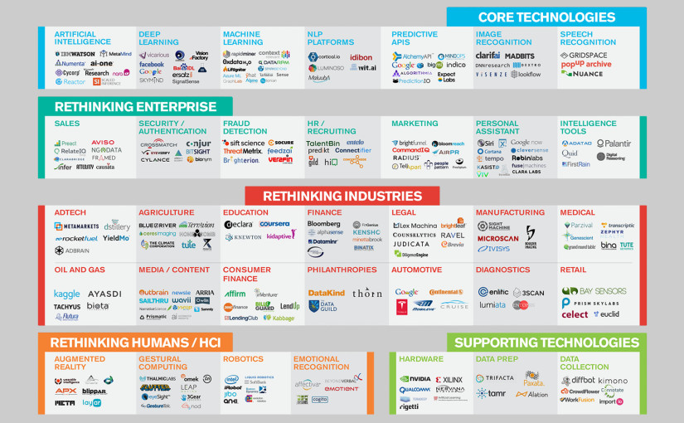
Who uses Machine Learning
Source: http://airesearch.com/ai-blog/ai-startups-companies-in-the-landscape-of-machine-intelligence/

Slide 6
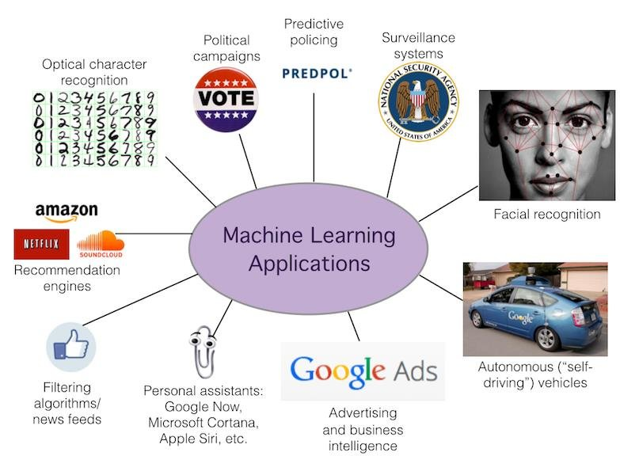
Applications
Source: https://www.researchgate.net/figure/Machine-Learning-Application_fig1_323108787

Slide 7
So, what next?
Now you know!
Use your power for good!

