Slide 1
Parsley Introduction
Kui Huang
Oct. 13, 2009

Slide 2
Topics
Background
Dependency Injection
Object Lifecycle
Message Bus
Sample
FW Extensions

Slide 3
Background
Introduce Injection (IOC) to ActionScript world
  Louse couple of the dependencies between interface and implementation
    Define some variables will be injected with instances at runtime dynamically; (Using declaration annotation/tag directly in codes)
    Define object pool in configuration files.
Design a powerful event-driven framework
    Louse couple of event dispatcher and listener
http://www.spicefactory.org/

Slide 4
Configuration and Initialization
Configuring and initializing the Parsley Framework usually consists of the following steps:
  Step 1: Telling the IOC Container which classes it should manage. This can be done with MXML, XML files or in ActionScript. All three mechanisms will be described in the following sections.
  Step 2: Configure the container services like Dependency Injection or Messaging for each individual class. This can be done with the mechanism you had chosen for step 1 (e.g. with MXML or XML configuration tags) or - in most cases - conveniently with AS3 Metadata Tags right within the classes themselves.
  Step 3: Initialize the IOC Container (usually on application startup). In Parsley 2 this is a one-liner in most cases. See the sections below for examples.

Slide 5
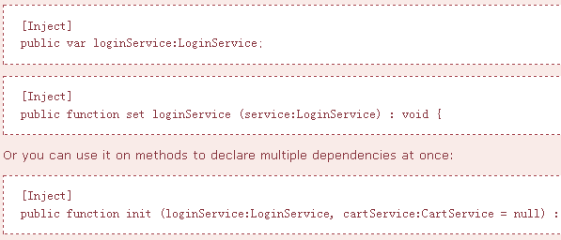
Dependency Injection

Slide 6
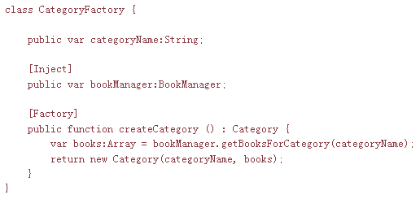
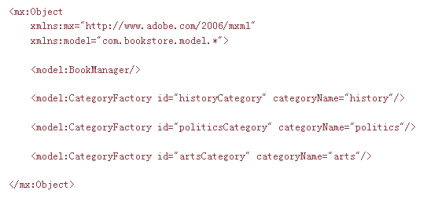
Using Factories
Notes:
Sometimes configuring the target object directly may not be sufficient. Maybe you want to execute some complex logic on object creation that would be difficult to setup declaratively. In these cases you can use a factory instead. The factory is a normal AS3 class that you can configure like any other class in Parsley, using Metadata, MXML or XML tags. The only difference is that one method is marked as a factory method (again using Metadata, MXML or XML)
Each of the factories we defined above will get the BookManager instance injected and then produce instances of Category.
The special thing about using factories is that under the hood Parsley actually creates two object definitions for each factory: One for the factory itself and one for the type the factory method produces. This means that you can also place metadata tags on the target type (in this case the Category class) if you want the object that the factory produces to send and receive application messages managed by Parsley for example.

Slide 7
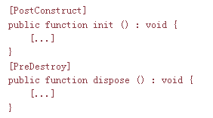
Object Lifecycle
If you want the Parsley Container to invoke methods on your object when it is created or when it is destroyed, you can add the [PostConstruct] or [PreDestroy] metadata tags to the corresponding methods:

Slide 8
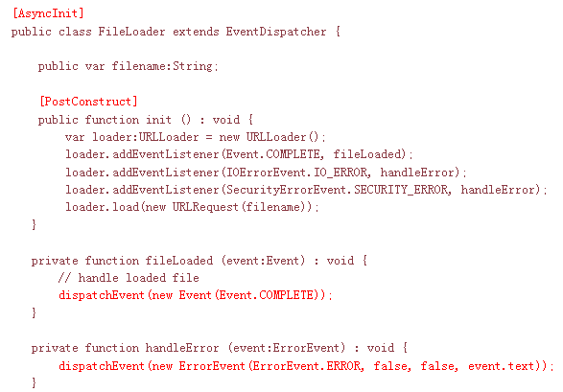
Asynchronous Object Initialization
Notes:
A lot of operations in the Flash Player execute asynchronously. So it might happen that you want an object configured in the Parsley IOC Container to load some data or assets first, before the rest of the Context gets initialized and before this asynchronously initializing object gets injected into other objects. In this cases you can use the [AsyncInit] tag on any EventDispatcher that fires events when the initialization is completed (or if it has failed)

Slide 9
Event.COMPLETE and ErrorEvent.ERROR are the default event types to signal whether initialization has completed or failed. They can be switched with attributes of the [AsyncInit] tag:
  [AsyncInit(completeEvent="myCustomCompleteEvent",errorEvent="myCustomErrorEvent")]
Initialization order. If you use more than one asynchronously initializing object and one depends on the other you may want to explicitly specify the initialization order. You can do that with the order attribute:
  [AsyncInit(order="1")]

Slide 10
Modular Contexts and Lifecycle
In larger applications you may want to split your application into modules which are loaded on demand. In this case it would be unfortunate to have a monolithic Context that is fully loaded and initialized at application startup.
This is where another feature of Parsley comes in handy: when creating a Context you can define an existing context as its parent with optional parameters of all the various context builder methods
  var parent:Context = ...; FlexContextBuilder.build(BookStoreConfig, parent);
If you load multiple Context instances as modules like described in the previous section, you may want to get rid of them when you unload a module.
  context.destroy();

Slide 11
When a Context gets destroyed the following actions occur:
  All objects configured in the destroyed Context stop receiving messages dispatched by Parsleys central MessageRouter. This affects all elements annotated with MessageHandler, MessageBinding or MessageInterceptor.
  If any objects declared in the destroyed Context declared ManagedEvents they will be ignored from now on and no longer dispatched trough Parsleys MessageRouter.
  All methods annotated with [PreDestroy] (or the corresponding MXML or XML tags) on any object of the destroyed Context get invoked.
  The destroyed Context will remove all internal references to the configured objects so they are eligible for garbage collection. (Of course you have to make sure that your application does not retain any references to those objects).
  The Context may no longer be used after invoking destroy. Any subsequent method invocations on that Context throw Errors. The parent of the destroyed Context (if any) is not affected and may continue to operate normally.

Slide 12
Message Bus
Louse couple of event dispatcher and listener
  not only means that the sender and the receiver do not have to know each other.
  sending and receiving objects are also fully decoupled from the framework itself.
Versus:
  Flash Event
  Cairngorm
  PureMVC
  Swiz
Notes:
This is an advantage ignored by most other Flex Frameworks (including version 1 of Parsley) where you have to use objects or static methods from the Framework API for dispatching application events or messages. Why is that important? If your objects are decoupled from the framework you can reuse them in a different context where you might want to use a different framework or no framework at all. For example you might want to wire dispatching and receiving instances programmatically for Unit Tests without the extra burden to initialize an application framework.

Slide 13
Message Bus
Dispatching Messages
Managed Events if the dispatching object is a regular EventDispatcher.
Injected MessageDispatchers if your messages are not subclasses of Event
Using the MessageRouter programmatically in rare cases where you need to use the Framework API directly

Slide 14
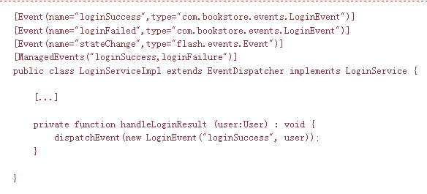
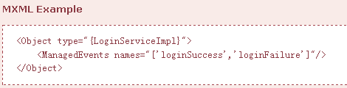
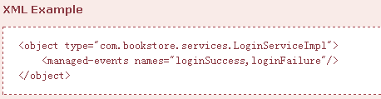
ManagedEvents
Notes:
If the class that you want to dispatch messages managed by Parsley is a regular EventDispatcher this is the most convenient option. It would work for any existing EventDispatcher implementation even if it wasn't designed with Parsley in mind. It requires two steps:
Declare the events that your class dispatches with regular [Event] tags. This is good practice anyway, whether you are using Parlsey or not, as it improves the readability of your classes and the ASDoc output where all events declared with this tag are included.
Tell Parsley which of those declared events should be "managed" so that they are available for message receivers configured for the framework. Like for all messaging features you can use AS3 Metadata, MXML or XML tags for this step.

Slide 15
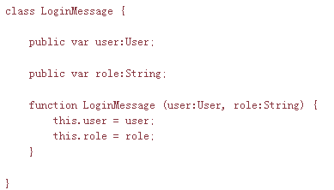
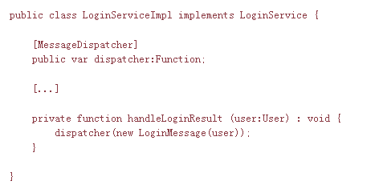
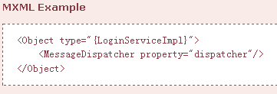
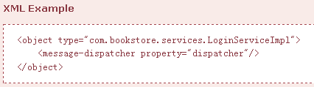
Injected MessageDispatchers
Notes:
Sometimes you don't want to work with events for your application messages. Somehow several event semantics may not make much sense in a particular scenario. Application events managed by Parsley cannot "bubble", stopPropagation would not have any effect in the Parsley message processing sequence and for fully decoupled messaging you may even want to avoid that the message receiver can get hold of the message dispatcher through event.target.
In those cases Parsley offers the option to use any class as an application message, whether it extends flash.events.Event or not. You can then request the framework to inject a message dispatcher function that you can use for your custom application messages.

Slide 16
Message Bus
Receiving Messages
MessageHandlers for methods that should be invoked when a particular message is dispatched.
MessageBindings for properties that should be set when a particular message is dispatched.
MessageInterceptors for intercepting, and optionally cancelling or deferring then redispatching a message before it is processed by handlers or bindings.
Using the MessageRouter programmatically in rare cases where you need to use the Framework API to register any of the features listed above.

Slide 17
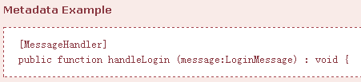
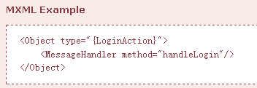
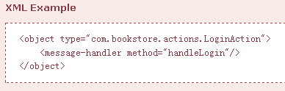
Message Handlers
Notes:
Message Handlers are the most common approach for the receiving side. You can declare methods to be invoked when a particular application message gets dispatched.

Slide 18
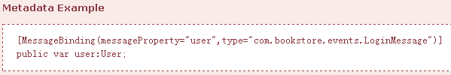
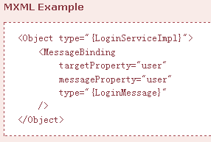
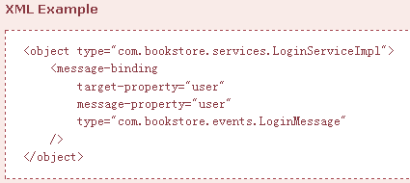
Message Bindings
In the following example the user property of the example will be set to the value of the user property of the LoginMessage instance whenever such a message is dispatched.
Notes:
Message Bindings are simply a shortcut, where you want to bind a property of a class to a property of a message, that should be updated whenever a message of a matching type is dispatched.

Slide 19
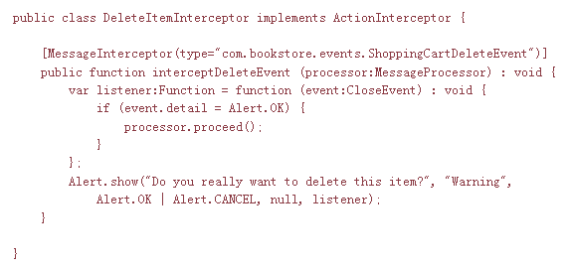
Message Interceptors
An example would be to show a simple warning before any delete operation is actually performed like in the following example. When the user hits cancel, the MessageProcessor never resumes and no subsequent handler or bindings will be executed.

Slide 20
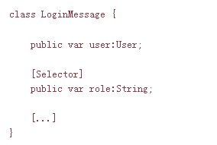
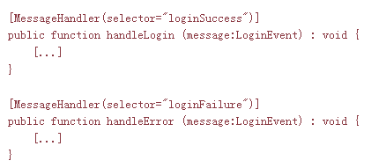
Using Selectors
In the examples for the sections about MessageHandlers, MessageBindings and MessageInterceptors the matching methods or properties were always determined solely by the type (class) of the message. Sometimes that may not be sufficient if you dispatch the same message type in different scenarios or application states. In such a case you can refine the selection process with custom selectors.

Slide 21
Others
Localization
Logging
Remoting
  Flex Remoting
  Pimento Data Services
  Cinnamon Remoting

Slide 22
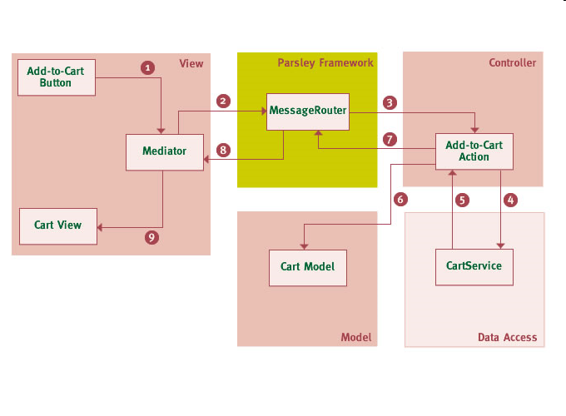
Sample

Slide 23
Extension of framework
Available Extension Points
  Factories/ObjectDefinitionDecorator
  Context/ObjectDefinition
  ……
Creating Custom Configuration Tags
Creating Tags that produce Objects
Custom Configuration Processors

Slide 24
Q&A

