Slide 1
Is more always better?
Determining the role of functional composition for ecosystem functioning
using a general ecosystem model
Alexander Hurley
Supervisors: Richard Davies (UEA) Mike Harfoot (MSRC)
Drew Purves (MSRC)

Slide 2
A general ecosystem Model
Notes:
I, like many others, believe that we can use the empirical knowledge that has been gathered over the last decades and extrapolate it to gain new insight. And the ‘easiest’ way to do this, is using models.

Slide 3
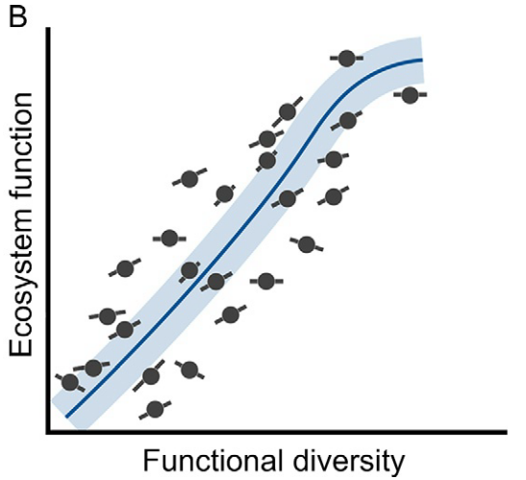
General Ecosystem Model
(Schmitz et al., 2015)

Slide 4
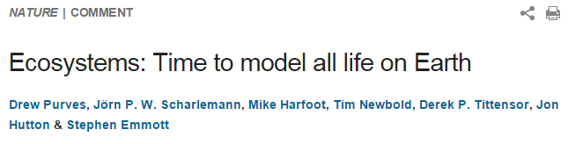
General Ecosystem Model

Slide 5


General Ecosystem Model

Slide 6
General Ecosystem Model
the first process-based, mechanistic GEM
Fundamental ecological principles and concepts
Universal (terrestrial and marine environments)
Spatially explicit (local climate)
Individual based
Functional groups (basic organismal and functional traits)

Slide 7
General Ecosystem Model
the first process-based, mechanistic GEM
Fundamental ecological principles and concepts
Universal (terrestrial and marine environments)
Spatially explicit (local climate)
Individual based
Functional groups (basic organismal and functional traits)
Test and generate
hypotheses

Slide 8
General Ecosystem Model
the first process-based, mechanistic GEM
Carnivore
Ectotherm
semelparous
iteroparous
Endotherm
iteroparous
Omnivore
Herbivore
Body Mass
Trophic Type
Metabolism
Reproduction
Autotrophs / Plants: standing stocks

Slide 9
General Ecosystem Model
the first process-based, mechanistic GEM
Carnivore
Ectotherm
semelparous
iteroparous
Endotherm
iteroparous
Omnivore
Herbivore
Body Mass
Trophic Type
Metabolism
Reproduction
Autotrophs / Plants: standing stocks

Slide 10
Project Background

Slide 11
Project Background
Rationale – why carnivores?
To date: mainly small scale & mesocosm experiments
→ Lack of scale (spatial, temporal) → Lacking interactions, dispersal capacity (e.g. Duffy et al., 2007)
Horizontal diversity of predators can dictate ecosystem functioning (e.g. Estes et al., 2011; Ripple et al., 2014)

Slide 12
Project Background
Objectives
Extend biodiversity – ecosystem functioning research to broader scale
Identify Implications for conservation

Slide 13
Project Background
Objectives
Extend biodiversity – ecosystem functioning research to broader scale
Identify Implications for conservation
Hypothesis
The functional composition of a carnivore assemblage is a stronger determinant of ecosystem functioning than the number of carnivore groups.

Slide 14
Project Background
Objectives
Extend biodiversity – ecosystem functioning research to broader scale
Identify Implications for conservation
Hypothesis
The functional composition of a carnivore assemblage is a stronger determinant of ecosystem functioning than the number of carnivore groups.
Carnivore Identity > Richness

Slide 15
Methods
Study Design
Carnivore
Ectotherm
semelparous
iteroparous
Endotherm
iteroparous
a
A
B

Slide 16
Methods
Carnivore
Ectotherm
semelparous
iteroparous
Endotherm
iteroparous
a
Study Design
A
A
B
a
B
Aa
AB
AaB
Aa

Slide 17
Methods
Study Design
Simulate two ecosystems over 100 years
Locations: Central England, South Uganda
1° × 1° grid cells
Monthly resolution
8 scenarios (all combinations + no carnivores)
Response: basal trophic levels at equilibrium (biomass density, abundance, average body mass)

Slide 18
Results

Slide 19
Results
Biomass Density for all scenarios
A: Ectotherm iter.
a: Ectotherm seml.
B: Endotherm
AaB
Aa
AB
aB
A
a
B
-
3
2
1
0

Slide 20
Results
Biomass Density for all scenarios
A: Ectotherm iter.
a: Ectotherm seml.
B: Endotherm
ab
b
a
a
c
d
cd
d
AaB
Aa
AB
aB
A
a
B
-
3
2
1
0

Slide 21
Results
Abundance (top) and Average Body Mass (bottom)
A: Ectotherm iter.
a: Ectotherm seml.
B: Endotherm
AaB
Aa
AB
aB
A
a
B
-

Slide 22
Results
Abundance (top) and Average Body Mass (bottom)
Herbivore abundance roughly equal to control
A: Ectotherm iter.
a: Ectotherm seml.
B: Endotherm
Higher herbivore body mass than in control
AaB
Aa
AB
aB
A
a
B
-
Notes:
B: High productivy aseasonal system → supports large endothermic carnivores. But: large allocation of Energy to maintain metabolism. → Less reproduction, while long-lived → upward shift of mass range. Predation ‘bin’ shifts equally → Larger herbivores -> more consumption
(In contrast: High resource availability + Higher activity, higher metabolic rates → better assimilation. → Higher reproduction, better suppression of herbivores
aB: Assume similar, but median value shifted due to smaller ecto semelp. Still a ‘released’ mass bin. Intra guild predation may affect survival of endotherms (B) in early life stages

Slide 23
Results
Implications for conservation
Ecosystem services (poly- vs. monoculture)
Temperature & ectotherms in tropics (Zeh et al., 2012)
Guiding management decision (controlling size structure)

Slide 24
Results
Next Steps
Quantitative comparison with empirical data
Higher detail in simulations

Slide 25
Conclusion
Hypothesis  ✓
Demonstrated potential of GEMs for ecology & conservation
Foundation for investigating effects of size structure

Slide 26




Acknowledgements
Mike Harfoot (MSRC) Richard Davies (UEA) Drew Purves (MSRC) Aldina Franco (UEA)

Slide 27


Acknowledgements

Slide 28
Literature
Chapman, A. D. (2009). Numbers of living species in Australia and the world. 2nd edition. Australian Biodiversity Information Services: Toowoomba, Australia.
Gitav, H., & Noble, I. R. (1997). O What are functional types and how should we seek them. Plant functional types: their relevance to ecosystem properties and global change, 1(3).
Schmitz, O. J., Buchkowski, R. W., Burghardt, K. T., & Donihue, C. M. (2015). Functional traits and trait-mediated interactions: connecting community-level interactions with ecosystem functioning. Advances in Ecological Research
Kleiber, M (1947). "Body size and metabolic rate". Physiological Reviews 27 (4): 511–541.
Buckley, L. B., Hurlbert, A. H., & Jetz, W. (2012). Broad‐scale ecological implications of ectothermy and endothermy in changing environments. Global Ecology and Biogeography, 21(9), 873-885.
Jennings, S., & Mackinson, S. (2003). Abundance–body mass relationships in size‐structured food webs. Ecology Letters, 6(11), 971-974.
Zeh, J. A., Bonilla, M. M., Su, E. J., Padua, M. V., Anderson, R. V., Kaur, D., ... & Zeh, D. W. (2012). Degrees of disruption: projected temperature increase has catastrophic consequences for reproduction in a tropical ectotherm. Global Change Biology, 18(6), 1833-1842.
Finke, D. L., & Denno, R. F. (2004). Predator diversity dampens trophic cascades. Nature, 429(6990), 407-410.
Harfoot, M. B., Newbold, T., Tittensor, D. P., Emmott, S., Hutton, J., Lyutsarev, V., ... & Purves, D. W. (2014). Emergent global patterns of ecosystem structure and function from a mechanistic general ecosystem model. PLoS Biol, 12(4), e1001841.
Estes, J. A., Terborgh, J., Brashares, J. S., Power, M. E., Berger, J., Bond, W. J., ... & Wardle, D. A. (2011). Trophic downgrading of planet Earth. science, 333(6040), 301-306.
Ripple, W. J., Estes, J. A., Beschta, R. L., Wilmers, C. C., Ritchie, E. G., Hebblewhite, M., ... & Wirsing, A. J. (2014). Status and ecological effects of the world’s largest carnivores. Science, 343(6167), 1241484.
Duffy, J. E., Cardinale, B. J., France, K. E., McIntyre, P. B., Thébault, E., & Loreau, M. (2007). The functional role of biodiversity in ecosystems: incorporating trophic complexity. Ecology letters, 10(6), 522-538.

Slide 29
Literature
Chapman, A. D. (2009). Numbers of living species in Australia and the world. 2nd edition. Australian Biodiversity Information Services: Toowoomba, Australia.
Gitav, H., & Noble, I. R. (1997). O What are functional types and how should we seek them. Plant functional types: their relevance to ecosystem properties and global change, 1(3).
Schmitz, O. J., Buchkowski, R. W., Burghardt, K. T., & Donihue, C. M. (2015). Functional traits and trait-mediated interactions: connecting community-level interactions with ecosystem functioning. Advances in Ecological Research
Kleiber, M (1947). "Body size and metabolic rate". Physiological Reviews 27 (4): 511–541.
Buckley, L. B., Hurlbert, A. H., & Jetz, W. (2012). Broad‐scale ecological implications of ectothermy and endothermy in changing environments. Global Ecology and Biogeography, 21(9), 873-885.
Jennings, S., & Mackinson, S. (2003). Abundance–body mass relationships in size‐structured food webs. Ecology Letters, 6(11), 971-974.
Zeh, J. A., Bonilla, M. M., Su, E. J., Padua, M. V., Anderson, R. V., Kaur, D., ... & Zeh, D. W. (2012). Degrees of disruption: projected temperature increase has catastrophic consequences for reproduction in a tropical ectotherm. Global Change Biology, 18(6), 1833-1842.
Finke, D. L., & Denno, R. F. (2004). Predator diversity dampens trophic cascades. Nature, 429(6990), 407-410.
Harfoot, M. B., Newbold, T., Tittensor, D. P., Emmott, S., Hutton, J., Lyutsarev, V., ... & Purves, D. W. (2014). Emergent global patterns of ecosystem structure and function from a mechanistic general ecosystem model. PLoS Biol, 12(4), e1001841.

Slide 30
General Ecosystem Model
(Harfoot, et al., 2014)

Slide 31
Results
Aseasonal System – Control (AaB)
autotrophs
herbivores
carnivores
omnivores

Slide 32
Results
Aseasonal System – Control (AaB)
autotrophs
herbivores
carnivores
omnivores

Slide 33
Results
Aseasonal System – Control (AaB)
autotrophs
herbivores
carnivores
omnivores

Slide 34
Results
Aseasonal System – Control (AaB)
autotrophs
herbivores
carnivores
omnivores

Slide 35
Results
Abundance and Average Body Mass
Higher herbivore abundances than in control
A: Ectotherm iter.
a: Ectotherm seml.
B: Endotherm
Herbivore body mass remains on lower levels
AaB
Aa
AB
aB
A
a
B
-
Notes:
a : maximum body size constrained -> semelparous organisms small. Marginal predation on overall range of herbivores. → higher abundances mean less available resources → average body mass remains low

Slide 36
Results
In Context:
Resulting patterns in agreement with empirical studies Endotherms: resource availability governs body mass range, higher metabolic costs, lower densities for larger organisms (Buckley et al., 2012; Jennings & Mackinson, 2003) Ectotherms: increased assimilation efficiency with lower metabolic costs (Buckley et al., 2012) Decreasing predator richness compensated by predator identity (Finke & Denno, 2005)

