Slide 1
Graphs
CS 302 – Data Structures
Section 9.3

Slide 2
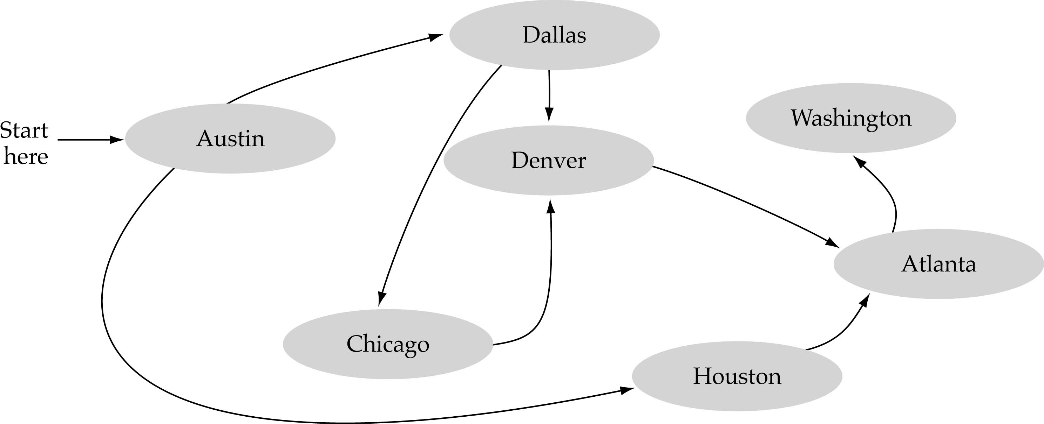
What is a graph?
A data structure that consists of a set of nodes (vertices) and a set of edges between the vertices.
The set of edges describes relationships among the vertices.
1
2
3
4

Slide 3


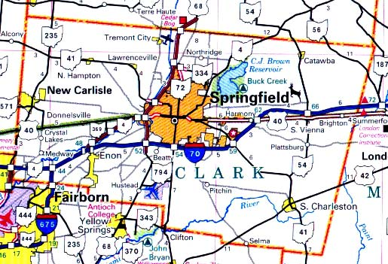

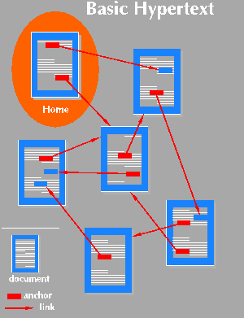
Applications
Schedules
Computer networks
Maps
Hypertext
Circuits

Slide 4
Formal definition of graphs
A graph G is defined as follows:
G=(V,E)
V: a finite, nonempty set of vertices
E: a set of edges (pairs of vertices)

Slide 5
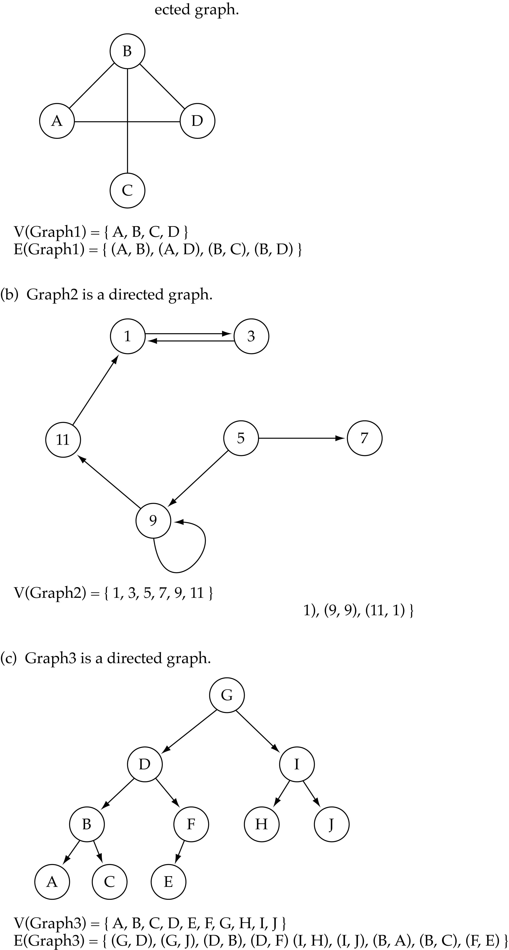
Undirected graphs
When the edges in a graph have no direction, the graph is called undirected
undirected graph
The order of vertices in E
is not important for
undirected graphs!!

Slide 6
Directed graphs
When the edges in a graph have a direction, the graph is called directed.
The order of vertices in E
is important for
directed graphs!!
E(Graph2) = {(1,3) (3,1) (5,9) (9,11) (5,7)

Slide 7
Trees vs graphs
Trees are special cases of graphs!!
I

Slide 8
Graph terminology
Adjacent nodes: two nodes are adjacent if they are connected by an edge
7 is adjacent from 5
or
5 is adjacent to 7
5
7
7 is adjacent from/to 5
or
5 is adjacent from/to 7
5
7

Slide 9
Graph terminology
Path: a sequence of vertices that connect two nodes in a graph.
The length of a path is the number of edges in the path.
1
2
e.g., a path from 1 to 4:
<1, 2, 3, 4>
3
4

Slide 10
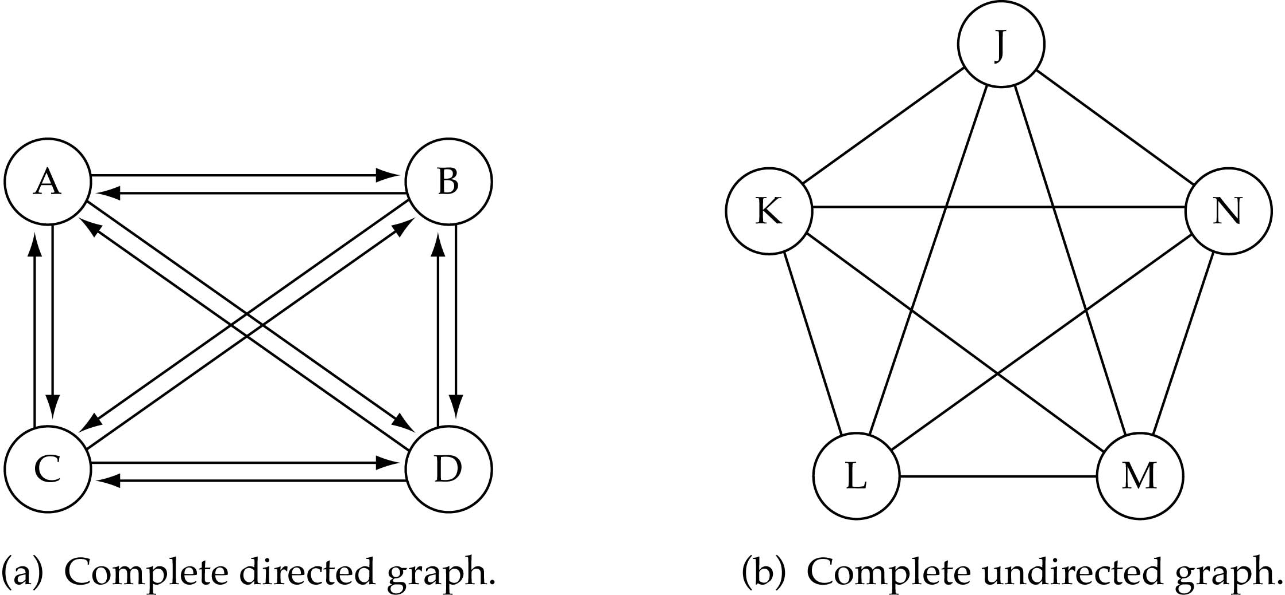
Graph terminology
Complete graph: a graph in which every vertex is directly connected to every other vertex

Slide 11
Graph terminology (cont.)
What is the number of edges E in a complete directed graph with V vertices?
E=V * (V-1)
or E=O(V²)

Slide 12
Graph terminology (cont.)
What is the number of edges E in a complete undirected graph with V vertices?
E=V* (V-1) / 2
or E=O(V²)

Slide 13
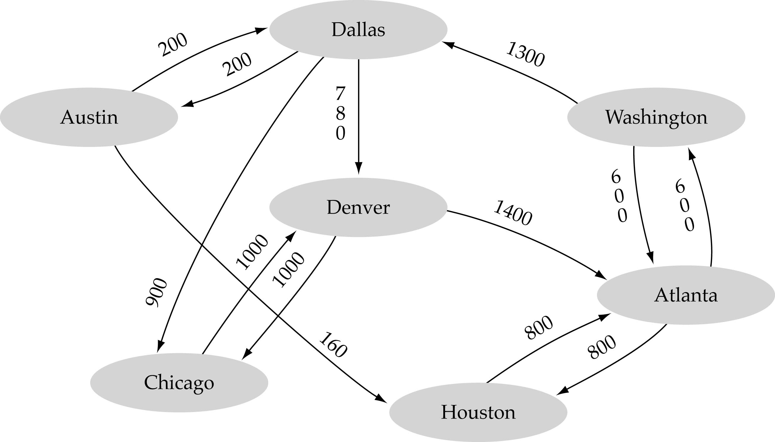
Graph terminology (cont.)
Weighted graph: a graph in which each edge carries a value

Slide 14
Graph Implementation
Array-based
Linked-list-based

Slide 15
Array-based implementation
Use a 1D array to represent the vertices
Use a 2D array (i.e., adjacency matrix) to represent the edges

Slide 16
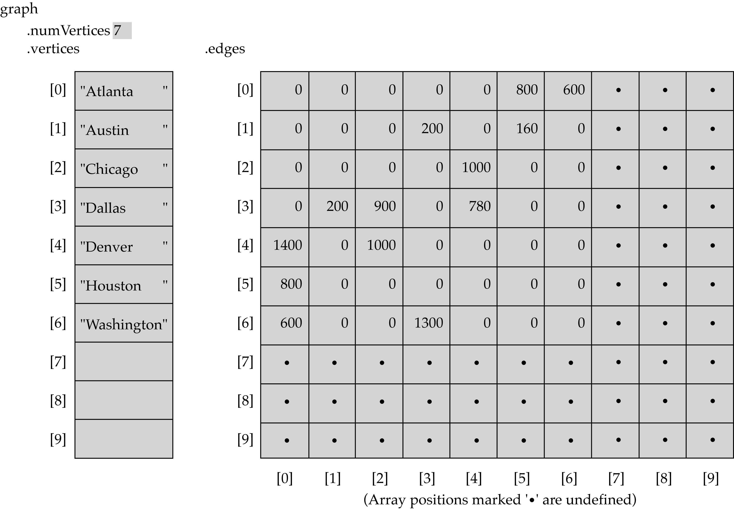
Array-based implementation (cont’d)

Slide 17
Array-Based Implementation (cont.)
Memory required
  O(V+V²)=O(V²)
Preferred when
  The graph is dense: E = O(V²)
Advantage
  Can quickly determine
  if there is an edge between two vertices
Disadvantage
  No quick way to determine the vertices adjacent
  from another vertex
x
?

Slide 18
Linked-list-based implementation
Use a 1D array to represent the vertices
Use a list for each vertex v which contains the vertices which are adjacent from v (adjacency list)

Slide 19
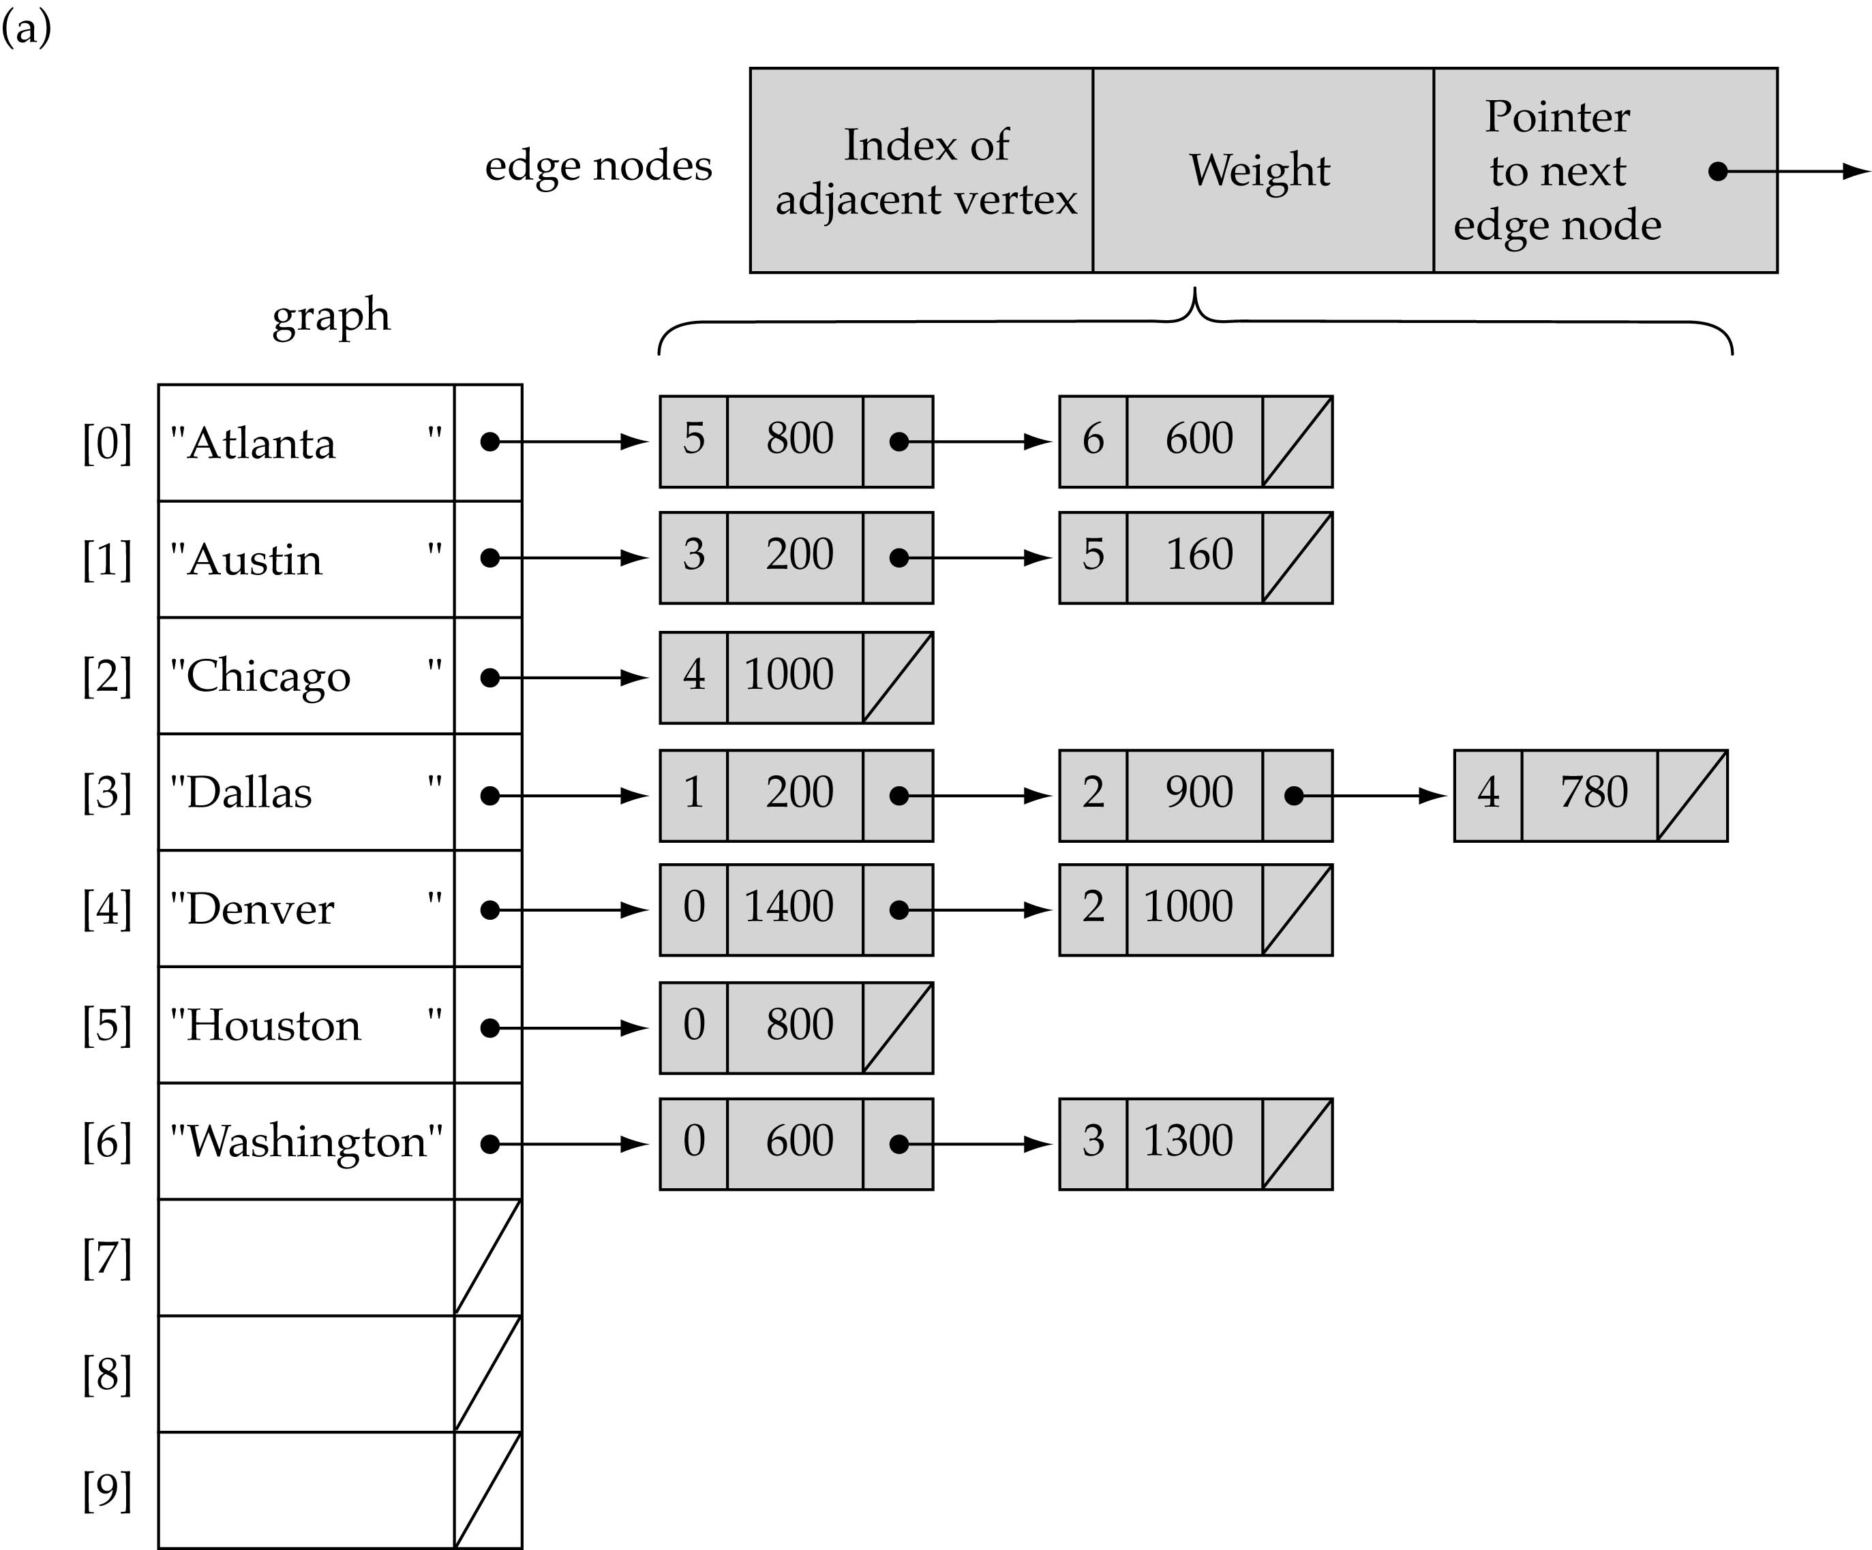
Linked-list-based implementation (cont’d)

Slide 20
Link-List-based Implementation (cont.)
Memory required
  O(V + E)
Preferred when
  for sparse graphs: E = O(V)
Disadvantage
  No quick way to determine whether
  there is an edge between vertices u and v
Advantage
  Can quickly determine the
  vertices adjacent from a given vertex
O(V) for sparse graphs since E=O(V)
O(V²) for dense graphs since E=O(V²)
x
?

Slide 21
Graph specification based on adjacency matrix representation
const int NULL_EDGE = 0;
template<class VertexType>
class GraphType {
public:
GraphType(int);
~GraphType();
void MakeEmpty();
bool IsEmpty() const;
bool IsFull() const;
void AddVertex(VertexType);
void AddEdge(VertexType, VertexType, int);
int WeightIs(VertexType, VertexType);
void GetToVertices(VertexType, QueType<VertexType>&);
void ClearMarks();
void MarkVertex(VertexType);
bool IsMarked(VertexType) const;
private:
int numVertices;
int maxVertices;
VertexType* vertices;
int **edges;
bool* marks;
};

Slide 22
template<class VertexType>
GraphType<VertexType>::GraphType(int maxV)
{
numVertices = 0;
maxVertices = maxV;
vertices = new VertexType[maxV];
edges = new int[maxV];
for(int i = 0; i < maxV; i++)
edges[i] = new int[maxV];
marks = new bool[maxV];
}

Slide 23
template<class VertexType>
GraphType<VertexType>::~GraphType()
{
delete [] vertices;
for(int i = 0; i < maxVertices; i++)
delete [] edges[i];
delete [] edges;
delete [] marks;
}

Slide 24
void GraphType<VertexType>::AddVertex(VertexType vertex)
{
vertices[numVertices] = vertex;
for(int index = 0; index < numVertices; index++) {
edges[numVertices][index] = NULL_EDGE;
edges[index][numVertices] = NULL_EDGE;
}
numVertices++;
}

Slide 25
template<class VertexType>
void GraphType<VertexType>::AddEdge(VertexType fromVertex, VertexType toVertex, int weight)
{
int row;
int column;
row = IndexIs(vertices, fromVertex);
col = IndexIs(vertices, toVertex);
edges[row][col] = weight;
}

Slide 26
template<class VertexType>
int GraphType<VertexType>::WeightIs(VertexType fromVertex, VertexType toVertex)
{
int row;
int column;
row = IndexIs(vertices, fromVertex);
col = IndexIs(vertices, toVertex);
return edges[row][col];
}

Slide 27
template<class VertexType>
void GraphType<VertexType>::GetToVertices(VertexType vertex,
QueTye<VertexType>& adjvertexQ)
{
int fromIndex;
int toIndex;
fromIndex = IndexIs(vertices, vertex);
for(toIndex = 0; toIndex < numVertices; toIndex++)
if(edges[fromIndex][toIndex] != NULL_EDGE)
adjvertexQ.Enqueue(vertices[toIndex]);
}

Slide 28
Graph searching
Problem: find if there is a path between two vertices of the graph (e.g., Austin and Washington)
Methods: Depth-First-Search (DFS) or Breadth-First-Search (BFS)

Slide 29
Depth-First-Search (DFS)
Main idea:
  Travel as far as you can down a path
  Back up as little as possible when you reach a "dead end" (i.e., next vertex has been "marked" or there is no next vertex)
DFS uses a stack !

Slide 30
Depth-First-Search (DFS) (cont.)
startVertex endVertex
found = false
stack.Push(startVertex)
DO
stack.Pop(vertex)
IF vertex == endVertex
found = true
ELSE
“mark” vertex
Push all adjacent, not “marked”, vertices onto stack
WHILE !stack.IsEmpty() AND !found
IF(!found)
Write "Path does not exist"

Slide 31
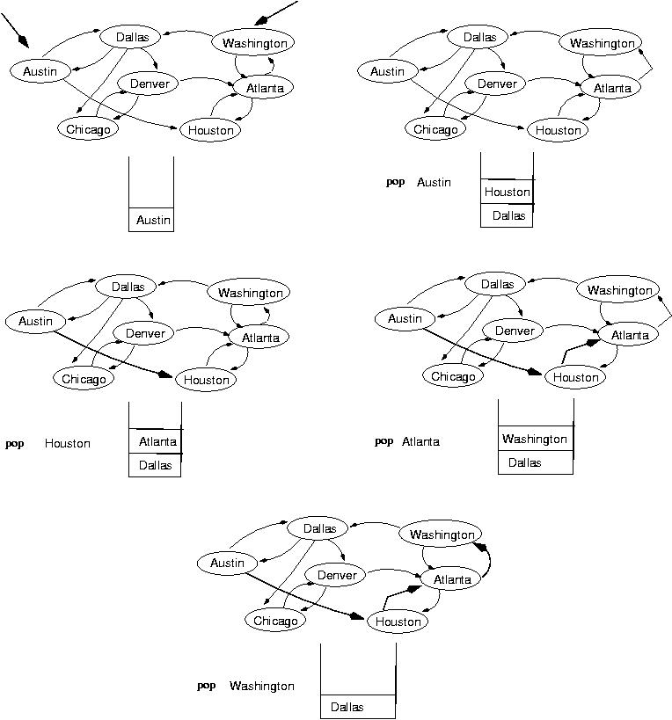
startVertex
endVertex
(initialization)

Slide 34
template <class VertexType>
void DepthFirstSearch(GraphType<VertexType> graph, VertexType startVertex, VertexType endVertex)
{
StackType<VertexType> stack;
QueType<VertexType> vertexQ;
bool found = false;
VertexType vertex;
VertexType item;
graph.ClearMarks();
stack.Push(startVertex);
do {
stack.Pop(vertex);
if(vertex == endVertex)
found = true;
(continues)

Slide 35
else
if(!graph.IsMarked(vertex)) {
graph.MarkVertex(vertex);
graph.GetToVertices(vertex, vertexQ);
while(!vertexQ.IsEmpty()) {
vertexQ.Dequeue(item);
if(!graph.IsMarked(item))
stack.Push(item);
}
}
} while(!stack.IsEmpty() && !found);
if(!found)
cout << "Path not found" << endl;
}

Slide 36
Breadth-First-Searching (BFS)
Main idea:
  Look at all possible paths at the same depth before you go at a deeper level
  Back up as far as possible when you reach a "dead end" (i.e., next vertex has been "marked" or there is no next vertex)
BFS uses a queue !

Slide 37
Breadth-First-Searching (BFS) (cont.)
startVertex endVertex
found = false
queue.Enqueue(startVertex)
DO
queue.Dequeue(vertex)
IF vertex == endVertex
found = true
ELSE
“mark” vertex
Enqueue all adjacent, not “marked”, vertices onto queue
WHILE !queue.IsEmpty() AND !found
IF(!found)
Write "Path does not exist"

Slide 38
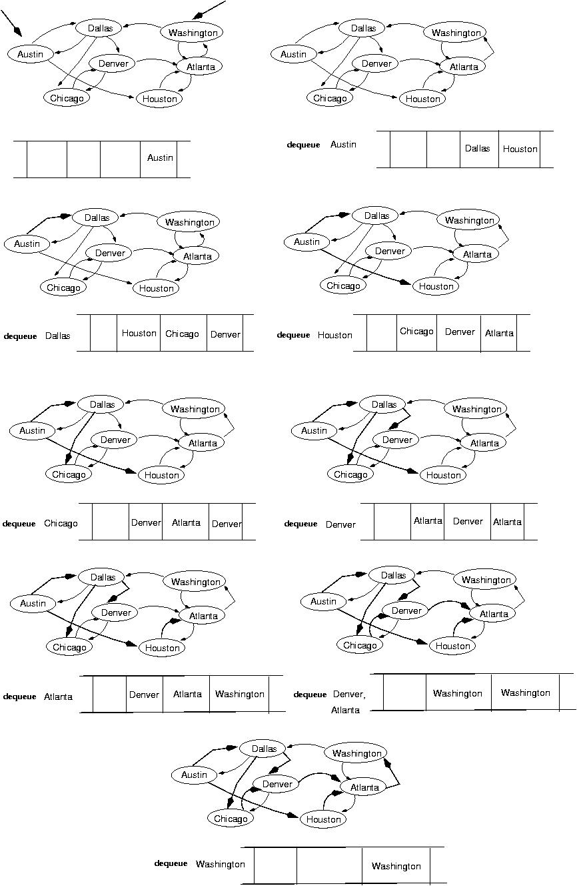
startVertex
endVertex
(initialization)

Slide 39
Duplicates: should we mark a vertex when it is Enqueued
or when it is Dequeued ?
....

Slide 41
template<class VertexType>
void BreadthFirtsSearch(GraphType<VertexType> graph, VertexType startVertex, VertexType endVertex);
{
QueType<VertexType> queue;
QueType<VertexType> vertexQ;
bool found = false;
VertexType vertex;
VertexType item;
graph.ClearMarks();
queue.Enqueue(startVertex);
do {
queue.Dequeue(vertex);
if(vertex == endVertex)
found = true;
(continues)

Slide 42
else
if(!graph.IsMarked(vertex)) {
graph.MarkVertex(vertex);
graph.GetToVertices(vertex, vertexQ);
while(!vertxQ.IsEmpty()) {
vertexQ.Dequeue(item);
if(!graph.IsMarked(item))
queue.Enqueue(item);
}
}
} while (!queue.IsEmpty() && !found);
if(!found)
cout << "Path not found" << endl;
}
“mark” when dequeue a vertex
→ allow duplicates!

Slide 43
Time Analysis
template<class VertexType>
void BreadthFirtsSearch(GraphType<VertexType> graph, VertexType startVertex, VertexType endVertex);
{
QueType<VertexType> queue;
QueType<VertexType> vertexQ;
bool found = false;
VertexType vertex;
VertexType item;
graph.ClearMarks();
queue.Enqueue(startVertex);
do {
queue.Dequeue(vertex);
if(vertex == endVertex)
found = true;
O(V)
O(V) times
(continues)

Slide 44
O(V) – arrays
O(E_{vi}) – linked lists
else {
if(!graph.IsMarked(vertex)) {
graph.MarkVertex(vertex);
graph.GetToVertices(vertex, vertexQ);
while(!vertxQ.IsEmpty()) {
vertexQ.Dequeue(item);
if(!graph.IsMarked(item))
queue.Enqueue(item);
}
}
}
} while (!queue.IsEmpty() && !found);
if(!found)
cout << "Path not found" << endl;
}
O(E_{Vi}) times
Arrays: O(V+V²+E_{v1}+E_{v2}+…)=O(V²+E)=O(V²)

Slide 45
O(V) - arrays
O(E_{vi}) – linked lists
else {
if(!graph.IsMarked(vertex)) {
graph.MarkVertex(vertex);
graph.GetToVertices(vertex, vertexQ);
while(!vertxQ.IsEmpty()) {
vertexQ.Dequeue(item);
if(!graph.IsMarked(item))
queue.Enqueue(item);
}
}
}
} while (!queue.IsEmpty() && !found);
if(!found)
cout << "Path not found" << endl;
}
O(E_{Vi}) times
O(V²)
dense
Linked Lists: O(V+2E_{v1}+2E_{v2}+…)=O(V+E)
O(V)
sparse

Slide 46
Shortest-path problem
There might be multiple paths from a source vertex to a destination vertex
Shortest path: the path whose total weight (i.e., sum of edge weights) is minimum
  Austin→Houston→Atlanta→Washington:
  1560 miles
  Austin→Dallas→Denver→Atlanta→Washington: 2980 miles

Slide 47
Variants of Shortest Path
Single-pair shortest path
  Find a shortest path from u to v for given vertices u and v
Single-source shortest paths
  G = (V, E) ⇒ find a shortest path from a given source vertex s to each vertex v ∈ V

Slide 48
Variants of Shortest Paths (cont’d)
Single-destination shortest paths
  Find a shortest path to a given destination vertex t from each vertex v
  Reversing the direction of each edge → single-source
All-pairs shortest paths
  Find a shortest path from u to v for every pair of vertices u and v

Slide 49
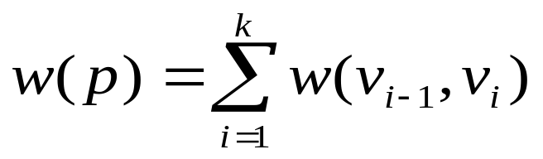
Notation
t
x
Weight of path p = ⟨v₀, v₁, . . . , v_{k}⟩
Shortest-path weight from s to v:
min w(p) : s v if there exists a path from s to v
∞ otherwise
3
6
9
3
1
4
s
0
2
2
7
5
3
5
11
6
y
z
p
δ(v) =

Slide 50
Negative Weights and
Negative Cycles
Negative-weight edges may form
negative-weight cycles.
If negative cycles are reachable
from the source, the shortest
path is not well defined.
  i.e., keep going around the cycle, and get
  w(s, v) = - ∞ for all v on the cycle
a
b
-4
3
4
c
6
d
g
s
0
5
8
y
-3
2
3
7
e
-6
f

Slide 51
Could shortest path solutions contain cycles?
Negative-weight cycles
  Shortest path is not well defined
Positive-weight cycles:
  By removing the cycle, we can get a shorter path
Zero-weight cycles
  No reason to use them; can remove them to obtain a path with same weight

Slide 52
Shortest-path algorithms
Solving the shortest path problem in a brute-force manner requires enumerating all possible paths.
  There are O(V!) paths between a pair of vertices in a acyclic graph containing V nodes.
We will discuss two algorithms
  Dijkstra’s algorithm
  Bellman-Ford’s algorithm

Slide 53
Shortest-path algorithms (cont’d)
Dijkstra’s and Bellman-Ford’s algorithms are “greedy” algorithms!
  Find a “globally” optimal solution by making “locally” optimum decisions.
Dijkstra’s algorithm
  Does not handle negative weights.
Bellman-Ford’s algorithm
  Handles negative weights but not negative cycles reachable from the source.

Slide 54
Shortest-path algorithms (cont’d)
Both Dijkstra’s and Bellman-Ford’s algorithms are iterative:
  Start with a shortest path estimate for every vertex: d[v]
  Estimates are updated iteratively until convergence:
d[v]→δ(v)

Slide 55
Shortest-path algorithms (cont’d)
Two common steps:
  (1) Initialization
  (2) Relaxation (i.e., update step)

Slide 56

Initialization Step
  Set d[s]=0 (i.e., source vertex)
  Set d[v]=∞ (i.e., large value) for
t
5
x
∞
∞
6
-2
-3
s
0
8
7
-4
7
2
∞
∞
9

Slide 57
Relaxation Step
Relaxing an edge (u, v) implies testing whether we can improve the shortest path to v found so far by going through u:
  If d[v] > d[u] + w(u, v)
  we can improve the shortest path to v
  ⇒ d[v]=d[u]+w(u,v)
s
s
u
v
u
v
5
2
9
5
2
6
RELAX(u, v, w)
RELAX(u, v, w)
u
v
u
v
5
2
7
5
2
6
no change

Slide 58
Bellman-Ford Algorithm
Can handle negative weights.
Detects negative cycles reachable from the source.
Returns FALSE if negative-weight cycles are reachable from the source s ⇒ no solution

Slide 59
Bellman-Ford Algorithm (cont’d)
Each edge is relaxed |V–1| times by making |V-1| passes over the whole edge set.
To make sure that each edge is relaxed exactly |V – 1| times, it puts the edges in an unordered list and goes over the list |V – 1| times.
(t, x), (t, y), (t, z), (x, t), (y, x), (y, z), (z, x), (z, s), (s, t), (s, y)
t
5
x
∞
∞
6
-2
-3
s
0
8
7
-4
7
2
∞
∞
9
y
z

Slide 60
Example
t
5
x
t
5
x
∞
∞
∞
∞
6
6
-2
6
-2
-3
-3
0
8
7
Pass 1
s
0
8
7
s
-4
-4
7
2
7
2
∞
∞
∞
∞
7
9
9
y
z
y
z
E: (t, x), (t, y), (t, z), (x, t), (y, x), (y, z), (z, x), (z, s), (s, t), (s, y)

Slide 61
Example
(t, x), (t, y), (t, z), (x, t), (y, x), (y, z), (z, x), (z, s), (s, t), (s, y)
t
5
x
t
x
Pass 1
(from
previous
slide)
Pass 2
5
6
∞
6
∞
4
11
6
-2
6
-2
-3
-3
s
0
8
7
8
7
s
0
-4
-4
7
2
7
2
7
∞
7
∞
9
2
y
z
9
y
z
Pass 3
t
5
x
Pass 4
t
5
x
6
∞
6
∞
2
4
2
11
4
11
6
-2
6
-2
-3
-3
s
0
8
7
0
8
7
s
-4
-4
7
2
7
2
7
∞
7
∞
2
2
9
9
-2
y
z
y
z

Slide 62
Detecting Negative Cycles: needs an extra iteration
s
b
for each edge (u, v) ∈ E do
if d[v] > d[u] + w(u, v)
then return FALSE
return TRUE
0
2
∞
-8
3
∞
c
1st pass
2nd pass
Consider edge (s, b):
d[b] = -1
d[s] + w(s, b) = -4
d[b] > d[s] + w(s, b)
→ d[b]=-4
(d[b] keeps changing!)
s
b
s
b
0
2
∞
-3
2
2
-3
2
-6
-1
-8
3
-8
3
∞
5
5
2
c
c
(s,b) (b,c) (c,s)

Slide 63
BELLMAN-FORD Algorithm
INITIALIZE-SINGLE-SOURCE(V, s)
for i ← 1 to |V| - 1
do for each edge (u, v) ∈ E
do RELAX(u, v, w)
for each edge (u, v) ∈ E
do if d[v] > d[u] + w(u, v)
then return FALSE
return TRUE
Time: O(V+VE+E)=O(VE)
O(V)
O(V)
O(VE)
O(E)
O(E)

Slide 64
Dijkstra’s Algorithm
Cannot handle negative-weights!
  w(u, v) > 0, ∀ (u, v) ∈ E
Each edge is relaxed only once!

Slide 65
Dijkstra’s Algorithm (cont’d)
At each iteration, it maintains two sets of vertices:
V
S
V-S
d[v]=δ (v)
d[v]>δ (v)
(estimates have
converged to the shortest
path solution)
(estimates have not
converged yet)
Initially, S is empty

Slide 66
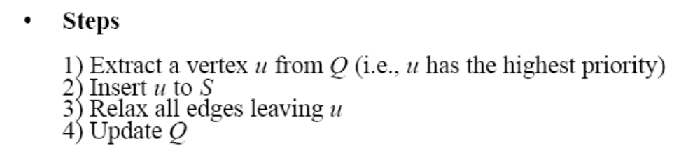
Dijkstra’s Algorithm (cont.)
Vertices in V–S reside in a min-priority queue Q
  Priority of u determined by d[u]
  The “highest” priority vertex will be the one having the smallest d[u] value.

Slide 67
Dijkstra (G, w, s)
S=<> Q=<s,t,x,z,y>
S=<s>
Q=<y,t,x,z>
Initialization
t
1
x
t
1
x
∞
∞
∞
∞
10
10
9
10
9
s
0
2
3
4
6
s
0
2
3
4
6
5
7
5
7
∞
∞
∞
∞
2
5
2
y
z
y
z

Slide 68
Example (cont.)
S=<s,y> Q=<z,t,x>
S=<s,y,z>
Q=<t,x>
t
1
x
t
1
x
10
∞
8
14
8
14
13
10
9
10
9
s
0
2
3
4
6
s
0
2
3
4
6
5
7
5
7
5
∞
5
7
7
2
2
y
z
y
z

Slide 69
Example (cont.)
S=<s,y,z,t> Q=<x>
S=<s,y,z,t,x> Q=<>
t
x
t
1
x
1
8
9
8
13
9
10
9
10
9
2
3
4
6
s
0
2
3
4
6
s
0
5
7
5
7
5
7
5
7
2
2
y
z
y
z
Note: use back-pointers to recover the shortest path solutions!

Slide 70
Dijkstra (G, w, s)
INITIALIZE-SINGLE-SOURCE(V, s)
S ← ∅
Q ← V[G]
while Q ≠ ∅
do u ← EXTRACT-MIN(Q)
S ← S ∪ {u}
for each vertex v ∈ Adj[u]
do RELAX(u, v, w)
Update Q (DECREASE_KEY)
Overall: O(V+2VlogV+(E_{v1}+E_{v2}+...)logV) =O(VlogV+ElogV)=O(ElogV)
← O(V)
build priority heap
← O(VlogV) – but O(V) is a tigther bound
← O(V) times
← O(logV)
← O(E_{vi})
O(E_{vi}logV)
← O(logV)

Slide 71
Dijkstra vs Bellman-Ford
Bellman-Ford
O(VE)
Dijkstra
  O(ElogV)
V²
if G is sparse: E=O(V)
V³
if G is dense: E=O(V²)
VlogV
if G is sparse: E=O(V)
V²logV
if G is dense: E=O(V²)

Slide 72
Improving Dijkstra’s efficiency
Suppose the shortest path from s to w is the following:
If u is the i-th vertex in this path, it can be shown that d[u] → δ (u) at the i-th iteration:
  move u from V-S to S
  d[u] never changes again
w
u
s
x
…
…

Slide 73
Add a flag for efficiency!
INITIALIZE-SINGLE-SOURCE(V, s)
S ← ∅
Q ← V[G]
while Q ≠ ∅
do u ← EXTRACT-MIN(Q)
S ← S ∪ {u};
for each vertex v ∈ Adj[u]
do RELAX(u, v, w)
Update Q (DECREASE_KEY)
← mark u
If v not marked

Slide 74
Example: negative weights
S=<> Q=<A,B,C>
(1) Suppose we start from A
d[A]=0, d[B]=d[C]=max
(2)
Relax (A,B), (A,C)
d[B]=1, d[C]=2
Update Q:
(3) S=<A,B>, mark B,
(4)
Relax (C,B)
d[B] will not be updated!
A
B
1
-2
S=<A> , mark A
2
C
Q=<B,C>
Q=<C>
Final values:
d[A]=0
d[B]=1
d[C]=2
Q=< >
S=<A,B,C>, mark C,

Slide 75
Eliminating negative weights
Dijkstra’s algorithm works as long as there are no negative edge weights.
Given a graph that contains negative weights, we can eliminate negative weights by adding a constant weight to all of the edges.
Would this work?

Slide 76
Eliminating negative weights
S
A
S
A
1
4
add 3
2
-2
1
5
B
B
This is not going to work well as it adds more “weight” to longer paths!

Slide 77
Revisiting BFS
BFS can be used to solve the shortest graph problem when the graph is weightless or when all the weights are equal.
  Path with lowest number of edges (connections).
Need to “mark” vertices before Enqueue! (i.e., do not allow duplicates)

Slide 78
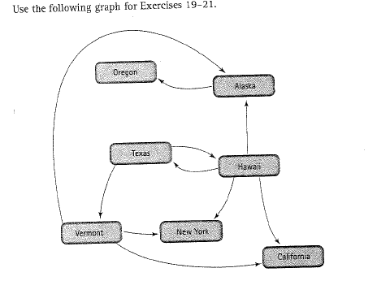
Exercises 19,21, p. 602

Slide 79
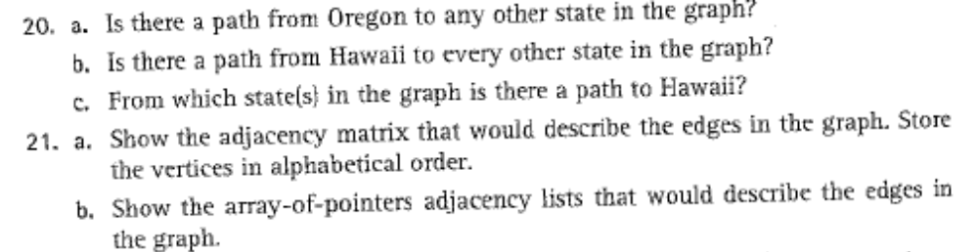
Exercises 19,21, p. 602
Using DFS/BFS, find if there is a path from
“Hawaii to Alaska“

