Slide 1

CSS Media Queries
BY : Anjali Sharma

Slide 2
Media Query
Using Media queries, you can apply CSS based on the device type (e.g., printers, TVs) and media features (e.g., viewport width).
Syntax :
@media media-type and (media-feature-expression)
{
/* CSS rules go here */
}

Slide 3
Media Types
Media types describe the general category of devices.
Possible types of media are:
Screen - For all Screened devices (mobiles, laptops, tablets, etc.)
print- For Printers.
tv- For Televisions.
all- Matches all types of devices and more...
If the media type is not declared, it will default to all.

Slide 4
Media Features
Using Media Features, we can write Media Query for a specific feature(s).
width, min-width, max-width
height, min-height, max-height
orientation and more..
Orientation :
The two most common types of orientation are:
Landscape - The width of the device is greater than the height.
portrait- The height of the device is greater than the width.

Slide 5
Combining Multiple Media Features
and : can combine multiple Media Features.
Syntax :
@media (media-feature-expression) and (media-feature-expression) {
/* CSS rules go here */
}
can also join media feature with a media type.
Syntax :
@media media-type and (media-feature-expression) {
/* CSS rules go here */
}
If you use and operator, only one media type for a media query can be included.

Slide 6
not : It negates the entire Media Query result..
If you use the not operator, you must also specify a media type.
Syntax :
@media not screen and (min-width: 600px) {
/* CSS rules go here */
}
Comma (,) : we can combine multiple Media Queries.
Syntax :
@media (orientation: landscape), (min-width: 600px) {
.bg-container {
background: yellowgreen;
}
}

Slide 7
CSS Grid
CSS Grid is a 2-dimensional layout system that lets you arrange content in rows and columns. It gives you full control over layout without using floats or flex hacks.
SYNTAX : →
.container {
display: grid;
}

Slide 8
Defining Columns and Rows
Use grid-template-columns and grid-template-rows to define the number and size of columns and rows.
.container {
display: grid;
grid-template-columns: 200px 200px; /* Two columns */
grid-template-rows: 100px 100px; /* Two rows */
}
You can use units like :
fr (fractional unit) → fraction of available space.
% → Based on the parent container’s size. Makes layout fluid, but not as flexible as fr.
px → Fixed size .
auto → The column/row takes up as much space as the content needs

Slide 9
Gap Between Grid Cells
gap: 10px; or
row-gap: 10px;
column-gap: 20px;
For Multiple Columns and rows
grid-template-columns: repeat(10, 1fr);
grid-template-rows: repeat(10, 1fr);

Slide 10
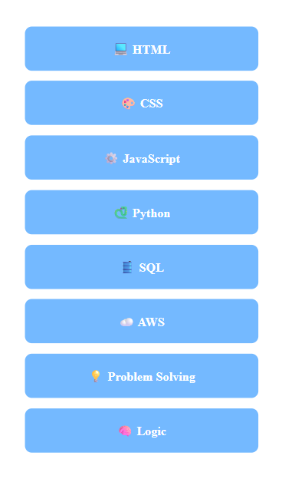
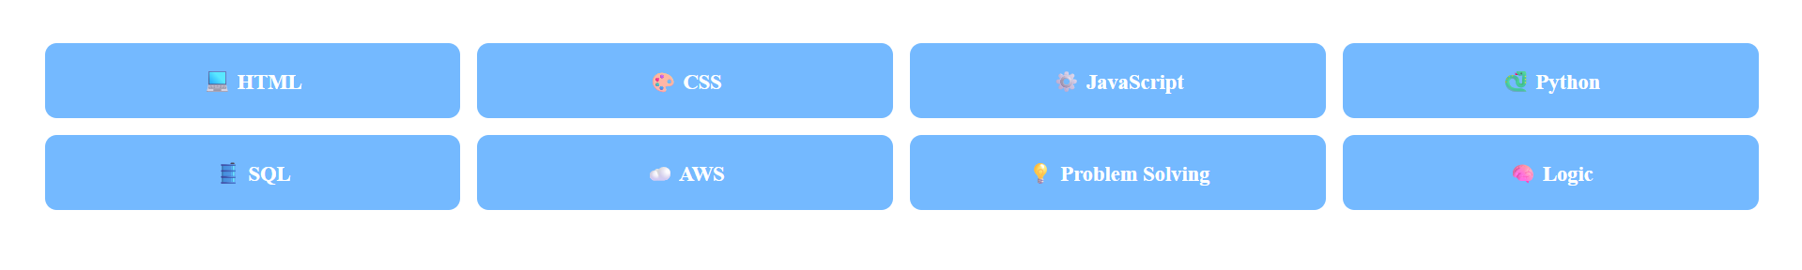
Coding Practice
Build Your Own Skill Set Control Panel :
create a responsive control panel showing their tech skills using CSS Grid and media queries , use these :
Grid layout with grid-template-columns, gap OR use flex-box
Responsive design with @media queries

Slide 11

Media query
Media type
Media feature
CSS grid
Defining columns and rows
Coding practice

Slide 12

Thank You
All the best !!

