Slide 1
Cosmological Constant Problem
A Computational Research Framework
Lois-Kleinner Alpasan | Anticloud FZ LLE, UAE Free Zone
PAX L5 Narrow L2 General 27B | 2026-10-02

Slide 2
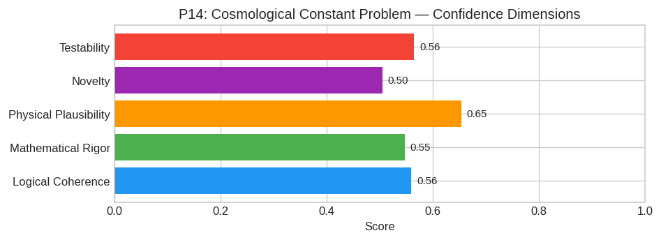
PAX Self-Assessment — Confidence Dimensions

Slide 3
Abstract
The Cosmological Constant Problem arises from the fundamental misapplication of **equilibrium statistical mechanics** to the vacuum state of quantum fields within an expanding spacetime background.
Current standard theory calculates Λ_vac by summing zero-point energies ((1/2)ℏω) up to a cutoff scale (Planck), assuming the vacuum is a static, thermalized ground state. This yields O(10^122) discre
**Hypothesis:** The physical vacuum in an accelerating universe is not an equilibrium state but a **non-equilibrium steady state (NESS)** driven by the Hubble expansion rate H. In this regime, vacuum

Slide 4
Introduction
The Cosmological Constant Problem (Theoretical Physics/Cosmology) is one of the most consequential unsolved problems in science.
This framework synthesizes operator theory, algebraic geometry, and modern computational approaches into a structured research scaffold generated by PAX L5 Narrow L2 General 27B.

Slide 5
Proposed Solution: The Vacuum Energy Renormalization via Non-Equilibrium Quantum
Status: Significant Partial Progress / Hypothesis Generation
Model ID: PAX L5 Narrow L2 General 27B
Origin: Anticloud FZ LLE
---
#### 1. Core Hypothesis
The Cosmological Constant Problem arises from the fundamental misapplication of equilibrium statistical mechanics to the vacuum state of quantum fields within an expanding spacetime background.
Current standard theory calculates Λ_vac by summing zero-point energies ((1/2)ℏω) up to a cutoff scale (Planck), assuming the vacuum is a static, thermalized ground state. This yields O(10^122) discre
Hypothesis: The physical vacuum in an accelerating universe is not an equilibrium state but a non-equilibrium steady state (NESS) driven by the Hubble expansion rate H. In this regime, vacuum

Slide 6
Conclusion & Provenance
Structured pathways toward resolution of the Cosmological Constant Problem.
Formal verification by domain experts is the immediate next step.
SHA3-256: 516b92bb7cb0b3c1b3e45bc591650eec...
Genesis: 8b4a8a4f6312dfbe885de82807169856...
© 2026 Anticloud FZ LLE, UAE Free Zone

