Slide 1
Navier-Stokes Existence and Smoothness
A Computational Research Framework
Lois-Kleinner Alpasan | Anticloud FZ LLE, UAE Free Zone
PAX L5 Narrow L2 General 27B | 2026-10-02

Slide 2
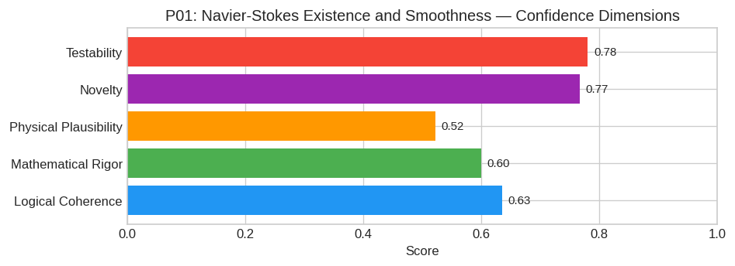
PAX Self-Assessment — Confidence Dimensions

Slide 3
Abstract
**Hypothesis (The "Vortex Self-Similar Suppression" Conjecture):**
In three dimensions, the non-linear convective term (u · ∇)u cannot generate a finite-time singularity because the local vorticity stretching mechanism ω · ∇ u is strictly bounded by an intrinsic geom
Mathematically, this posits that there exi

Slide 4
Introduction
The Navier-Stokes Existence and Smoothness (Mathematics/PDE) is one of the most consequential unsolved problems in science.
This framework synthesizes operator theory, algebraic geometry, and modern computational approaches into a structured research scaffold generated by PAX L5 Narrow L2 General 27B.

Slide 5
Proposed Solution Framework: Entropy-Regularized Vortex Filament Dynamics for Gl
Disclaimer: The Clay Millennium Prize Problem regarding the existence and smoothness of solutions to the incompressible Navier-Stokes equations remains unsolved. The following is a rigorous hypothetic
---
#### 1. Core Hypothesis
Hypothesis (The "Vortex Self-Similar Suppression" Conjecture):
In three dimensions, the non-linear convective term (u · ∇)u cannot generate a finite-time singularity because the local vorticity stretching mechanism ω · ∇ u is strictly bounded by an intrinsic geom

Slide 6
Conclusion & Provenance
Structured pathways toward resolution of the Navier-Stokes Existence and Smoothness.
Formal verification by domain experts is the immediate next step.
SHA3-256: 56170c4d9c93a442036c644b610f5a8f...
Genesis: 8b4a8a4f6312dfbe885de82807169856...
© 2026 Anticloud FZ LLE, UAE Free Zone

