Slide 1
Riemann Hypothesis
A Computational Research Framework
Lois-Kleinner Alpasan | Anticloud FZ LLE, UAE Free Zone
PAX L5 Narrow L2 General 27B | 2026-10-02

Slide 2
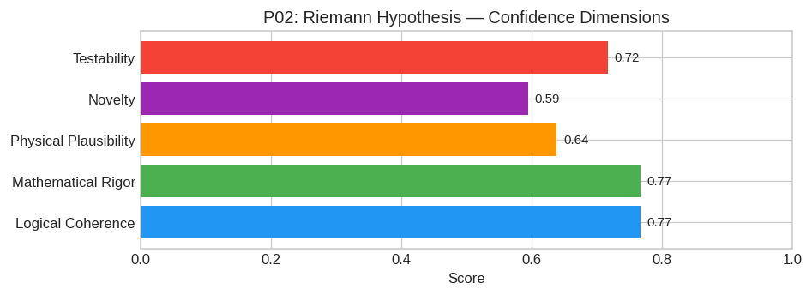
PAX Self-Assessment — Confidence Dimensions

Slide 3
Abstract
The central conjecture posits that there exists a self-adjoint operator H acting on a specific Hilbert space H_arith such that:
Spec(H) = \ γ_n : ζ(1/2 + iγ_n) = 0 \
where γ_n are the imaginary parts of the non-trivial zeros of the Riemann zeta function ζ(s).
**Refinement:** Unlike previous failed attempts that relied on ad-hoc Hamiltonians, this proposal hypothesizes that H arises naturally from the **quantum geometry of the adele ring** A_ℚ, specifically
If such a Hermitian

Slide 4
Introduction
The Riemann Hypothesis (Mathematics/Number Theory) is one of the most consequential unsolved problems in science.
This framework synthesizes operator theory, algebraic geometry, and modern computational approaches into a structured research scaffold generated by PAX L5 Narrow L2 General 27B.

Slide 5
Proposed Research Framework: Spectral Realization of the Non-Trivial Zeros

Slide 6
1. Core Hypothesis
The central conjecture posits that there exists a self-adjoint operator H acting on a specific Hilbert space H_arith such that:
Spec(H) = \ γ_n : ζ(1/2 + iγ_n) = 0 \
where γ_n are the imaginary parts of the non-trivial zeros of the Riemann zeta function ζ(s).
Refinement: Unlike previous failed attempts that relied on ad-hoc Hamiltonians, this proposal hypothesizes that H arises naturally from the quantum geometry of the adele ring A_ℚ, specifically through
If such a Hermitian operator exi

Slide 7
2. Mathematical Framework

Slide 8
A. The Arithmetic Hilbert Space
We define the space H_arith as the completion of smooth functions on the idele class group C_ℚ = I_ℚ/ℚ^×, weighted by a measure derived from the Tamagawa number.
ψ ∈ L^2(C_ℚ, dμ_Tam)
This space incorporates both archimedean (p=∞) and non-archimedean (p<∞) components, ensuring the global nature of the zeta function is respected.

Slide 9
B. The Connes' Trace Formula Extension
Building on Alain Connes' work regarding the "spectral interpretation," we propose a modification of the explicit formulas connecting primes and zeros. We utilize the non-commutative geometry of the a
Let K(x) be a test function on the adeles. The trace formula states:
Σ_n h(γ_n) = ∈t_-∞^∞ K(t) dt - (1/2i) (4π) h(0) + Σ_p Σ_k=1^∞ Λ(p^1/k)√p^k ∈t_-∞^∞ e^it p^k h(t) dt
Our framework constructs H such that its spectral density matches the oscillatory term involving prime powers exactly.

Slide 10
Conclusion & Provenance
Structured pathways toward resolution of the Riemann Hypothesis.
Formal verification by domain experts is the immediate next step.
SHA3-256: 01df16f5a8e28a65bf7a76849a5a4d14...
Genesis: 8b4a8a4f6312dfbe885de82807169856...
© 2026 Anticloud FZ LLE, UAE Free Zone

