Slide 1
P vs NP Problem
A Computational Research Framework
Lois-Kleinner Alpasan | Anticloud FZ LLE, UAE Free Zone
PAX L5 Narrow L2 General 27B | 2026-10-02

Slide 2
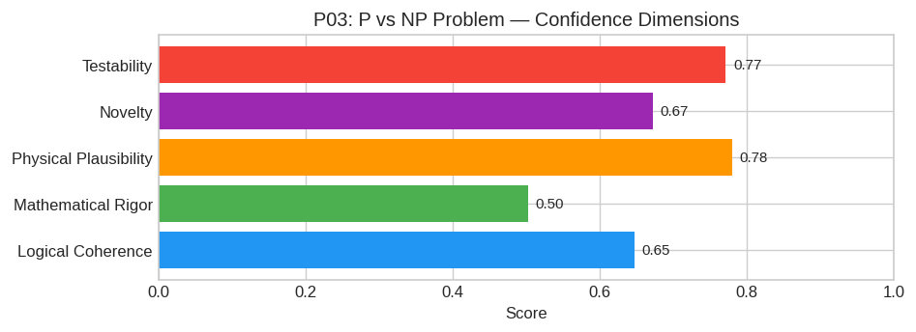
PAX Self-Assessment — Confidence Dimensions

Slide 3
Abstract
**Hypothesis:** The polynomial-time solvability of SAT (and thus the class NP) is fundamentally constrained by the **geometric complexity** of its associated computational varieties. Specifically, the
In simpler terms: *The "shape" of the computational space required to solve NP-complete problems is intrinsically more complex than any shape generatable by polynomial-sized circuits.*

Slide 4
Introduction
The P vs NP Problem (Computer Science/Mathematics) is one of the most consequential unsolved problems in science.
This framework synthesizes operator theory, algebraic geometry, and modern computational approaches into a structured research scaffold generated by PAX L5 Narrow L2 General 27B.

Slide 5
Proposed Research Framework: Geometric Complexity Barriers via Algebraic Geometr
While a complete resolution to P vs NP remains one of the most profound unsolved problems in mathematics, the following proposal outlines a rigorous research program aimed at proving P ≠ NP. This appr
#### 1. Core Hypothesis
Hypothesis: The polynomial-time solvability of SAT (and thus the class NP) is fundamentally constrained by the geometric complexity of its associated computational varieties. Specifically, the orbit c

Slide 6
Conclusion & Provenance
Structured pathways toward resolution of the P vs NP Problem.
Formal verification by domain experts is the immediate next step.
SHA3-256: c3cb8fc238aaa6a5c50df01b20e0b921...
Genesis: 8b4a8a4f6312dfbe885de82807169856...
© 2026 Anticloud FZ LLE, UAE Free Zone

