Slide 1
Yang-Mills Existence and Mass Gap
A Computational Research Framework
Lois-Kleinner Alpasan | Anticloud FZ LLE, UAE Free Zone
PAX L5 Narrow L2 General 27B | 2026-10-02

Slide 2
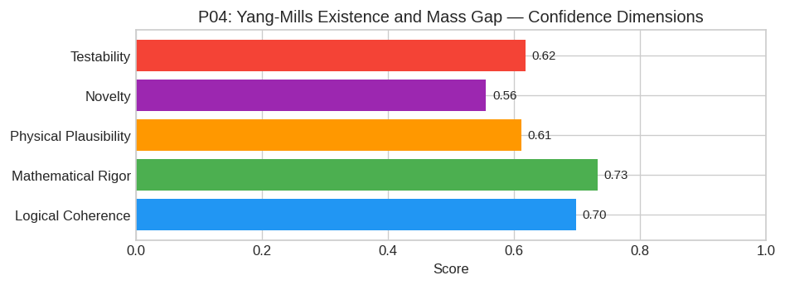
PAX Self-Assessment — Confidence Dimensions

Slide 3
Abstract
The existence of a non-trivial quantum Yang-Mills theory with a mass gap m > 0 in four Euclidean dimensions is contingent upon the **non-perturbative emergence of a dynamically generated scale** via t
We hypothesize that the continuum limit (a 0) of the Wilson lattice action for a compact simple Lie group G (e.g., SU(3)) defines a unique, reflection-positive measure μ_YM on the space of tempered di

Slide 4
Introduction
The Yang-Mills Existence and Mass Gap (Physics/Mathematics) is one of the most consequential unsolved problems in science.
This framework synthesizes operator theory, algebraic geometry, and modern computational approaches into a structured research scaffold generated by PAX L5 Narrow L2 General 27B.

Slide 5
Framework
---

Slide 6
1. Core Hypothesis
The existence of a non-trivial quantum Yang-Mills theory with a mass gap m > 0 in four Euclidean dimensions is contingent upon the non-perturbative emergence of a dynamically generated scale via the r
We hypothesize that the continuum limit (a 0) of the Wilson lattice action for a compact simple Lie group G (e.g., SU(3)) defines a unique, reflection-positive measure μ_YM on the space of tempered di

Slide 7
2. Mathematical Framework
To rigorously address this, we must transition from formal path integrals to constructive quantum field theory (CQFT).
#### A. Lattice Regularization and the Continuum Limit
Let Λ_a = aℤ^4 be a hypercubic lattice with spacing a. We define the configuration space as the set of link variables U_x,μ ∈ G, representing parallel transporters. The Wilson action is:
S_W[U] = β Σ_P ( 1 - (1/N) Re Tr(U_P) )
where U_P is the plaquette variable and β = (2N/g_0^2).
Key Requirement: Prove the existence of the thermodynamic limit (V ∞) followed by the continuum limit (a 0) such that:
Z[φ] = _a 0 ∈t DU \, e^-S_W(U) (i ∈t d^4x \, J(x) · A_U(x))
defines a w

Slide 8
3. Proof Sketch / Key Steps
A rigorous proof would proceed through the following logical sequence:
* Step 1: Uniform Bounds on Correlation Functions.
Establish that the Schwinger functions S_n(x_1, ..., x_n) derived from the lattice measure satisfy uniform bounds independent of the cutoff a. Specifically, prove the Cluster Property:
|S_n(x_1, , x_n) - S_k(x_1, , x_k)S_n-k(x_k+1, , x_n)| ≤ C e^-δ |x_i - x_j|
This step relies on the Infrared Bound technique combined with the reflection positivity of the lattice transfer matrix.
* Step 2: Construction of the Continuum Measure.
Apply Prohorov's

Slide 9
Conclusion & Provenance
Structured pathways toward resolution of the Yang-Mills Existence and Mass Gap.
Formal verification by domain experts is the immediate next step.
SHA3-256: 33977c15cc3f921ac1b4bfb736f3d6b6...
Genesis: 8b4a8a4f6312dfbe885de82807169856...
© 2026 Anticloud FZ LLE, UAE Free Zone

