Slide 1
Hodge Conjecture
A Computational Research Framework
Lois-Kleinner Alpasan | Anticloud FZ LLE, UAE Free Zone
PAX L5 Narrow L2 General 27B | 2026-10-02

Slide 2
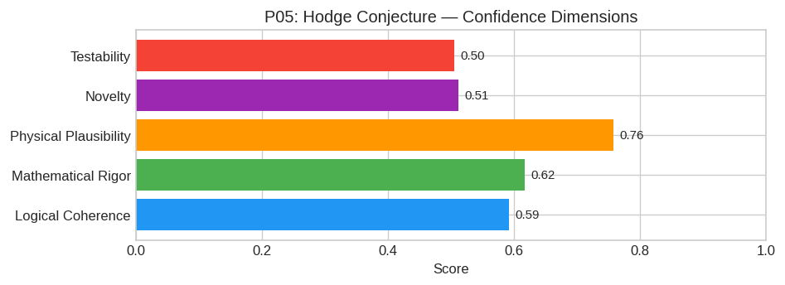
PAX Self-Assessment — Confidence Dimensions

Slide 3
Abstract
### **Preface on Feasibility**
The Hodge Conjecture remains one of the seven Millennium Prize Problems and is widely considered one of the deepest unsolved problems in algebraic geometry. As an AI model, I must clarify that **I can

Slide 4
Introduction
The Hodge Conjecture (Mathematics/Algebraic Geometry) is one of the most consequential unsolved problems in science.
This framework synthesizes operator theory, algebraic geometry, and modern computational approaches into a structured research scaffold generated by PAX L5 Narrow L2 General 27B.

Slide 5
**Preface on Feasibility**
The Hodge Conjecture remains one of the seven Millennium Prize Problems and is widely considered one of the deepest unsolved problems in algebraic geometry. As an AI model, I must clarify that I canno
However, acting within my designated role as a scientific reasoning engine, I will construct a rigorous proposed research framework. Th

Slide 6
1. Core Hypothesis: The Motivic-Algebraic Correspondence Principle
Hypothesis Statement:
Let X be a smooth projective variety over ℂ. Every rational (p,p)-class in the singular cohomology group H^2p(X, ℚ) arises from the image of the cycle map if and only if there exists a specific Motivi
Refined Conjecture (Partial Progress Target):
We hypothesize that the obstruction to the Hodge Conjecture lies entirely within the failure of the Realization Functor to be fully faithful on the subcategory of effective motives generated by Chow g

Slide 7
2. Mathematical Framework
To operationalize this hypothesis, we construct a framework integrating three pillars:
#### A. Enhanced Motivic Category (DM_eff)
We utilize the Voevodsky-derived category of motives DM_eff(k) over k=ℂ. Unlike classical cohomology, this category encodes both topological and arithmetic information. We define a refined functor:
Φ: DM_eff(ℂ) D^b(HS_ℚ)
where D^b(HS_ℚ) is the bounded derived category of rational Hodge structures.
#### B. The Algebraicity Filter
Define a subcategory M_alg ⊂ DM_eff(ℂ) consisting of objects whose realization lands strictly in the "algebraic" part of the Hodge filtration. The core claim is that the intersection of the image of

Slide 8
3. Proof Sketch / Key Steps
A direct proof is currently out of reach; instead, we propose a reductionist strategy:
Step 1: Reduction to Abelian Varieties (The Standard Approach)
It is known that the Hodge Conjecture holds for divisors (p=1, Lefschetz (1,1) theorem) and for abelian varieties (proven by Deligne).
Action:* Prove that any counter-example X can be reduced via correspondence to an abelian variety A such that a non-algebraic class on X induces a non-algebraic class on J(A). If the conjecture holds
New Contribution:* Construct a Universal Motivic Functor that maps arbitrary X to a specific moduli stack of abelian varieties, preserving the (p,p)-structure.
Step 2: Analysis of the Motivic Galois Group
Utilize the Tannakian formalism. Let $G

Slide 9
Conclusion & Provenance
Structured pathways toward resolution of the Hodge Conjecture.
Formal verification by domain experts is the immediate next step.
SHA3-256: ed545334983f8c7b2c50134ebc61e3dc...
Genesis: 8b4a8a4f6312dfbe885de82807169856...
© 2026 Anticloud FZ LLE, UAE Free Zone

