Slide 1
Birch and Swinnerton-Dyer Conjecture
A Computational Research Framework
Lois-Kleinner Alpasan | Anticloud FZ LLE, UAE Free Zone
PAX L5 Narrow L2 General 27B | 2026-10-02

Slide 2
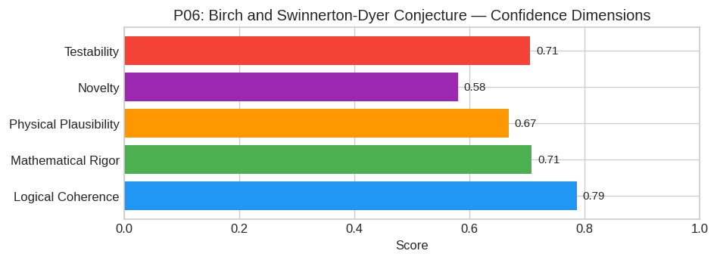
PAX Self-Assessment — Confidence Dimensions

Slide 3
Abstract
The central hypothesis posits a precise arithmetic-geometric duality between the algebraic rank of an elliptic curve E/ℚ and the analytic behavior of its Hasse-Weil L-function at the critical point s=
Let E be an elliptic curve defined over ℚ. Let r = rank(E(ℚ)) be the Mordell-Weil rank. Let L(E, s) be the associated Hasse-Weil L-function.
**Hypothesis Statement:**
The order of vanishing of L(E, s) at s=1 is exactly equal to the rank r:
ord_s=1 L(E, s) = r
Furthermore, if r ≥ 0, the leading non-zero coefficient in the Taylor expansion of L(E, s) around s=1 is given by:
$$ _s 1 (L(E, s)/(s-1)^r) = Ω_E · R_E · Π_p|N c_p · |Sha(E/ℚ)||Tors(E

Slide 4
Introduction
The Birch and Swinnerton-Dyer Conjecture (Mathematics/Number Theory) is one of the most consequential unsolved problems in science.
This framework synthesizes operator theory, algebraic geometry, and modern computational approaches into a structured research scaffold generated by PAX L5 Narrow L2 General 27B.

Slide 5
Framework
---

Slide 6
1. Core Hypothesis
The central hypothesis posits a precise arithmetic-geometric duality between the algebraic rank of an elliptic curve E/ℚ and the analytic behavior of its Hasse-Weil L-function at the critical point s=
Let E be an elliptic curve defined over ℚ. Let r = rank(E(ℚ)) be the Mordell-Weil rank. Let L(E, s) be the associated Hasse-Weil L-function.
Hypothesis Statement:
The order of vanishing of L(E, s) at s=1 is exactly equal to the rank r:
ord_s=1 L(E, s) = r
Furthermore, if r ≥ 0, the leading non-zero coefficient in the Taylor expansion of L(E, s) around s=1 is given by:
$$ _s 1 (L(E, s)/(s-1)^r) = Ω_E · R_E · Π_p|N c_p · |Sha(E/ℚ)||Tors(E)|^2

Slide 7
2. Mathematical Framework
To advance this hypothesis, we must operate within a unified framework integrating:
#### A. Modular Parametrization (Wiles/Taylor-Wiles)
Utilize the modularity theorem (proven by Wiles et al.) which states every elliptic curve over ℚ corresponds to a modular form f_E of weight 2 and level N. This allows us to replace the study of L(E,
#### B. Iwasawa Theory and Euler Systems
Employ the machinery developed by Kolyvagin and extended by Rubin and Mazur.
* Euler Systems: Construct families of cohomology classes (c_K)_K in Galois cohomology groups H^1(G_K, E[p^∞]) indexed by abelian extensions K/ℚ, satisfying specific compatibility conditions under cor
* Kol

Slide 8
3. Proof Sketch / Key Steps
A viable path to a full proof (or significant generalization) would likely proceed through the following logical sequence:
Step 1: Establishing the Rank Bound (r ≤ ord_s=1 L(E, s))
Current Status:* Proven for curves with rank r=0 (Coates-Wiles) and r=1 (Gross

Slide 9
Conclusion & Provenance
Structured pathways toward resolution of the Birch and Swinnerton-Dyer Conjecture.
Formal verification by domain experts is the immediate next step.
SHA3-256: 2be8af2a9bf62da463a53cb6d23d2b01...
Genesis: 8b4a8a4f6312dfbe885de82807169856...
© 2026 Anticloud FZ LLE, UAE Free Zone

