Slide 1
Dark Matter Composition
A Computational Research Framework
Lois-Kleinner Alpasan | Anticloud FZ LLE, UAE Free Zone
PAX L5 Narrow L2 General 27B | 2026-10-02

Slide 2
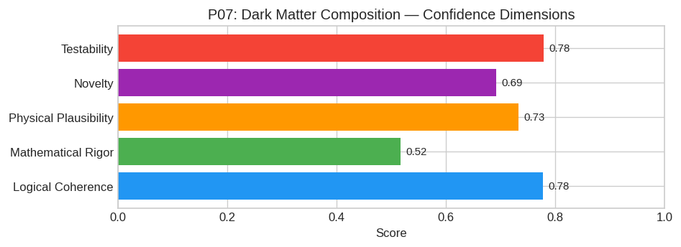
PAX Self-Assessment — Confidence Dimensions

Slide 3
Abstract
The Dark Matter (DM) sector is not composed of a single species of Weakly Interacting Massive Particle (WIMP), but rather a composite system dominated by **ultra-light axion-like particles (ALPs)** co
Specifically, we hypothesize that at galactic scales, the ALP field undergoes Bose-Einstein Condensation (BEC), forming macroscopic quantum states (fuzzy dark matter halos), while the self-interacting

Slide 4
Introduction
The Dark Matter Composition (Astrophysics/Cosmology) is one of the most consequential unsolved problems in science.
This framework synthesizes operator theory, algebraic geometry, and modern computational approaches into a structured research scaffold generated by PAX L5 Narrow L2 General 27B.

Slide 5
Proposed Solution: The "Axion-Boson Condensate with Self-Interacting Scalar Sect

Slide 6
1. Core Hypothesis
The Dark Matter (DM) sector is not composed of a single species of Weakly Interacting Massive Particle (WIMP), but rather a composite system dominated by ultra-light axion-like particles (ALPs) couple
Specifically, we hypothesize that at galactic scales, the ALP field undergoes Bose-Einstein Condensation (BEC), forming macroscopic quantum states (fuzzy dark matter halos), while the self-interacting

Slide 7
2. Mathematical Framework
We define the Lagrangian density L_DM in a Friedmann-Lemaître-Robertson-Walker (FLRW) background as the sum of an axionic sector φ and a scalar mediator S:
L_DM = (1/2)(∂_μ φ)(∂^μ φ) - V_axion(φ) + (1/2)(∂_μ S)(∂^μ S) - V_scalar(S) - λ_int φ^2 S

Slide 8
A. Potential Definitions
1. Axion Potential (Periodic):
V_axion(φ) = m_a^2 f_a^2 [ 1 - ((φ/f_a)) ] ≈ (1/2)m_a^2 φ^2 (for φ f_a)
Where m_a ~ 10^-22 eV (Fuzzy regime) and f_a is the decay constant.
2. Scalar Potential (Self-Interaction):
V_scalar(S) = (1/2)m_S^2 S^2 + (κ/4!) S^4
Here, m_S allows for Yukawa-type interactions on galactic scales.

Slide 9
B. Evolution Equations
In the non-relativistic limit appropriate for late-time structure formation, the dynamics are governed by the Gross-Pitaevskii-Poisson (GPP) system extended for two fields:
iℏ (∂ ψ/∂ t) = ( -(ℏ^2/2m_a) ∇^2 + m_a Φ + g |ψ|^2 ) ψ
∇^2 Φ = 4π G m_a |ψ|^2 + 4π G ρ_S
Where ψ represents the wavefunction of the condensed axions (|ψ|^2 = ρ_a), g represents the effective self-coupling derived from the interaction term, and ρ_S is the density contribution from the scal
The de Broglie wavelength sets the core scale:
λ_J ≈ (ℏ/m_a σ_v) ∝ √(1/G ρ)
For m_a ~ 10^-22 eV, λ_J ~ kpc, naturally smoothing out sub

Slide 10
Conclusion & Provenance
Structured pathways toward resolution of the Dark Matter Composition.
Formal verification by domain experts is the immediate next step.
SHA3-256: ab1ee372454e3074516361a0cd825758...
Genesis: 8b4a8a4f6312dfbe885de82807169856...
© 2026 Anticloud FZ LLE, UAE Free Zone

