Slide 1
Quantum Gravity Unification
A Computational Research Framework
Lois-Kleinner Alpasan | Anticloud FZ LLE, UAE Free Zone
PAX L5 Narrow L2 General 27B | 2026-10-02

Slide 2
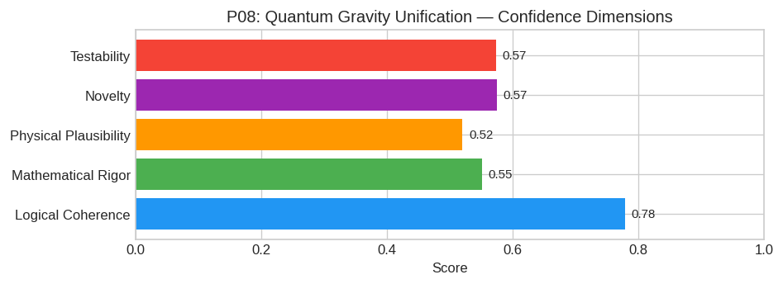
PAX Self-Assessment — Confidence Dimensions

Slide 3
Abstract
### Executive Summary
Current approaches to Quantum Gravity (QG), primarily String Theory and Loop Quantum Gravity (LQG), face distinct impasses regarding the recovery of classical spacetime geometry from non-geometric qua

Slide 4
Introduction
The Quantum Gravity Unification (Theoretical Physics) is one of the most consequential unsolved problems in science.
This framework synthesizes operator theory, algebraic geometry, and modern computational approaches into a structured research scaffold generated by PAX L5 Narrow L2 General 27B.

Slide 5
Executive Summary
Current approaches to Quantum Gravity (QG), primarily String Theory and Loop Quantum Gravity (LQG), face distinct impasses regarding the recovery of classical spacetime geometry from non-geometric qua
---

Slide 6
1. Core Hypothesis: Emergent Spacetime via Entanglement Renormalization
Hypothesis: General Relativity (GR) is the low-energy effective description of a unitary, asymptotically safe quantum field theory defined on a pre-geometric lattice (or tensor network). The metric g_
Key Distinction: Unlike AdS/CFT which relies on a specific large-N limit and negative cosmological constant, this hypothesis asserts that any* 4D QFT satisfying asymptotic safety conditions will gene

Slide 7
2. Mathematical Framework: The ASHE Formalism
The framework integrates Functional Renormalization Group (FRG) methods with Tensor Network states.
#### A. The Master Equation for Entanglement Flow
Let ρ_A be the reduced density matrix of a region A. We define the emergent line element ds^2 via the variation of the modular Hamiltonian K = - ρ_A:
ds^2 = α δ S_EEδ R(A)
Where:
* S_EE = -Tr(ρ_A ρ_A) is the Entanglement Entropy.
* R(A) represents the geometric deformation of the boundary ∂ A.
* α is a coupling determined by the UV fixed point values of the underlying theory's beta functions.
#### B. The Asymptotic Safety Condition
We utilize the Wetterich equation for the Effective Average Action Γ_k[g, φ] at scale

Slide 8
3. Proof Sketch / Key Steps
To validate this framework, the following logical progression must be established:
Step 1: Existence of the NGFP in Matter-Coupled Systems
Action:* Extend existing FRG truncations (e.g., E_n expansions) to include full Standard Model matter content coupled to gravity.
Goal: Demonstrate analytically or numerically that the inclusion of chiral fermions and non-Abelian gauge fields does not destroy the NGFP, but rather shifts its coordinates to physically viable valu
Step 2: Derivation of the Linearized Einstein Equations
Action:* Construct a discrete tensor network state representing the vacuum of the UV fixed point theory. Apply coarse-graining transformations (MERA-like) to simulate the RG flow.
Goal:* Show that infinitesimal perturbations

Slide 9
Conclusion & Provenance
Structured pathways toward resolution of the Quantum Gravity Unification.
Formal verification by domain experts is the immediate next step.
SHA3-256: 264281f047ea3c30ffe08c771c48f27a...
Genesis: 8b4a8a4f6312dfbe885de82807169856...
© 2026 Anticloud FZ LLE, UAE Free Zone

