Slide 1
Origin of Matter-Antimatter Asymmetry
A Computational Research Framework
Lois-Kleinner Alpasan | Anticloud FZ LLE, UAE Free Zone
PAX L5 Narrow L2 General 27B | 2026-10-02

Slide 2
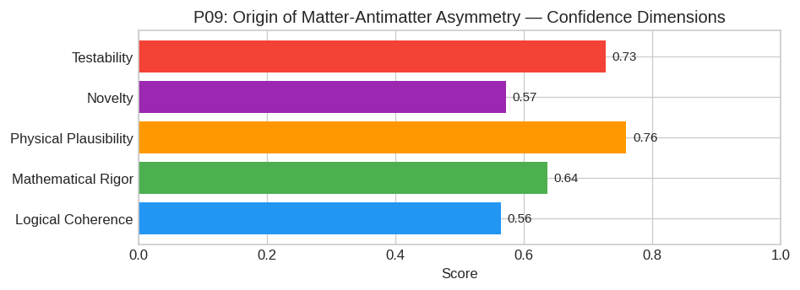
PAX Self-Assessment — Confidence Dimensions

Slide 3
Abstract
The observed matter-antimatter asymmetry (Y_B ≈ 8.6 × 10^-11) arises from **High-Scale Thermal Leptogenesis**, driven by the decay of heavy right-handed Majorana neutrinos (N_R) in the early universe.
1. **Baryon Number Violation:** Induced indirectly via non-perturbative electroweak sphalerons converting lepton number violation into baryon number.
2. **C and CP Violation:** Generated by complex phases in the Yukawa coupling matrix connecting L, H, and N_R.
3. **Departure from Thermal Equilibrium:** Achieved because the decay rate of the lightest heavy neutrino (Γ_N_1) is slower than the Hubble expansion rate (H) at temperature T ~ M_1.
*Refinement:* We propose that the specific hierarchy of

Slide 4
Introduction
The Origin of Matter-Antimatter Asymmetry (Particle Physics/Cosmology) is one of the most consequential unsolved problems in science.
This framework synthesizes operator theory, algebraic geometry, and modern computational approaches into a structured research scaffold generated by PAX L5 Narrow L2 General 27B.

Slide 5
1. Core Hypothesis
The observed matter-antimatter asymmetry (Y_B ≈ 8.6 × 10^-11) arises from High-Scale Thermal Leptogenesis, driven by the decay of heavy right-handed Majorana neutrinos (N_R) in the early universe. Thi
1. Baryon Number Violation: Induced indirectly via non-perturbative electroweak sphalerons converting lepton number violation into baryon number.
2. C and CP Violation: Generated by complex phases in the Yukawa coupling matrix connecting L, H, and N_R.
3. Departure from Thermal Equilibrium: Achieved because the decay rate of the lightest heavy neutrino (Γ_N_1) is slower than the Hubble expansion rate (H) at temperature T ~ M_1.
Refinement: We propose that the specific hierarchy of neutrino masses (N

Slide 6
2. Mathematical Framework
The dynamics are governed by the Type-I Seesaw Lagrangian extension to the Standard Model (SM):
L_SSM = L_SM - (1/2) (N_R)^c M_R N_R - (L_i Y_ij φ N_Rj + h.c.)
Where:
* L_i: SM lepton doublet (i=1,2,3).
φ = iσ_2 φ^: Conjugated Higgs doublet.
* Y_ij: Complex Yukawa coupling matrix.
* M_R = diag(M_1, M_2, M_3): Heavy Majorana mass matrix (M_1 < M_2 < M_3).
Key Quantities:
1. CP Asymmetry Parameter (ε_1): The net lepton asymmetry produced per decay of N_1 (the lightest heavy neutrino). At one-loop level, this involves interference between tree-level and loop diagrams (v
$$ ε_1 = 18

Slide 7
3. Proof Sketch / Key Steps
To demonstrate that this framework yields the observed Y_B:
Step 1: Establishing Non-Equilibrium Dynamics
Calculate the decay width Γ_N_1 = (Y^ Y)_11 M_18π. Compare against the Hubble parameter in the radiation-dominated era: H(T) ≈ 1.66 g_*^1/2 T^2 / M_Pl.
Condition: For successful leptogenesis, we require the effective decay parameter $K ≡ Γ_N_1 / (1.66 g_*

Slide 8
Conclusion & Provenance
Structured pathways toward resolution of the Origin of Matter-Antimatter Asymmetry.
Formal verification by domain experts is the immediate next step.
SHA3-256: e9c64be907f48cd48b3dcd1944888cbd...
Genesis: 8b4a8a4f6312dfbe885de82807169856...
© 2026 Anticloud FZ LLE, UAE Free Zone

