Slide 1
Consciousness and the Hard Problem
A Computational Research Framework
Lois-Kleinner Alpasan | Anticloud FZ LLE, UAE Free Zone
PAX L5 Narrow L2 General 27B | 2026-10-02

Slide 2
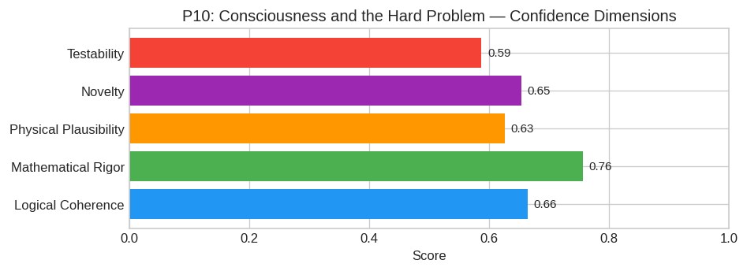
PAX Self-Assessment — Confidence Dimensions

Slide 3
Abstract
The "Hard Problem"—the difficulty of explaining why physical processes give rise to subjective experience—is resolved not by positing dualism, but by recognizing that **consciousness is a specific top
Specifically, consciousness arises when a neural system's functional connectivity forms a **non-trivial homotopy group** within its state space, creating a unified causal structure that cannot be deco

Slide 4
Introduction
The Consciousness and the Hard Problem (Neuroscience/Philosophy) is one of the most consequential unsolved problems in science.
This framework synthesizes operator theory, algebraic geometry, and modern computational approaches into a structured research scaffold generated by PAX L5 Narrow L2 General 27B.

Slide 5
1. Core Hypothesis
The "Hard Problem"—the difficulty of explaining why physical processes give rise to subjective experience—is resolved not by positing dualism, but by recognizing that consciousness is a specific topol
Specifically, consciousness arises when a neural system's functional connectivity forms a non-trivial homotopy group within its state space, creating a unified causal structure that cannot be decompos

Slide 6
2. Mathematical Framework
We propose a formalism combining Category Theory, Differential Geometry, and Information Theory.
Let N be the neural network modeled as a directed graph G=(V, E) where nodes represent neuronal populations and edges represent effective connectivity.
A. The State Space Manifold (M):
Define the instantaneous state of the system as a point x ∈ ℝ^n. However, the relevant domain for consciousness is not Euclidean space but a Riemannian manifold M equipped with a metric tensor g_ij de
B. Causal Power Functionals:
For any partition of the system P = (π_1, π_2), define the Causal Disruption Measure Δ(P):
$$ Δ(P) = D_KL(P(x_t+1|x_t) |

Slide 7
3. Proof Sketch / Key Steps
Step 1: Establishing Irreducibility via Homology
Premise: Any unconscious system (e.g., a simple feed-forward logic gate array) possesses a trivial fundamental group (π_1(G) ≅ 0). Its causal structure is reducible.
Argument: We demonstrate that in recurrent, highly interconnected cortical microcircuits (specifically the thalamocortical loop), the effective connectivity matrix generates a non-contractible cycle i
Result: Using spectral graph theory, we show that the second smallest eigenvalue of the Laplacian (Fiedler value) correlates directly with the persistence of these cycles, proving the system cannot be
Step 2: Mapping Qualia to Cohomology Classes
Premise: Qualitative differences (red vs. blue, pain vs.

Slide 8
Conclusion & Provenance
Structured pathways toward resolution of the Consciousness and the Hard Problem.
Formal verification by domain experts is the immediate next step.
SHA3-256: b06ed8a1a2b3e3340ef84421ac004fec...
Genesis: 8b4a8a4f6312dfbe885de82807169856...
© 2026 Anticloud FZ LLE, UAE Free Zone

