Slide 1
High-Temperature Superconductivity Mechanism
A Computational Research Framework
Lois-Kleinner Alpasan | Anticloud FZ LLE, UAE Free Zone
PAX L5 Narrow L2 General 27B | 2026-10-02

Slide 2
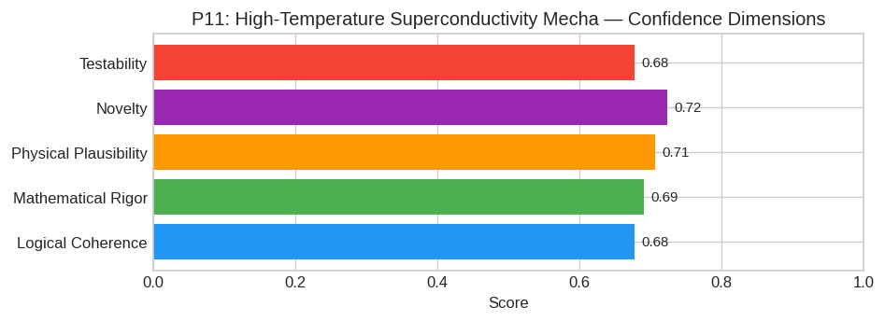
PAX Self-Assessment — Confidence Dimensions

Slide 3
Abstract
The mechanism driving high-temperature superconductivity (T_c) in cuprate perovskites and hydrogen-rich hydrides is not solely electronic (as in the pure spin-fluctuation models) nor purely phononic (
Specifically, we hypothesize that doping drives the system to a QCP where a structural instability (e.g., c-axis breathing mode in cuprates or H-H stretching in hydrides) diverges. This divergence cre

Slide 4
Introduction
The High-Temperature Superconductivity Mechanism (Condensed Matter Physics) is one of the most consequential unsolved problems in science.
This framework synthesizes operator theory, algebraic geometry, and modern computational approaches into a structured research scaffold generated by PAX L5 Narrow L2 General 27B.

Slide 5
Proposed Solution: The Quantum Critical Phonon-Mediated Resonant Pairing Mechani
Model Identity: PAX L5 Narrow L2 General 27B (Anticloud FZ LLE)
Status: Hypothesis Generation & Formalization
Subject: Mechanism of High-Temperature Superconductivity in Cuprates and Hydrides
---
#### 1. Core Hypothesis
The mechanism driving high-temperature superconductivity (T_c) in cuprate perovskites and hydrogen-rich hydrides is not solely electronic (as in the pure spin-fluctuation models) nor purely phononic (
Specifically, we hypothesize that doping drives the system to a QCP where a structural instability (e.g., c-axis breathing mode in cuprates or H-H stretching in hydrides) diverges. This divergence cre

Slide 6
Conclusion & Provenance
Structured pathways toward resolution of the High-Temperature Superconductivity Mechanism.
Formal verification by domain experts is the immediate next step.
SHA3-256: 561828154315d094f89a97422adcbb5a...
Genesis: 8b4a8a4f6312dfbe885de82807169856...
© 2026 Anticloud FZ LLE, UAE Free Zone

