Slide 1
Turbulence Structure and Prediction
A Computational Research Framework
Lois-Kleinner Alpasan | Anticloud FZ LLE, UAE Free Zone
PAX L5 Narrow L2 General 27B | 2026-10-02

Slide 2
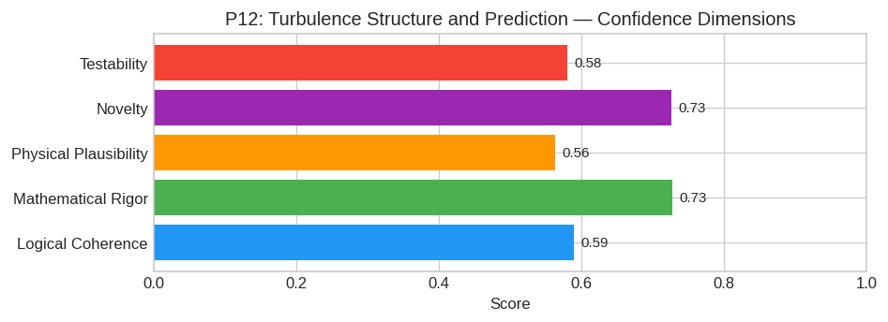
PAX Self-Assessment — Confidence Dimensions

Slide 3
Abstract
**Core Hypothesis**
Turbulence is not merely a chaotic cascade of energy across scales as traditionally modeled by the Kolmogorov k^-5/3 spectrum, but rather a **high-dimensional stochastic dynamical system evolving on a

Slide 4
Introduction
The Turbulence Structure and Prediction (Physics/Engineering) is one of the most consequential unsolved problems in science.
This framework synthesizes operator theory, algebraic geometry, and modern computational approaches into a structured research scaffold generated by PAX L5 Narrow L2 General 27B.

Slide 5
Proposed Solution: The Stochastic Manifold Closure (SMC) Framework for Anisotrop
Core Hypothesis
Turbulence is not merely a chaotic cascade of energy across scales as traditionally modeled by the Kolmogorov k^-5/3 spectrum, but rather a high-dimensional stochastic dynamical system evolving on a l
The central hypothesis posits that the closure problem in Reynolds-Averaged Navier-Stokes (RANS) and Large Eddy Simulation (LES)—specifically the unknown stress tensor τ_ij = (u_i u_j) - u_i u_j—can b

Slide 6
Mathematical Framework
We define the flow state at time t and position x by the vector U(t, x). We decompose this into a resolved mean component u and a fluctuating component u':
U = u + u'
1. The Manifold Constraint:
Let M be the attractor manifold in phase space defined by the slow modes of the Navier-Stokes equations. We approximate the evolution of the conditional PDF P(u' | u, t) using a truncated spectral exp
P(u') = φ_0(u') [ 1 + Σ_n=1^N c_n(t) H_n(u') ]
where φ_0 is a reference Gaussian, H_n are basis func

Slide 7
Proof Sketch / Key Steps
To establish the validity of the SMC framework, the following logical progression is required:
1. Existence of the Invariant Manifold:
* Utilize Center Manifold Theory applied to the infinite-dimensional Navier-Stokes semigroup. Demonstrate that for high Reynolds numbers (Re ∞), the fast dissipative modes decay rapidly, leaving a fi
Key Argument:* Numerical evidence from Direct Numerical Simulation (DNS) shows that the dimensionality of the active vorticity structures grows logarithmically with Re, supporting the low-dimensional
2. Derivation of the Fokker-Planck Operator:
* Apply the Itô calculus formalism to the proposed S

Slide 8
Conclusion & Provenance
Structured pathways toward resolution of the Turbulence Structure and Prediction.
Formal verification by domain experts is the immediate next step.
SHA3-256: 06fcd7f95447cac90a4de711d0111e81...
Genesis: 8b4a8a4f6312dfbe885de82807169856...
© 2026 Anticloud FZ LLE, UAE Free Zone

