Slide 1
Protein Misfolding Diseases Mechanism
A Computational Research Framework
Lois-Kleinner Alpasan | Anticloud FZ LLE, UAE Free Zone
PAX L5 Narrow L2 General 27B | 2026-10-02

Slide 2
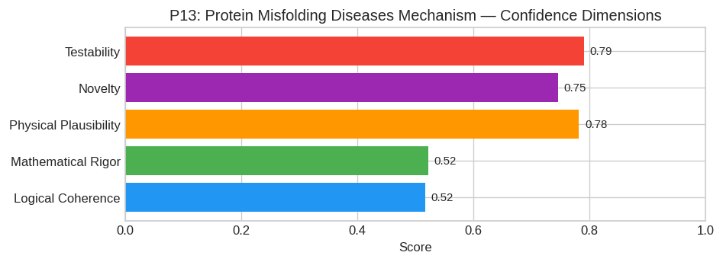
PAX Self-Assessment — Confidence Dimensions

Slide 3
Abstract
Protein misfolding diseases (e.g., Alzheimer's, Parkinson's, Prion diseases) do not arise solely from thermodynamic instability of the native state (N) versus an aggregated state (A), nor purely from
The central thesis is that disease pathology is driven by a **non-equilibrium phase transition** initiated by the nucleation of a metastable oligomeric intermediate (I^*) characterized by a distinct β

Slide 4
Introduction
The Protein Misfolding Diseases Mechanism (Biochemistry/Medicine) is one of the most consequential unsolved problems in science.
This framework synthesizes operator theory, algebraic geometry, and modern computational approaches into a structured research scaffold generated by PAX L5 Narrow L2 General 27B.

Slide 5
Proposed Solution: The Stochastic Topological Funnel with Kinetic Trapping (STFK
#### 1. Core Hypothesis
Protein misfolding diseases (e.g., Alzheimer's, Parkinson's, Prion diseases) do not arise solely from thermodynamic instability of the native state (N) versus an aggregated state (A), nor purely from
The central thesis is that disease pathology is driven by a non-equilibrium phase transition initiated by the nucleation of a metastable oligomeric intermediate (I^) characterized by a distinct β-shee

Slide 6
Conclusion & Provenance
Structured pathways toward resolution of the Protein Misfolding Diseases Mechanism.
Formal verification by domain experts is the immediate next step.
SHA3-256: 0bf72f49573b61258155038b68573809...
Genesis: 8b4a8a4f6312dfbe885de82807169856...
© 2026 Anticloud FZ LLE, UAE Free Zone

