Slide 1
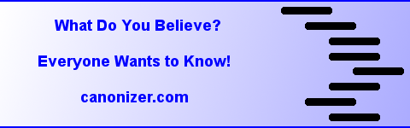

Slide 2
Biggest Problems with Internet
Spam and Scam
Drinking from a fire hose
…

Slide 3
Reputation
Concise and quantitative measure of what everyone thinks.

Slide 4
Competition?
Wikipedia (fails if any diversity of opinion)
Petition Systems (Once first person signs, statement is locked in stone)
Online Surveys (Nobody can ever get the questions / answers right and can’t change.)
Social Networks (Great friendship tools, but no way to crowd for common moral good)
Scientific / Academic Journals (Everyone knows this primitive methodology is ripe and ready for disruption.)

Slide 5
Scientific Consensus
Consciousness Survey Project
Proof of concept
Ready to publish dramatic data

Slide 6
Business Model
So far like Wikipedia (free, open source, volunteer…)
Money will bias and ruin Wikipedia
Canonizer system isolates motivated bias from what is important – it is encouraged.

Slide 7
Current Thinking
No owners, no management.
Will become what the crowd wants.
All contributions and ideas by anyone are recognized with shares according to a canonization process.
We could use something like $200K, perhaps like a NSF science grant, to fund a few years of one or more of us quitting our day jobs to push things towards critical mass that much sooner.

