Slide 1
The current state of the
LLM Pruning Thesis by Michal
as of 13 May 2025

Slide 2
Recap: conclusions of last meeting
LLM depth pruning methods are quite coarse-grained:
Transformer 1
Transformer 2
Attention 1
Attention 2
MLP 1
MLP 2

Slide 3

Recap: conclusions of last meeting
LLM depth pruning methods are quite coarse-grained:
Transformer Block Pruning
Transformer 1
Transformer 2
Attention 1
Attention 2
MLP 1
MLP 2

Slide 4
Recap: conclusions of last meeting
LLM depth pruning methods are quite coarse-grained:
Attention/MLP Pruning
Transformer 1
Transformer 2
Attention 1
Attention 2
MLP 1
MLP 2

Slide 5
Recap: conclusions of last meeting
Transformer 1
Transformer 2
Attention 1
Attention 2
MLP 1
MLP 2
Need to:
Find a way to depth-prune on a finer scale
See how far the smallest models can be pushed with finer-grained pruning
Carefully select benchmarks; pruning performance can be task-dependent

Slide 6

New Developments
Carefully select benchmarks
2025-05-09:16:24:12 INFO [__main__:440] Selected Tasks: ['hellaswag']
2025-05-09:16:24:12 INFO [evaluator:185] Setting random seed to 0 | Setting numpy seed to 1234 | Setting torch manual seed to 1234 | Setting fewshot manual seed to 1234
2025-05-09:16:24:12 INFO [evaluator:223] Initializing hf model, with arguments: {'pretrained': 'unsloth/Qwen3-4B-unsloth-bnb-4bit', 'trust_remote_code': True}
2025-05-09:16:24:12 INFO [models.huggingface:137] Using device 'cuda:0'
2025-05-09:16:24:17 INFO [api.task:434] Building contexts for hellaswag on rank 0...
100%|████████████████████████████████████████████████| 10042/10042 [00:01<00:00, 6640.77it/s]
2025-05-09:16:24:19 INFO [evaluator:559] Running loglikelihood requests
Running loglikelihood requests: 3%|▋ | 1347/40168 [01:12<27:33, 23.47it/s]
Found a benchmarking
toolkit that:

Slide 7
New Developments
Carefully select benchmarks
2025-05-09:16:24:12 INFO [__main__:440] Selected Tasks: ['hellaswag']
2025-05-09:16:24:12 INFO [evaluator:185] Setting random seed to 0 | Setting numpy seed to 1234 | Setting torch manual seed to 1234 | Setting fewshot manual seed to 1234
2025-05-09:16:24:12 INFO [evaluator:223] Initializing hf model, with arguments: {'pretrained': 'unsloth/Qwen3-4B-unsloth-bnb-4bit', 'trust_remote_code': True}
2025-05-09:16:24:12 INFO [models.huggingface:137] Using device 'cuda:0'
2025-05-09:16:24:17 INFO [api.task:434] Building contexts for hellaswag on rank 0...
100%|████████████████████████████████████████████████| 10042/10042 [00:01<00:00, 6640.77it/s]
2025-05-09:16:24:19 INFO [evaluator:559] Running loglikelihood requests
Running loglikelihood requests: 3%|▋ | 1347/40168 [01:12<27:33, 23.47it/s]
Found a benchmarking
toolkit that:
implements a wide variety of benchmarks

Slide 8
New Developments
Carefully select benchmarks
2025-05-09:16:24:12 INFO [__main__:440] Selected Tasks: ['hellaswag']
2025-05-09:16:24:12 INFO [evaluator:185] Setting random seed to 0 | Setting numpy seed to 1234 | Setting torch manual seed to 1234 | Setting fewshot manual seed to 1234
2025-05-09:16:24:12 INFO [evaluator:223] Initializing hf model, with arguments: {'pretrained': 'unsloth/Qwen3-4B-unsloth-bnb-4bit', 'trust_remote_code': True}
2025-05-09:16:24:12 INFO [models.huggingface:137] Using device 'cuda:0'
2025-05-09:16:24:17 INFO [api.task:434] Building contexts for hellaswag on rank 0...
100%|████████████████████████████████████████████████| 10042/10042 [00:01<00:00, 6640.77it/s]
2025-05-09:16:24:19 INFO [evaluator:559] Running loglikelihood requests
Running loglikelihood requests: 3%|▋ | 1347/40168 [01:12<27:33, 23.47it/s]
Found a benchmarking
toolkit that:
implements a wide variety of benchmarks
supports HuggingFace models

Slide 9
New Developments
Carefully select benchmarks
2025-05-09:16:24:12 INFO [__main__:440] Selected Tasks: ['hellaswag']
2025-05-09:16:24:12 INFO [evaluator:185] Setting random seed to 0 | Setting numpy seed to 1234 | Setting torch manual seed to 1234 | Setting fewshot manual seed to 1234
2025-05-09:16:24:12 INFO [evaluator:223] Initializing hf model, with arguments: {'pretrained': 'unsloth/Qwen3-4B-unsloth-bnb-4bit', 'trust_remote_code': True}
2025-05-09:16:24:12 INFO [models.huggingface:137] Using device 'cuda:0'
2025-05-09:16:24:17 INFO [api.task:434] Building contexts for hellaswag on rank 0...
100%|████████████████████████████████████████████████| 10042/10042 [00:01<00:00, 6640.77it/s]
2025-05-09:16:24:19 INFO [evaluator:559] Running loglikelihood requests
Running loglikelihood requests: 3%|▋ | 1347/40168 [01:12<27:33, 23.47it/s]
Found a benchmarking
toolkit that:
implements a wide variety of benchmarks
supports HuggingFace models
can be made to run on DelftBlue (WIP)

Slide 10
New Developments
Find a way to depth-prune on a finer scale

Slide 11
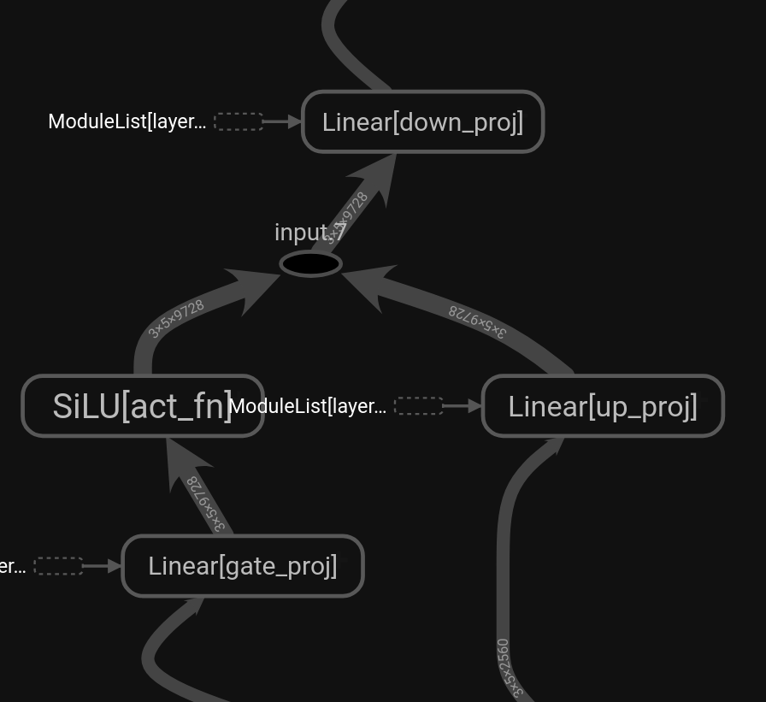
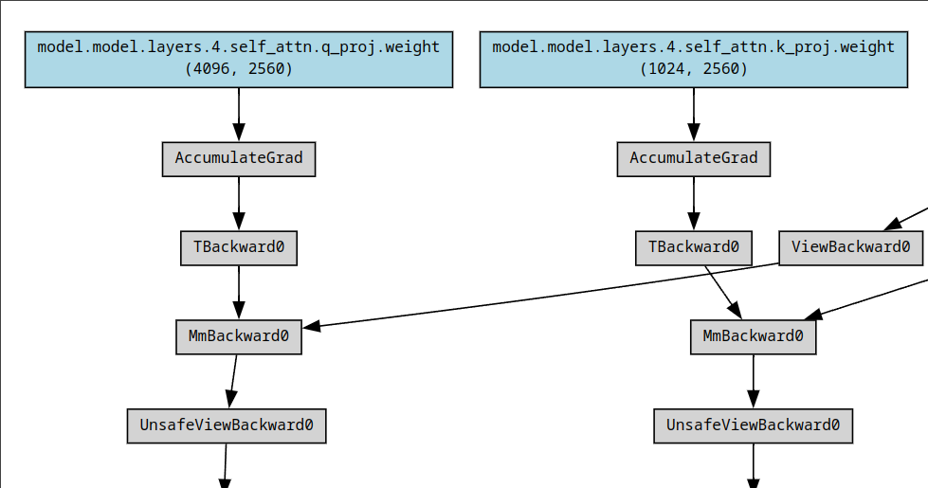
New Developments
Find a way to depth-prune on a finer scale
Got some perspective using data flow modeling and dependency modeling via the computation graph

Slide 12
New Developments
Find a way to depth-prune on a finer scale

Slide 13
New Developments
Find a way to depth-prune on a finer scale
Too coarse:
Attention 1
Scale
Coarse
Fine

Slide 14
New Developments
Find a way to depth-prune on a finer scale
Too coarse:
Not depth:
Attention 1
Scale
Coarse
Fine

Slide 15
New Developments
Find a way to depth-prune on a finer scale
Too coarse:
Not depth:
?
Attention 1
Scale
Coarse
Fine

Slide 16
New Developments
Find a way to depth-prune on a finer scale
Too coarse:
Prune on the parameter matrix level:
Not depth:
Attention 1

Slide 17
New Developments
Find a way to depth-prune on a finer scale
Too coarse:
Prune on the parameter matrix level:
Not depth:
Attention 1
Identify matrices that behave like identity transformations.
Hypothesis: deleting identity-like transformations has minimal performance impact.
Patch dimension conflicts using upstream/downstream width pruning.

Slide 18
New Developments
Prune on the parameter matrix level:
Case 1: Matching dimensions
Case 1: Matching dimensions

Slide 19
New Developments
Prune on the parameter matrix level:
Case 1: Matching dimensions
Case 1: Matching dimensions

Slide 20
New Developments
Prune on the parameter matrix level:
Case 1: Matching dimensions
Case 1: Matching dimensions

Slide 21
New Developments
Prune on the parameter matrix level:
Case 2: Output dimension shrinkage

Slide 22
New Developments
Prune on the parameter matrix level:
Case 2: Output dimension shrinkage

Slide 23
New Developments
Prune on the parameter matrix level:
Case 2: Output dimension shrinkage

Slide 24
New Developments
Prune on the parameter matrix level:
Case 2: Output dimension shrinkage
Hypothesis:
Identity-like behavior of rectangular matrix = dimension transformation without information loss
Implies existence of extraneous dimensions before the given layer
Compress dimensions earlier

Slide 25
New Developments
Prune on the parameter matrix level:
Case 2: Output dimension shrinkage
compress rows here
Hypothesis:
Identity-like behavior of rectangular matrix = dimension transformation without information loss
Implies existence of extraneous dimensions before the given layer
Compress dimensions earlier

Slide 26
New Developments
Prune on the parameter matrix level:
Case 2: Output dimension shrinkage
compress here
to solve problem here
Hypothesis:
Identity-like behavior of rectangular matrix = dimension transformation without information loss
Implies existence of extraneous dimensions before the given layer
Compress dimensions before the given layer

Slide 27
New Developments
Prune on the parameter matrix level:
Case 3: Output dimension expansion

Slide 28
New Developments
Prune on the parameter matrix level:
Case 3: Output dimension expansion

Slide 29
New Developments
Prune on the parameter matrix level:
Case 3: Output dimension expansion

Slide 30
New Developments
Prune on the parameter matrix level:
Case 3: Output dimension expansion
compress columns here
Hypothesis:
Implies existence of extraneous dimensions after the given layer
Compress dimensions after the given layer

Slide 31
Next Steps
Sub-problems I am currently working on:
Adapting existing dependency modeling code for this use case
Figuring out cases of non-linear & element-wise ops. adjacent to pruned layer
Researching & implementing means of measuring “identity-like” characteristic
Researching & implementing dimension compression techniques

