Slide 1

[PANTHEON]
Kammara Trivikram
Mohammad Adnan Khan

Slide 2
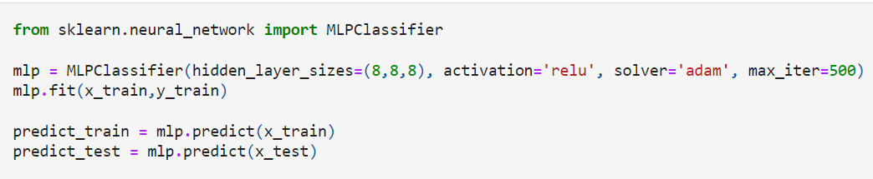
Diabetes Prediction using neural networks and mlp classifier ON a given dataset
In this project we are trying to apply a machine learning model on a given data set of many independent variables which are the various factors that tend to affect the probability of being diabetes positive and determine the result that is whether a person is at the risk of diabetes or not which is the dependent variables.
We accomplished this using neural networks and MLP classifier which refers to Multi-layer Perceptron classifier which uses multiple layers of input and output neural networks to predict and classify a dependent variable based on the independent variables affecting it.

Slide 3
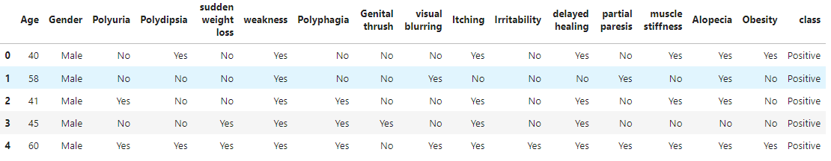
Given above is the preview of the dataset provided to us on which the machine learning model must be deployed.
The data set consists of various columns like age, gender, sudden weight loss, obesity and more which are the various factors that influence the probability of getting Diabetes.
The last column , as you can see is nothing but the resultant column which shows whether a person is having diabetes or not based on all of the various factors.
This is the result that is to be predicted and classified by the deployed machine learning model.

Slide 4
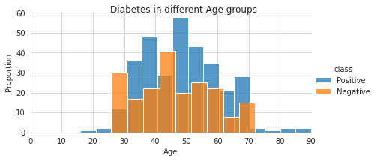
The histogram below shows the relation between age and number of people of that age that have diabetes and do not have diabetes.
This shows that age is also a major factor in determining whether a person is diabetic or not.

Slide 5
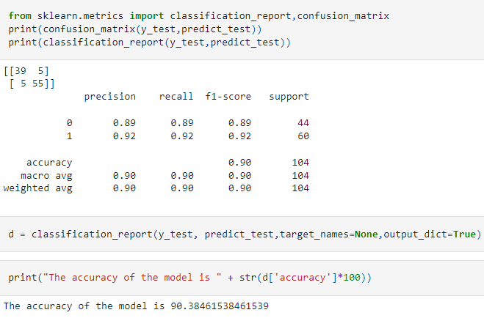
Accuracy of the model
This cell determines the accuracy of the machine learning model that is build using the MLP classifier.
As you can see the accuracy of our mode is around 90% .
This is a really good accuracy and cannot be achieved using a regression model.
Neural networks are what that made this possible.

Slide 6

Thank you

