Slide 1

CruelRenderer Development report
Yiwen Xue, Mar 26

Slide 2
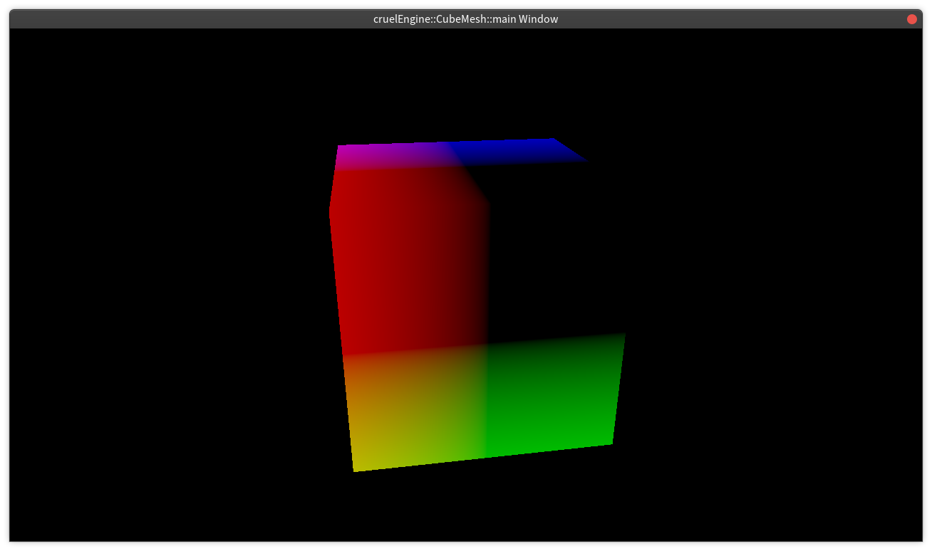
Contents
Code Style
Currently Progress
Later work
Game Dev

Slide 3
Code Style
clang-format
clang-tidy

Slide 4
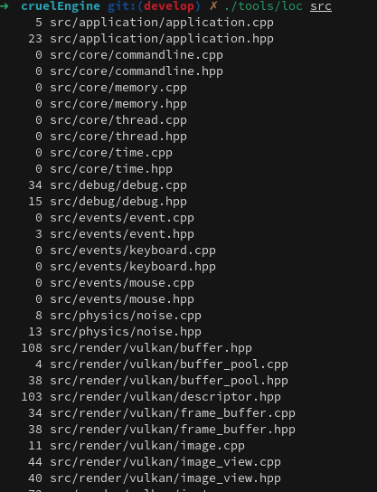
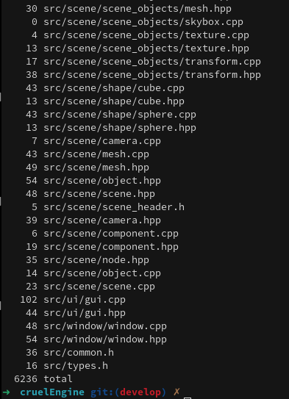
Currently Progress
Vulkan API wrap
Renderer API
Scene Graph

Slide 5
Vulkan API wrap
Instance : Good enough.
PhysicalDevice: Good.
LogicalDevice: Good.
Window: platform bug --> Wayland bug
SwapChain: Need Image and ImageView
FrameBuffer: Good.

Slide 6
Vulkan API wrap
PipeLine: PipeLine State --> Push Constant
PipeLineLayout: ShaderVariant --> Need Information about Shader's requirements.
ShaderModule: ShaderVariant --> Need to tell the PipeLineLayout what data is needed.
Queue: Queue Status --> Add some mutex or fence support.
CommandBufffer: Not Finished --> Need a Bind template
…

Slide 7
Render API
RenderContext – Ready
RenderSession – Ready
RenderTask – Not Finished
Resource Cache – Todo

Slide 8
Scene Graph
Scene – Not Finished
Node & Entity – Not Finished
Component
  Light – Not Finished
  Camera – Not Finished
  Material – Not Finished
  Mesh – Not Finished
  Texture – Not Finished
  Script – Todo
  ...

Slide 9
Later Works
Todos – 1 mon
Gui Layer
Vulkan Debug Marker
Timer
Profile & benchmark

Slide 10
Thanks

