Slide 1
Cruel Render Engine
Project init

Slide 2
Topics
Goals
Team
Platform
Develop tools
Conferences

Slide 3
Goal
Render Engine
  global illumination
Or Game Engine
  Game development
Or just kidding
  End

Slide 4
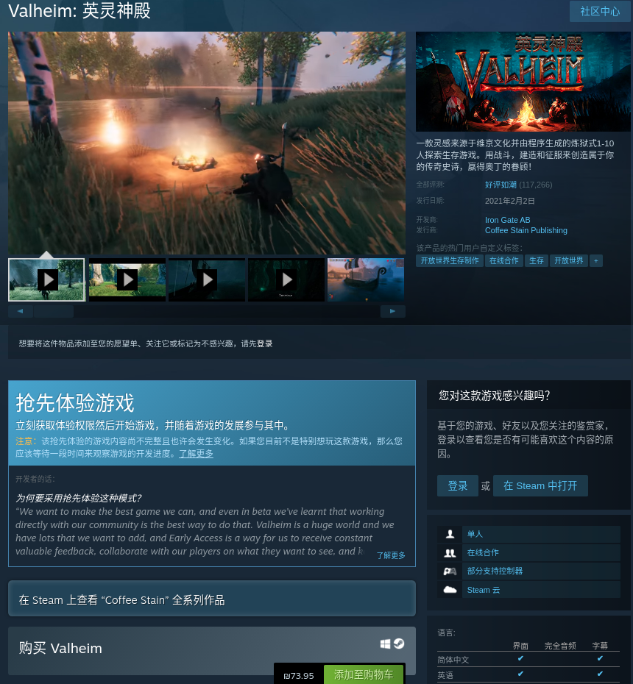
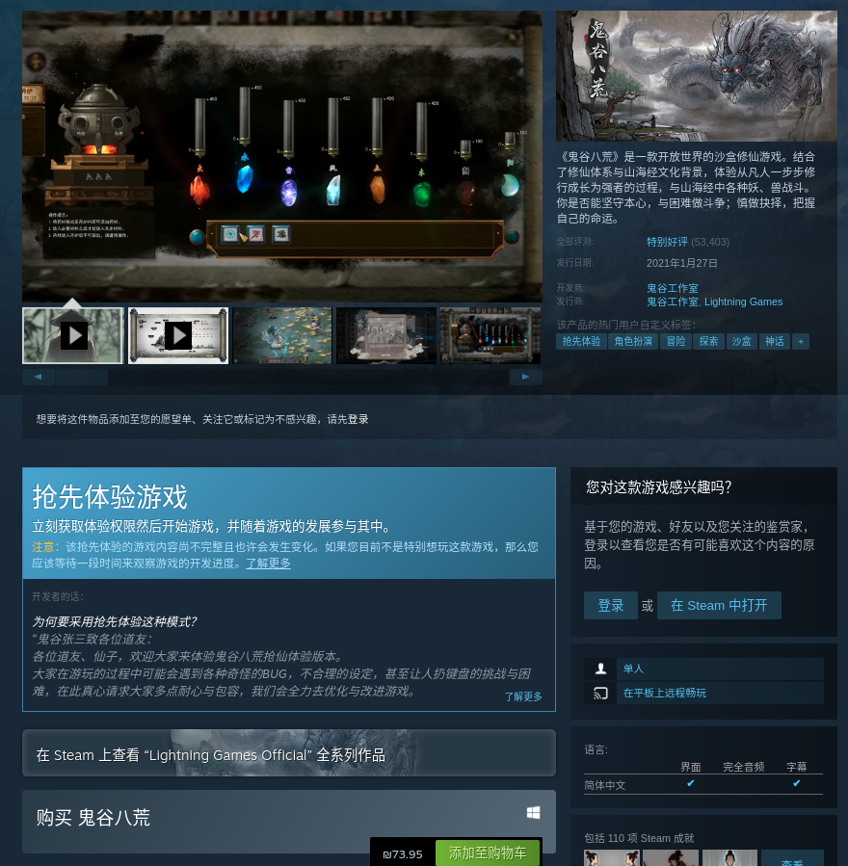
鬼谷八荒
Valheim

Slide 5
Team
Programmers
  X 2

Slide 6
Platform
PC
  Windows
  Linux
  Macos
Phone
  Android

Slide 7
Develop Env
Vstudio
Vscode
Clion

Slide 8
Meetings
Zoom – video
Discord – text message (support markdown)
Slack

