Slide 1
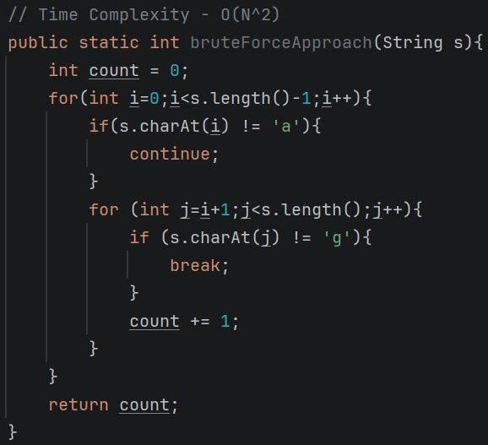
Carry-Forward & Sub-Arrays
Q) Given a string “S” of lowercase characters, return the count of (i, j) such that i < j and s[i]==‘a’ and s[j]==‘g’.
Ex: S = “abegag”.
Ans: (0, 3) , (0, 5) , and (4, 5) --- Total Count = 3.
Brute-Force Approach (Traditional):
T.C – O(N^2)
S.C – O(1)
0 | 1 | 2 | 3 | 4 | 5
a | b | e | g | a | g

Slide 2
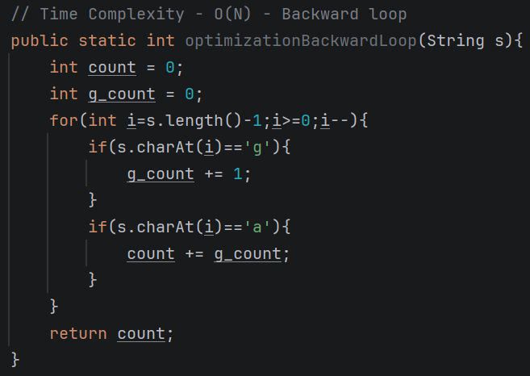
Optimization:
What if we can count number of g’s from back side and increase the count when we encounter ‘a’.
Here we are carry forwarding count of g from back to front.
Think of forward approach?

Slide 3
Sub-Arrays:
Contiguous part of an array.
Empty Array {} – is not a subarray
Number of sub-arrays in an array of size ‘n’ = n*(n+1)/2
0 | 1 | 2 | 3 | . | . | n

