Slide 1

ADKit
By The Differentiators: Dimitris Vamvourellis, Michael Scott, Royce Yap, Yiwen Wang
Notes:
Derivatives – we see them all around us, from fluid dynamics to machine learning. Imagine what you would do without them. Today, our group, self-titled as the Differentiators, bring to you ADKit, a Python package created to calculate derivatives of vector functions through the use of Automatic Differentiation.

Slide 2
Why Automatic Differentiation?
Heavily used in solving optimization problems; able to calculate the partial derivatives of any function at any point
More accurate than numeric differentiation
Faster and occupies less memory than symbolic differentiation
Two modes in Automatic Differentiation - forward and reverse
Notes:
So what is Automatic Differentiation? To calculate derivatives, there are in general three ways: Automatic Differentiation, Numeric Differentiation and Symbolic Differentiation.
We think that Automatic Differentiation (AD) is the best because AD calculate the partial derivatives of any function at any point efficiently and accurately. It has the advantages of the other two methods without their disadvantages. - unlike numeric differentiation, AD does not have the problem of floating point precision errors. Compared to symbolic differentiation, AD is not as memory intense, and can be much faster in terms of the calculation.
Automatic Differentiation has two modes, the forward mode and the reverse mode.

Slide 3



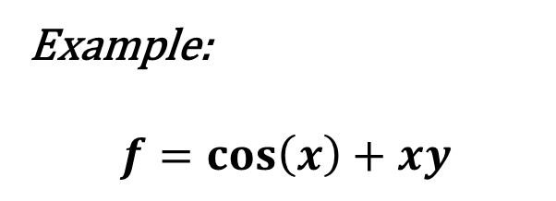












Background
Forward Mode
Example:
$$f=\cos\left(x\right)+xy$$
$\frac{dx_{1}}{ⅆx}=1$
$\frac{dx_{2}}{ⅆx}=0$
$$x$$
$$y$$
$$x_{1}$$
$$x_{2}$$
$$\cos{ }$$
$$×$$
$\frac{dx_{3}}{ⅆx}=\frac{dx_{3}}{ⅆx_{1}}{∙\frac{dx_{1}}{ⅆx}}$
$$x_{3}$$
$$x_{4}$$
$\frac{dx_{4}}{ⅆx}=\frac{dx_{4}}{ⅆx_{1}}{∙\frac{dx_{1}}{ⅆx}+\frac{dx_{4}}{ⅆx_{2}}{∙\frac{dx_{2}}{ⅆx}}}$
$$+$$
$$x_{5}$$
$\frac{dx_{5}}{ⅆx}=\frac{dx_{5}}{ⅆ3}{∙\frac{dx_{3}}{ⅆx}+\frac{dx_{5}}{ⅆx_{4}}{∙\frac{dx_{4}}{ⅆx}}}$
Notes:
At the core of Automatic Differentiation is the principle that functions implemented as computer code can be broken down into elementary functions, ranging from elementary arithmetic operations (e.g. addition, multiplication etc.) and other functions (e.g. sin etc.). Hence, any differentiable function can be interpreted as a composition of different functions.
As you can see from the example, f = cos(x) + xy. in forward mode, the chain rule can be applied successively to each elementary operation to obtain the derivative of the function with respect to the input variables, and both the variable's value and derivative are calculated along the way, leading to a complete derivative trace.

Slide 4
Background
Forward Mode
Example:
$$f=\cos\left(x\right)+xy$$
$\frac{dx_{1}}{ⅆx}=1$
$\frac{dx_{2}}{ⅆx}=0$
$$x$$
$$y$$
$$x_{1}$$
$$x_{2}$$
$$\cos{ }$$
$$×$$
$\frac{dx_{3}}{ⅆx}=\frac{dx_{3}}{ⅆx_{1}}{∙\frac{dx_{1}}{ⅆx}}$
$$x_{3}$$
$$x_{4}$$
$\frac{dx_{4}}{ⅆx}=\frac{dx_{4}}{ⅆx_{1}}{∙\frac{dx_{1}}{ⅆx}+\frac{dx_{4}}{ⅆx_{2}}{∙\frac{dx_{2}}{ⅆx}}}$
$$+$$
$$x_{5}$$
$\frac{dx_{5}}{ⅆx}=\frac{dx_{5}}{ⅆ3}{∙\frac{dx_{3}}{ⅆx}+\frac{dx_{5}}{ⅆx_{4}}{∙\frac{dx_{4}}{ⅆx}}}$
Notes:
At the core of Automatic Differentiation is the principle that functions implemented as computer code can be broken down into elementary functions, ranging from elementary arithmetic operations (e.g. addition, multiplication etc.) and other functions (e.g. sin etc.). Hence, any differentiable function can be interpreted as a composition of different functions.
As you can see from the example, f = cos(x) + xy. in forward mode, the chain rule can be applied successively to each elementary operation to obtain the derivative of the function with respect to the input variables, and both the variable's value and derivative are calculated along the way, leading to a complete derivative trace.

Slide 5
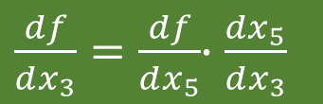




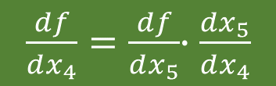

Background
Reverse Mode
Example:
$$f=\cos\left(x\right)+xy$$
$\frac{df}{ⅆx_{1}}=\frac{df}{ⅆx_{3}}{∙\frac{dx_{3}}{ⅆx_{1}}+\frac{df}{ⅆx_{4}}{∙\frac{dx_{4}}{ⅆx_{1}}}}$
$\frac{df}{ⅆx_{2}}=\frac{df}{ⅆx_{4}}{∙\frac{dx_{4}}{ⅆx_{2}}}$
$$x$$
$$y$$
$$x_{1}$$
$$x_{2}$$
$$\cos{ }$$
$$×$$
$\frac{df}{ⅆx_{3}}=\frac{df}{ⅆx_{5}}{∙\frac{dx_{5}}{ⅆx_{3}}}$
$$x_{3}$$
$$x_{4}$$
$\frac{df}{ⅆx_{4}}=\frac{df}{ⅆx_{5}}{∙\frac{dx_{5}}{ⅆx_{4}}}$
$\frac{dx_{3}}{ⅆx_{1}}=−\sin{x}$
$$\frac{dx_{4}}{ⅆx_{1}}=x_{2} \frac{dx_{4}}{ⅆx_{2}}=x_{1}$$
$$+$$
$$x_{5}$$
$$\frac{df}{ⅆx_{5}}=1$$
Notes:
How does this differ in the reverse mode? In reverse mode, there is a forward pass, where the intermediate variables are computed and their values and partial derivatives with respect to the previous layer stored in the memory.
Then, we have the reverse pass, where we propagate back the derivatives with the help of the chain rule. We start with the gradient of the function with respect to x5, which ends up being 1. As we go through the reverse pass and apply the chain rule, we finally end up with the partial derivatives of the input variables.
In terms of efficiency, the forward mode is more efficient when the number of functions to evaluate is much greater than the number of inputs, whereas the reverse mode, which computes the Jacobian-transpose-vector-product is more efficient when the number of inputs is much greater than the number of functions.

Slide 6
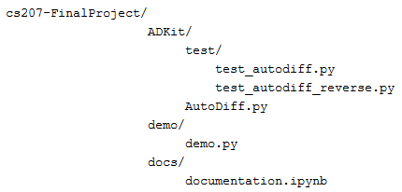
Software Organization
Single AutoDiff.py module
Two classes: Ad_Var and rAd_Var
Flexibility to choose between forward and reverse mode
Difference in implementation = limited reusability of code between classes
Notes:
The primary module is a single AutoDiff.py file. Contained within it are two classes - Ad_Var for the forward mode and rAd_Var for the reverse mode.
This allows the user of this package the flexibility to choose between the two modes of automatic differentiation, depending on the vector functions and variables that they plan to differentiate
The choice of keeping them as two separate classes is based on the fact that there is limited resuability of code between both implementations - the forward mode determines the derivatives of the variables using the chain rule whereas reverse mode traverses the computational graph in the forward pass and stores both parent-child relationships and the partial derivatives without doing the chain rule.ls

Slide 7
Additional Features – Reverse Mode
Outwards-in vs. inwards-out (forward)
Faster (lots of input variables)
More space demanding
Storing the evaluation tree
Parents and children
parent
sin
f(x, y) = sin(x + y)
+
children
x
y

Slide 8
Additional Features – Reverse Mode
rAd_Var class
Largely identical to Ad_Var
Same operators
size(rAd_Var) > size(Ad_Var)
Cannot be reused once computation is complete
Derivatives cannot be manually overridden

Slide 9
Future extensions
Hessian Matrix Calculation
How? Combine forward and reverse mode
Applications: Optimization, Image Processing
Backpropagation for Deep Learning
Black-Box Variational Inference for Bayesian Deep Learning

Slide 10

Forward Mode
The Differentiators
REVERSE Mode

