Slide 1

Streams
A sequence of elements(optionally ordered)
Doesn't store the data
Lazy evalutation
Declarative syntax
Close to the problem statement
Processing delagated to the framework
May execute sequentially or in parallel
Primitive Streams – IntStream, LongStream, DoubleStream

Slide 2
Select roll_no, name, age
from students
where age >= 18

Slide 3
An example
int sum = widgets.stream()
.filter(w -> w.getColor() ==RED)
.mapToInt(w -> w.getWeight())
.sum();

Slide 4
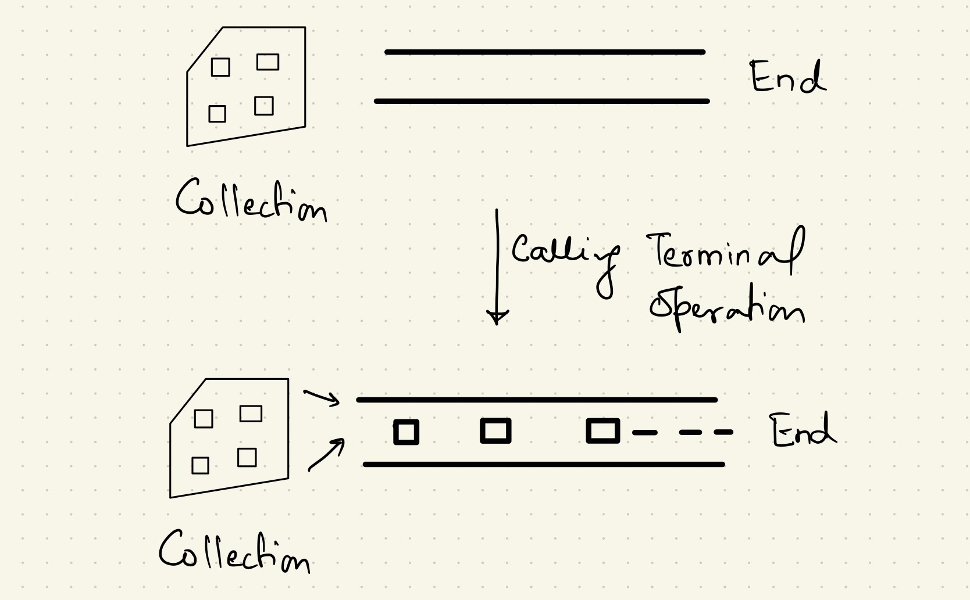
Streams are Lazy

Slide 5
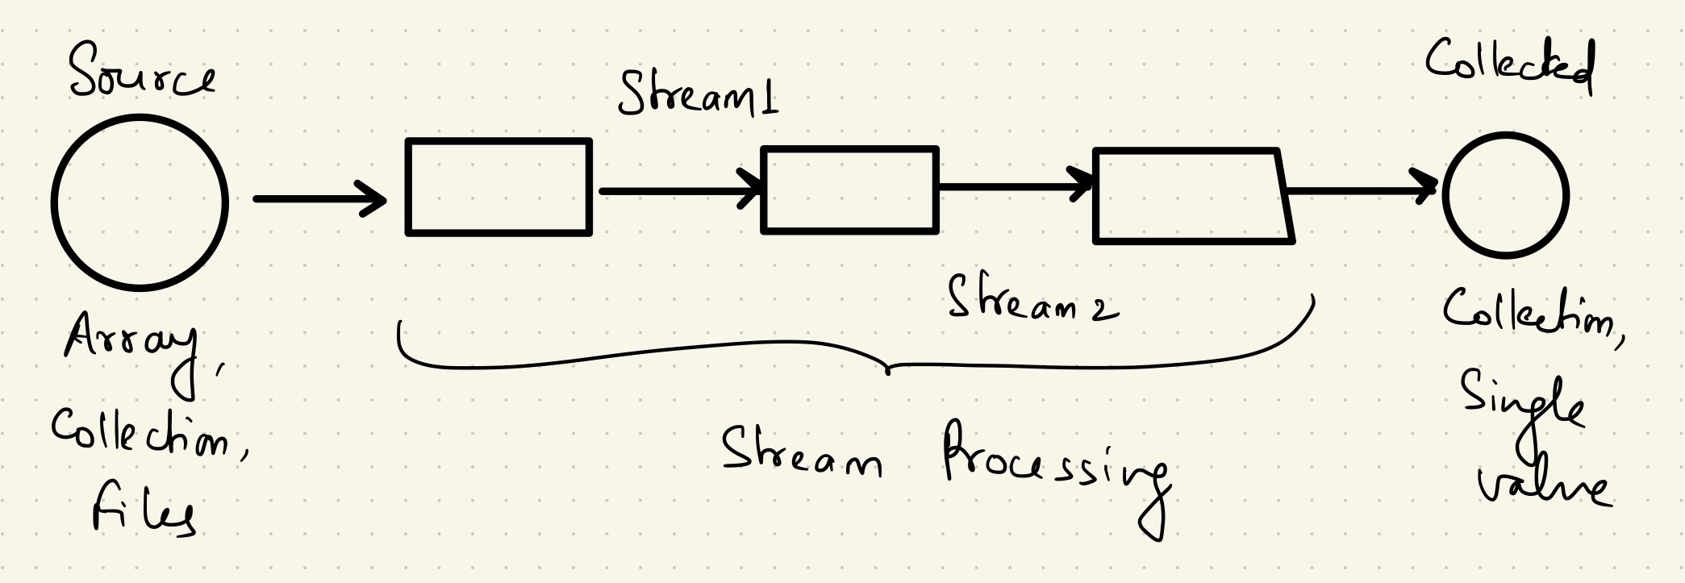
Pipeline

