Slide 1
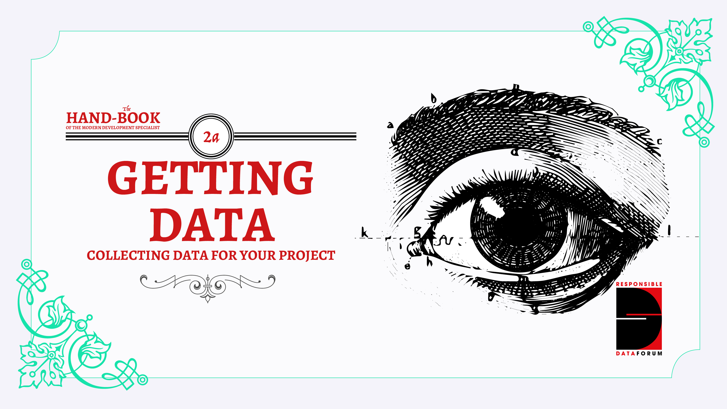

Slide 2
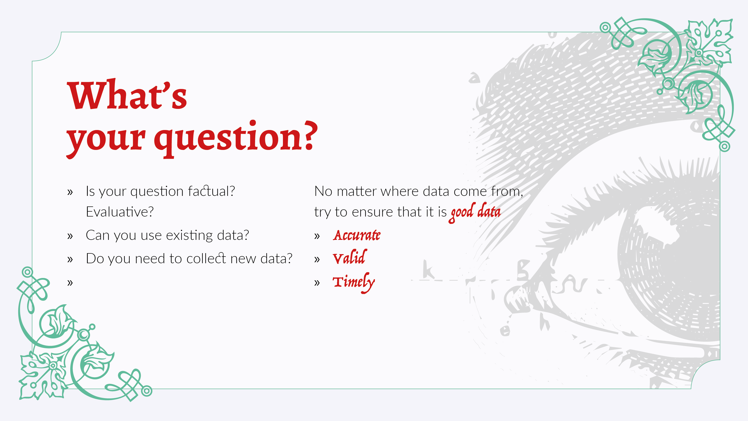
Notes:
Why are you collecting data in the first place? To make sure your data gathering is relevant and actually useful, frame your data collection in terms of a concrete question, and build out processes and data points based on that specific question. You might not always need to directly collect your own data, either, as there are ways of getting data from existing sources - such as Freedom of Information requests from governments, or simply searching to see if anyone has already published the data you need.

Slide 3
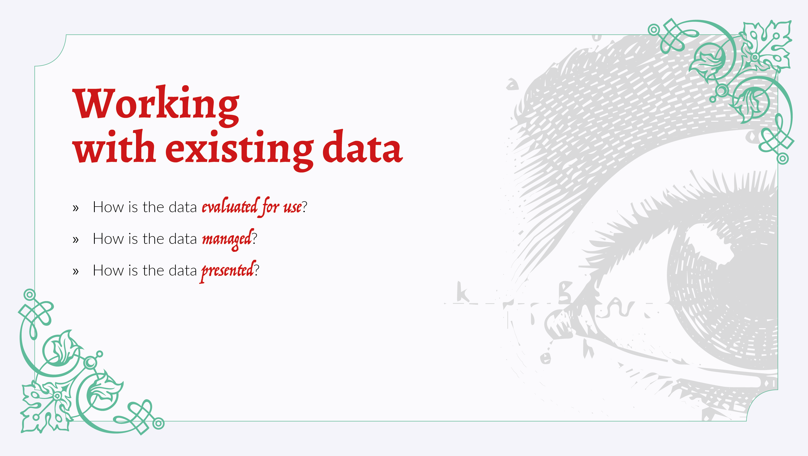
Notes:
If you can identify existing datasets that support your project activity, there are three primary areas of responsibility to consider, that are explored in more detail here:
1. How the data is evaluated for use
Understanding the biases that have gone into the dataset is crucial to making sure it is used in an appropriate and responsible way.
2. How it is managed
Best practices with regards to data management include keeping multiple, well-labelled versions of your data if it is undergoing transformations. It is also important to consider the legal and licensing considerationsto make sure you respect the intellectual property restrictions that may (or may not) be associated with the data.
When manipulating the data, it's important to keep in mind **the people in the data.** How might various manipulations or combinations of datasets reveal personal or private details about their lives? Thinking through carefully what kinds of information could be revealed from a certain dataset is crucial, and can provide a useful, though perhaps dystopian, project planning exercise.
3. How it is presented
Including context to the data is vital, and so is being transparent about what the data does, and doesn't, represent. Being explicit about what is and isn't there can help others interpret and manage your data responsibly.

Slide 4
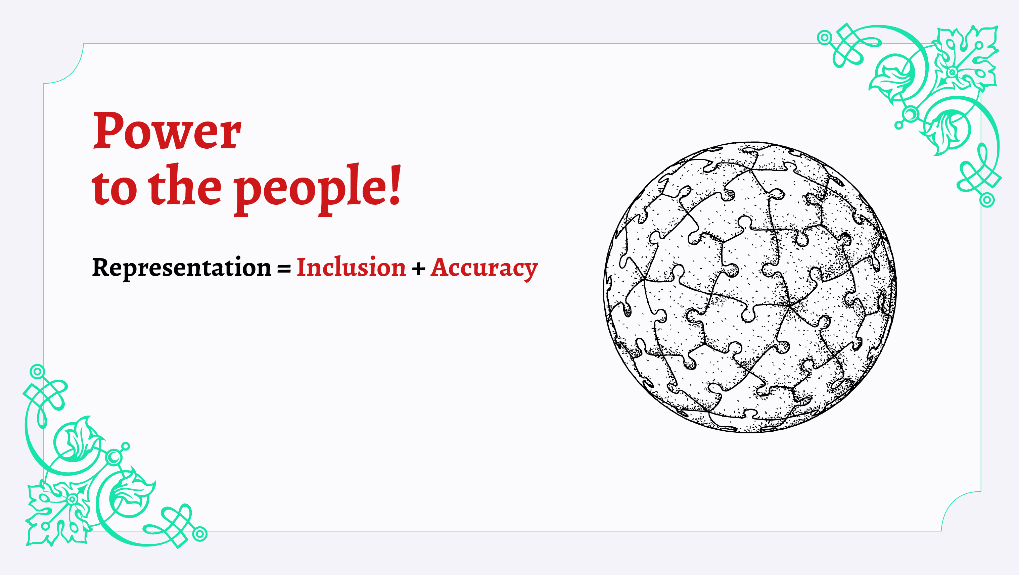
Notes:
Ultimately, much of the data we are collecting refers to a particular group of people, and it's the people who are reflected in the data who should have the most say over how the data is used. With regards to **representation**, for example, there are two main considerations: **inclusion** and **accuracy**.
Inclusion:
When collecting or finding data, ask yourself: who does the data leave out? Who is not reflected in this data and what impact might that have on their lives when using that data for programming, advocacy or policy change?
Accuracy:
Data needs to be as accurately reflective as possible of the reality of the people involved. Otherwise, the narrative that is developed from the data can be harmful for those people.

Slide 5
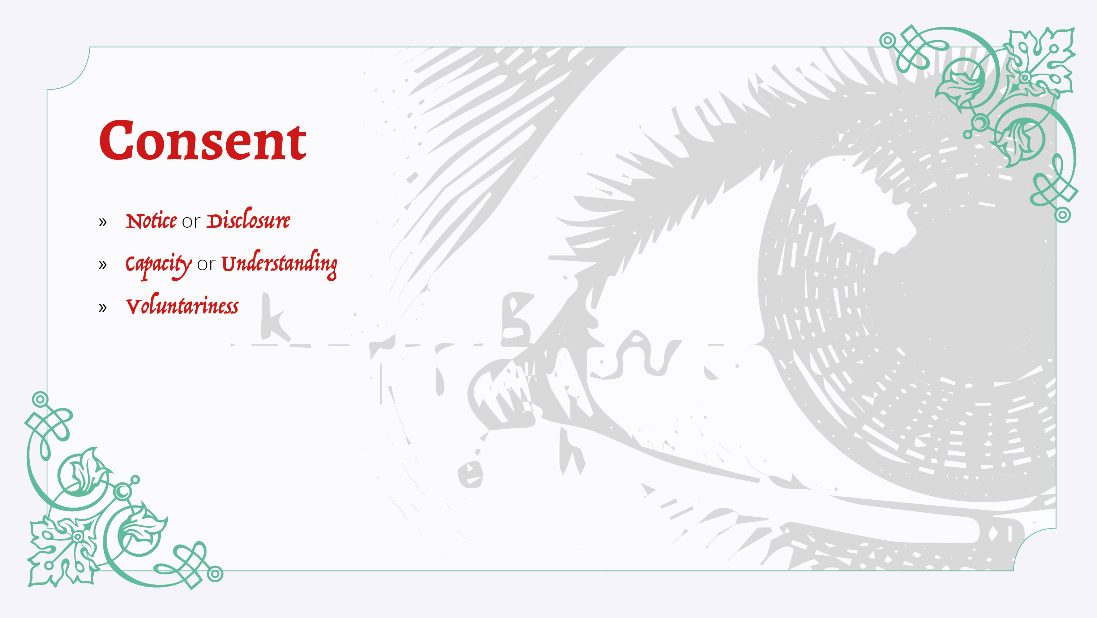
Notes:
Informed consent is the mechanism through which people agree to provide information for research or data collection projects. Generally, consent has been understood as something that is given by individuals during direct interaction with researchers or surveyors, and is composed of three components:
Notice or Disclosure: the consent process has to ensure that the participant must be informed of the nature and purpose of the research, the procedures to be used, the expected benefits (if any), reasonably foreseeable risks, possibilities of not participating and procedures for confidentiality and anonymity.
Capacity, or Understanding: the information must be easily understood in that specific context (language, technical jargon) of the participant and they must be given the opportunity to have any of their questions answered.
Voluntariness: the consent to participate must be voluntary, free of any coercion or inflated promise, and not involve people who have power over the participants. In the development context, it is difficult - if not impossible - to remove any power dynamics entirely, however.
Developing a strong consent policy within a project or an organisation can help others set up responsible consent procedures more easily

Slide 6
