Slide 1
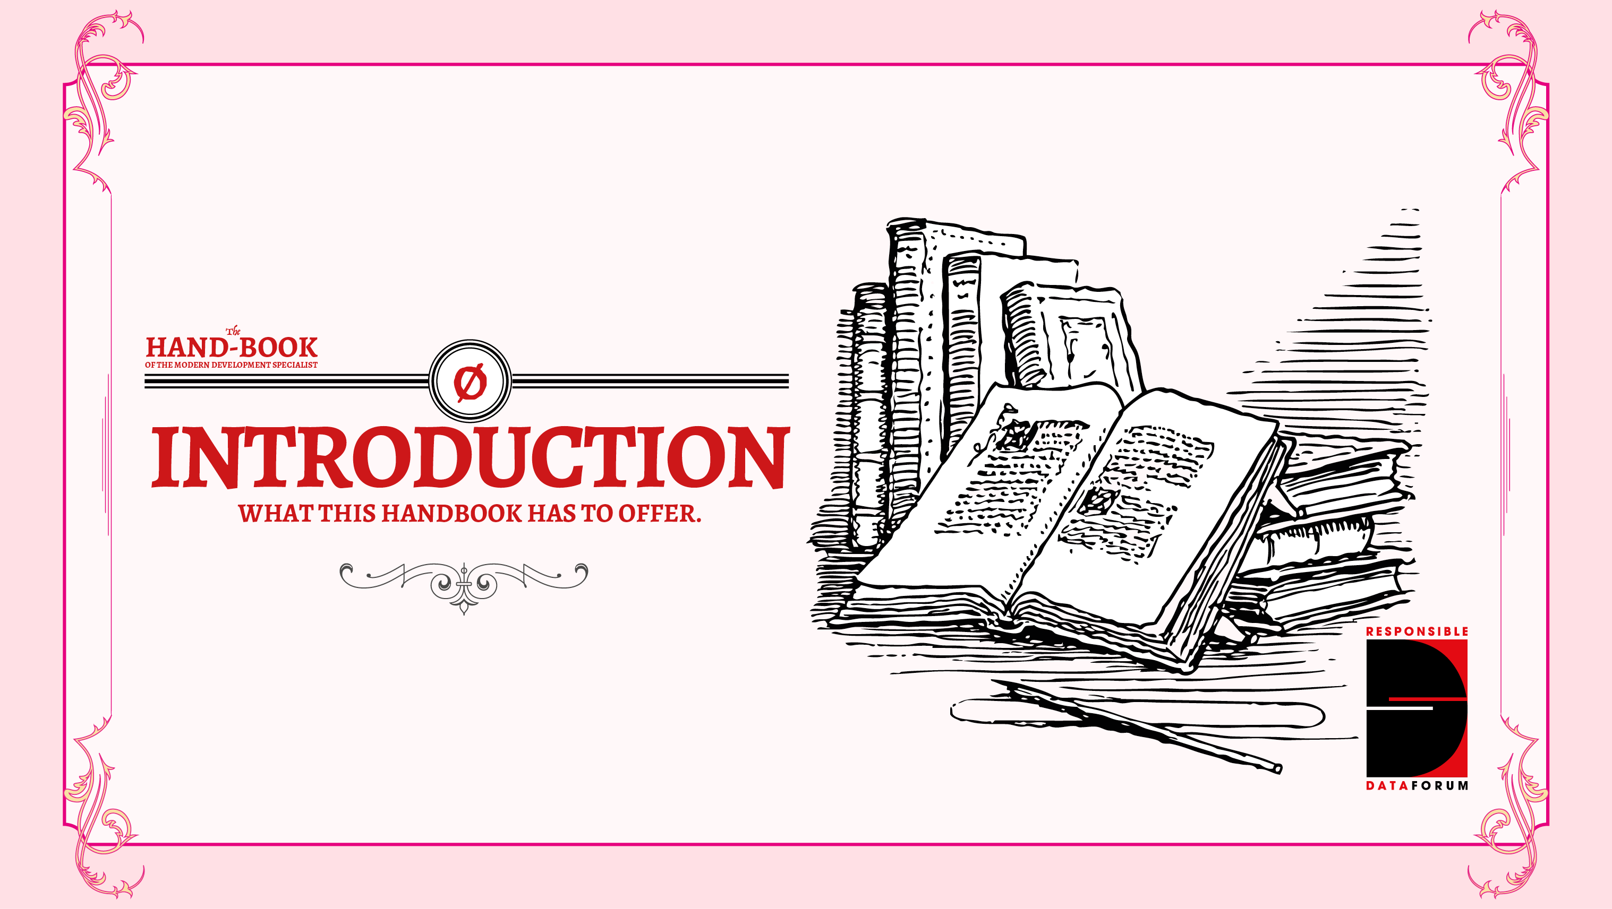

Slide 2
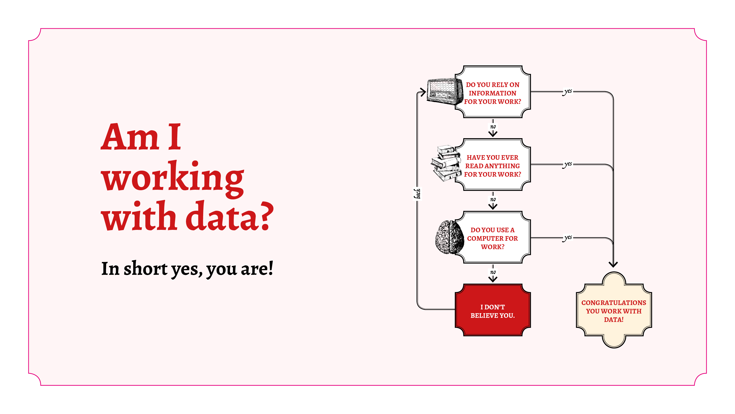
Notes:
In short, yes, you are. Data is everywhere, whether we recognise it or not, and it can be qualitative (eg. words or photos) or quantitative (eg. spreadsheets with lots of numbers).
But whatever the kind of data we're talking about, it's important to remember **the people reflected in the data**. Gathering more and more data on people, even if it is on large groups can be dangerous, unknowingly supporting discrimination that might be present in the dataset. Or, with enough aggregated datasets about the same population, it could reveal details about individuals that violates their privacy.
The responsibility to mitigate against these kinds of decisions lies with all of us, not simply with the person who is directly responsible for analysing or collecting the data. As this area of thought is relatively new, a variety of perspectives and disciplines is essential in thinking through the risks that come with using more, and new, types of data.

Slide 3
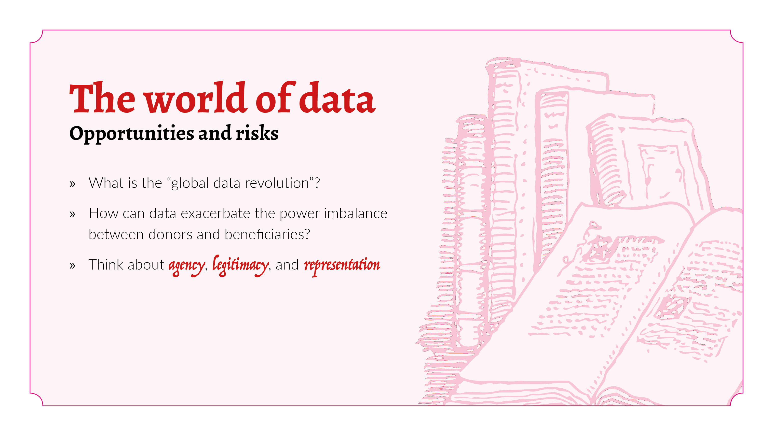
Notes:
The data revolution, broadly, is the transformative actions needed to respond to complex agendas and improve how data is produced and used, closing data gaps to prevent discrimination, build capacity and data literacy in small and big data analytics, modernize systems of data collection, promotion of transparency and accountability, and developing new targets and indicators. But, to date, there's not been so much of a critical debate around the potential harms, or risks, associated with increased data use.
Data is used in more than just "data-driven projects" or "data journalism" - nowadays, all sorts of international development projects rely on data in various formats. But though the rate of data use has increased rapidly over the past couple of decades, the discussion around ethics and politics of data has not evolved at quite the same rate.
What role can data play in either exacerbating, or (hopefully!) weakening power disparities that are present within the development sector?
Having data is synonymous with having a certain amount of power. Within development, power disparities between donors and beneficiaries are already well-pronounced, and data could exacerbate those tensions. The data collector - in many cases, the donor - effectively owns a commodity relating to an individual, and that data could be financially valuable.
Issues of agency, legitimacy and representation pose additional problems in international development: the audience with which you are engaging may not be in a position to make informed choices or provide consent. Often, these communities are already lacking vital services and are unable to access their basic human rights; they might not be aware of the implications of their data being collected or used, have little or no awareness of their digital rights, and even less power to influence the process.

Slide 4
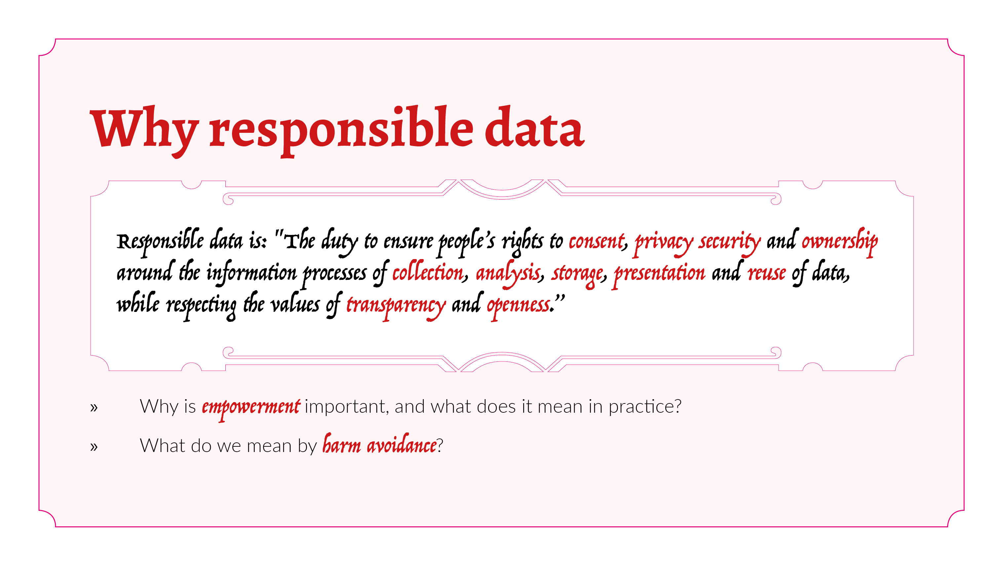
Notes:
How a framing of **responsible data** can help, and why we think it is important.
At its base, discussions around responsible data centre around **empowerment** and **avoidance of harm**; more than discussions about privacy and digital security. We understand responsible data to be about prioritising dignity, respect and privacy of the people we work with.
Empowerment: We use data and technology to produce and mobilise appropriate information, to ensure that policies take everyone into account, especially focusing upon marginalised communities, and place the person in question as central to the data universe rather than as a tangential bystander or even byproduct, empowering users to be active participants rather than passive data "subjects".
Harm avoidance: We do all we can to ensure that we do no harm and that the way in which we use data and technology does not facilitate or exacerbate harm done by others.

Slide 5
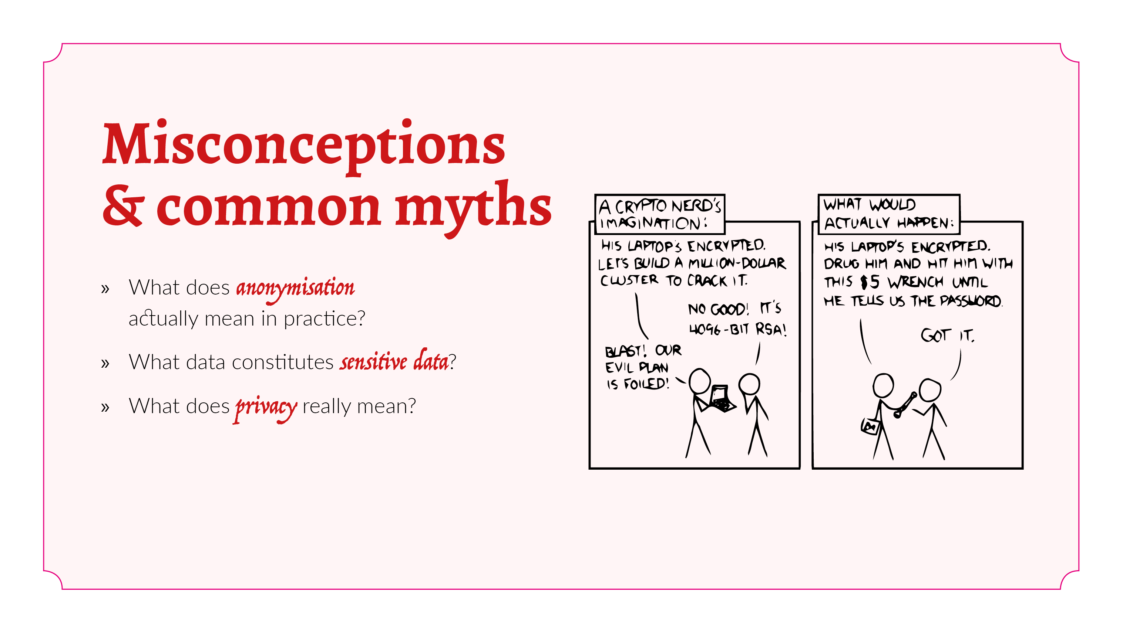
Notes:
Often, these advocacy strategies can be met with misconceptions around what responsibility means in this sense, and the very real harm that can be done with misuse of data. A few of the most common misconceptions are addressed here, such as misunderstandings around:
what **anonymisation** actually means in practice
Taking names out of data doesn't make it anonymous. There are multiple tactics for re-identifying data, and we have recently seen several instances where presumably anonymous data sets were combined with powerful algorithms to identify individuals and their online activity. This phenomenon, called the Mosaic effect, is especially problematic because it's not possible to estimate the chances that any given data set can be re-identified, because it's not possible to anticipate all the data sets that might be produced and meshed with it. Let alone the impossibility of anticipating what kinds of data sets might be made available in the future…
What data constitutes **sensitive** data;
Perhaps you think your data isn’t sensitive. Not sensitive for whom? Perhaps not for you, but have you asked the people who are reflected in the data whether they think it's sensitive? Will it be sensitive a year from now? What if the government changes, if political tensions are exacerbated or if discriminatory legislation is passed?
Different understandings of what **privacy** really means.
Everyone is entitled to basic human rights, and privacy rights (or digital rights) are just part of these. Responsible data is simply a way of understanding how best to respect the privacy rights of those around us. If the concept or the word 'privacy' is problematic, there are many other ways of framing it: respecting human rights, using information respectfully, being safe in the digital world. The consequences of violating someone's privacy rights could be just as serious as violating their other human rights - for example, leading to physical violence or preventing them from access to vital services.

Slide 6
