Slide 1
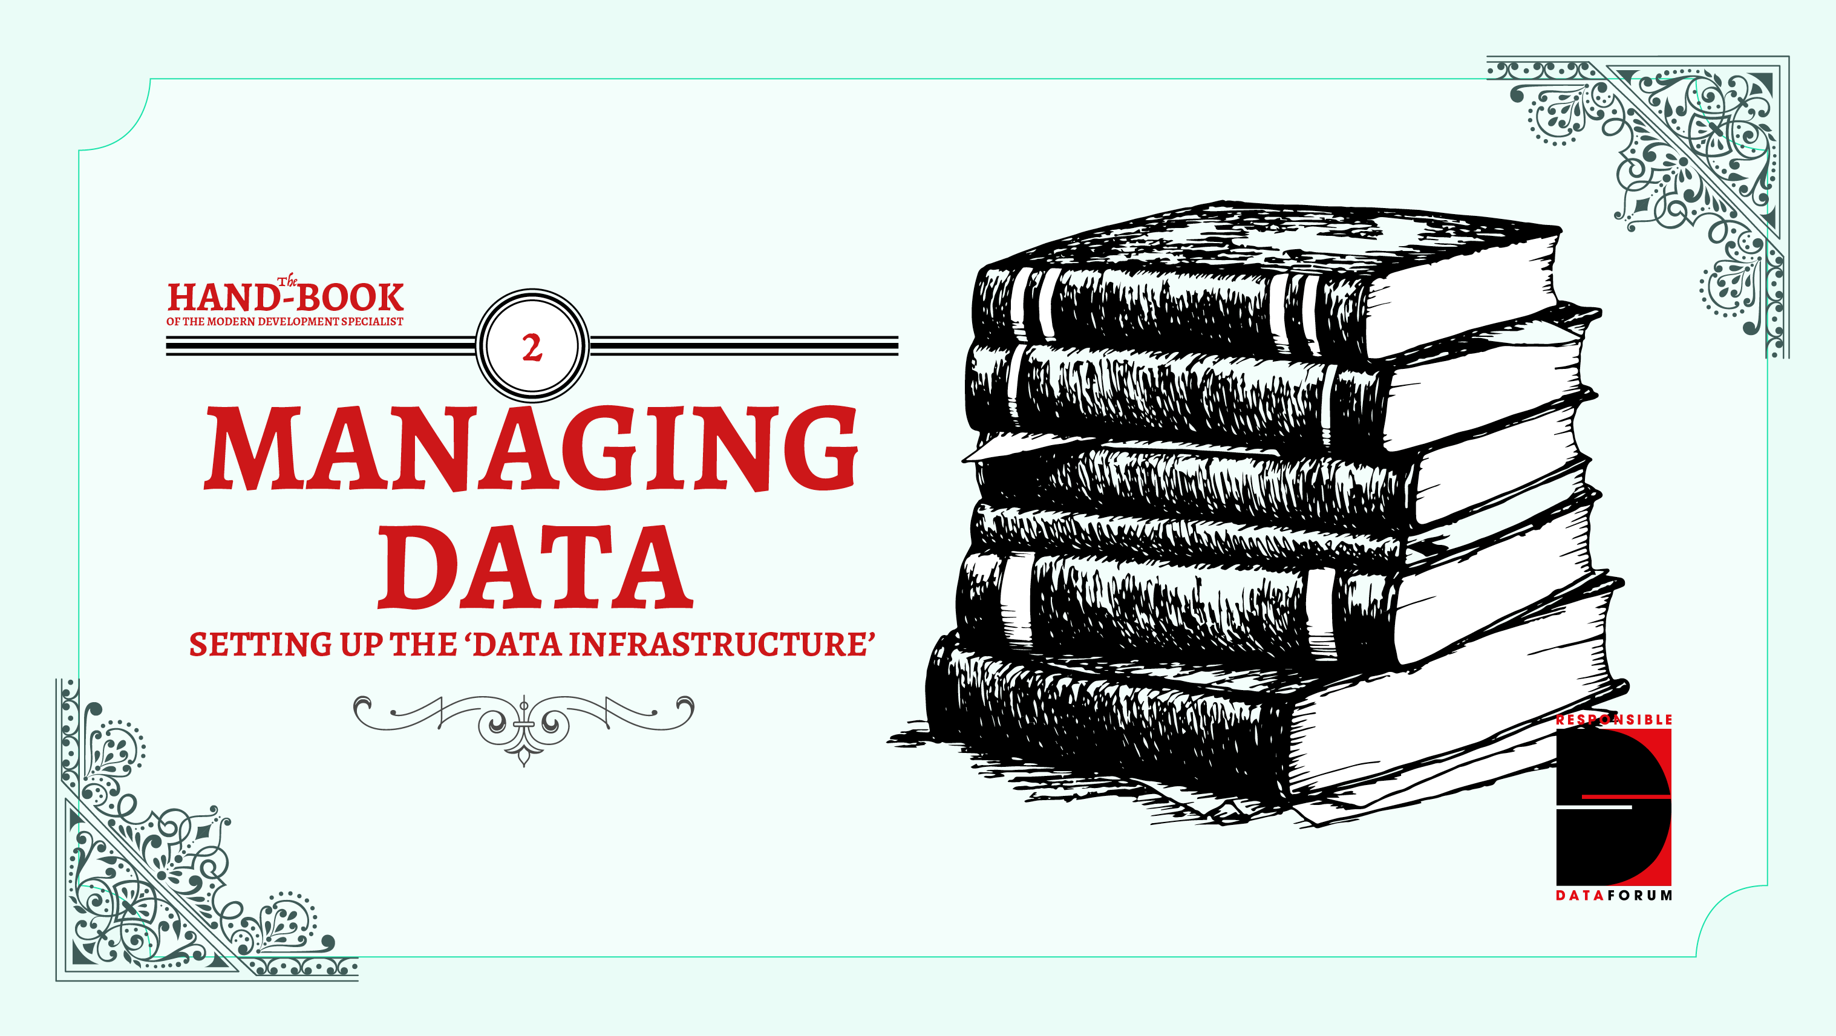

Slide 2
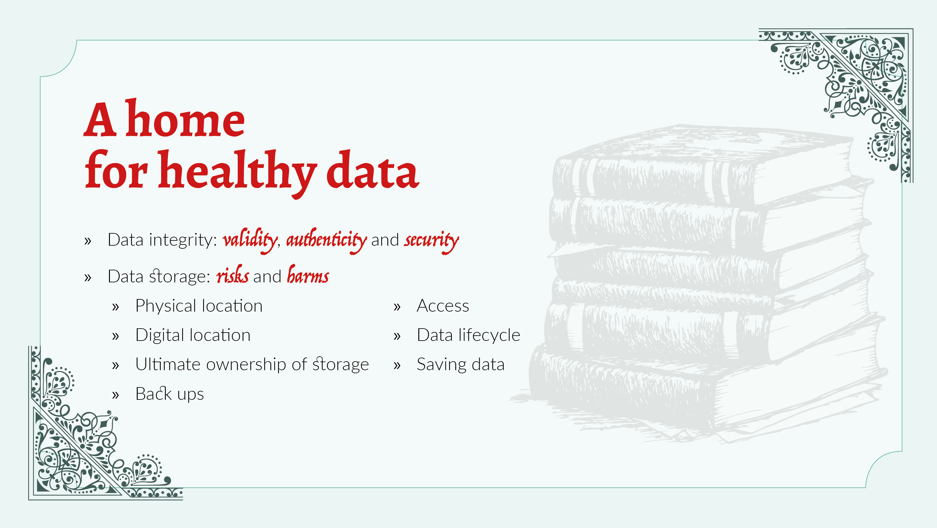
Notes:
All data occupies physical space, even if we don't think of it as such.
There are lots of decisions and processes that go into creating, storing and sharing data. Some main considerations to bear in mind when interrogating the **integrity of your data** include:
Is the data checked for changes at key points?
Are there granular permissions for making changes to the data during analysis?
Is the data collection process well-documented?
Are appropriate backup mechanisms in place?
Is the software used to manage and store the data fully up to date and licensed?
Have you future-proofed your data?
Other risks and harms associated specifically with **data storage** include:
Loss of information (deliberate or accidental)
Confiscation of information
Data breach
Legal threats
Malicious attack
What are some potential mitigation strategies?
What are the pros and cons of different storage options?
storing data locally,
in the cloud, or
within a network.

Slide 3
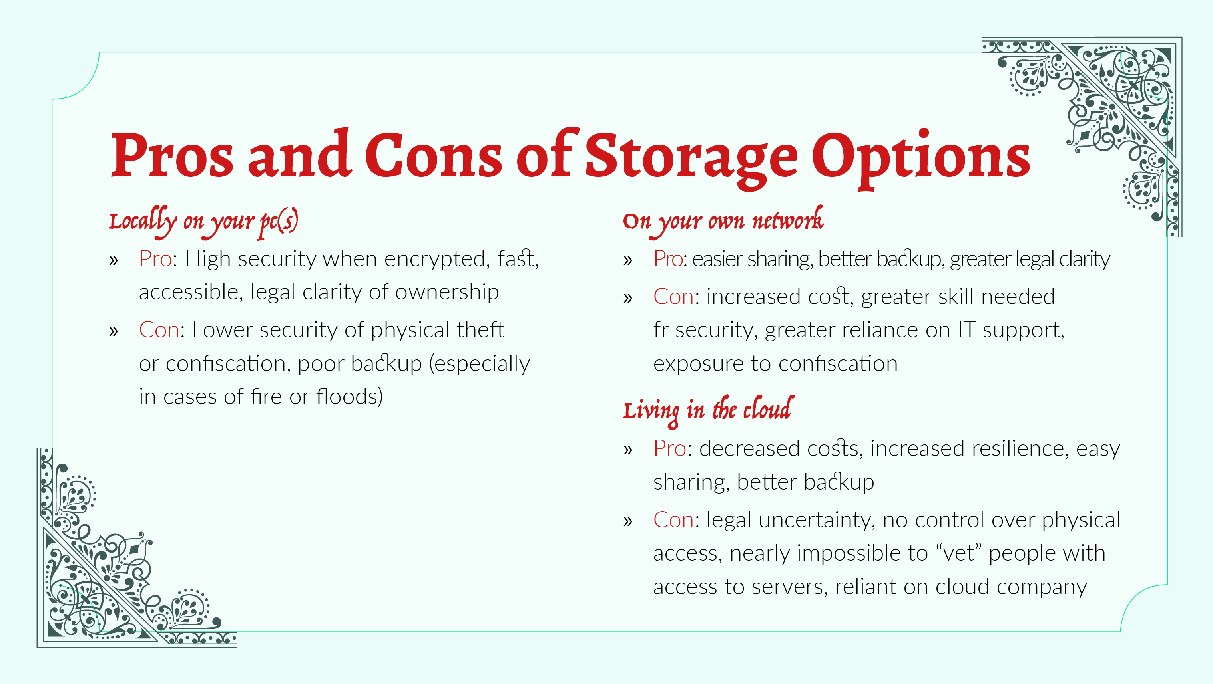

Slide 4
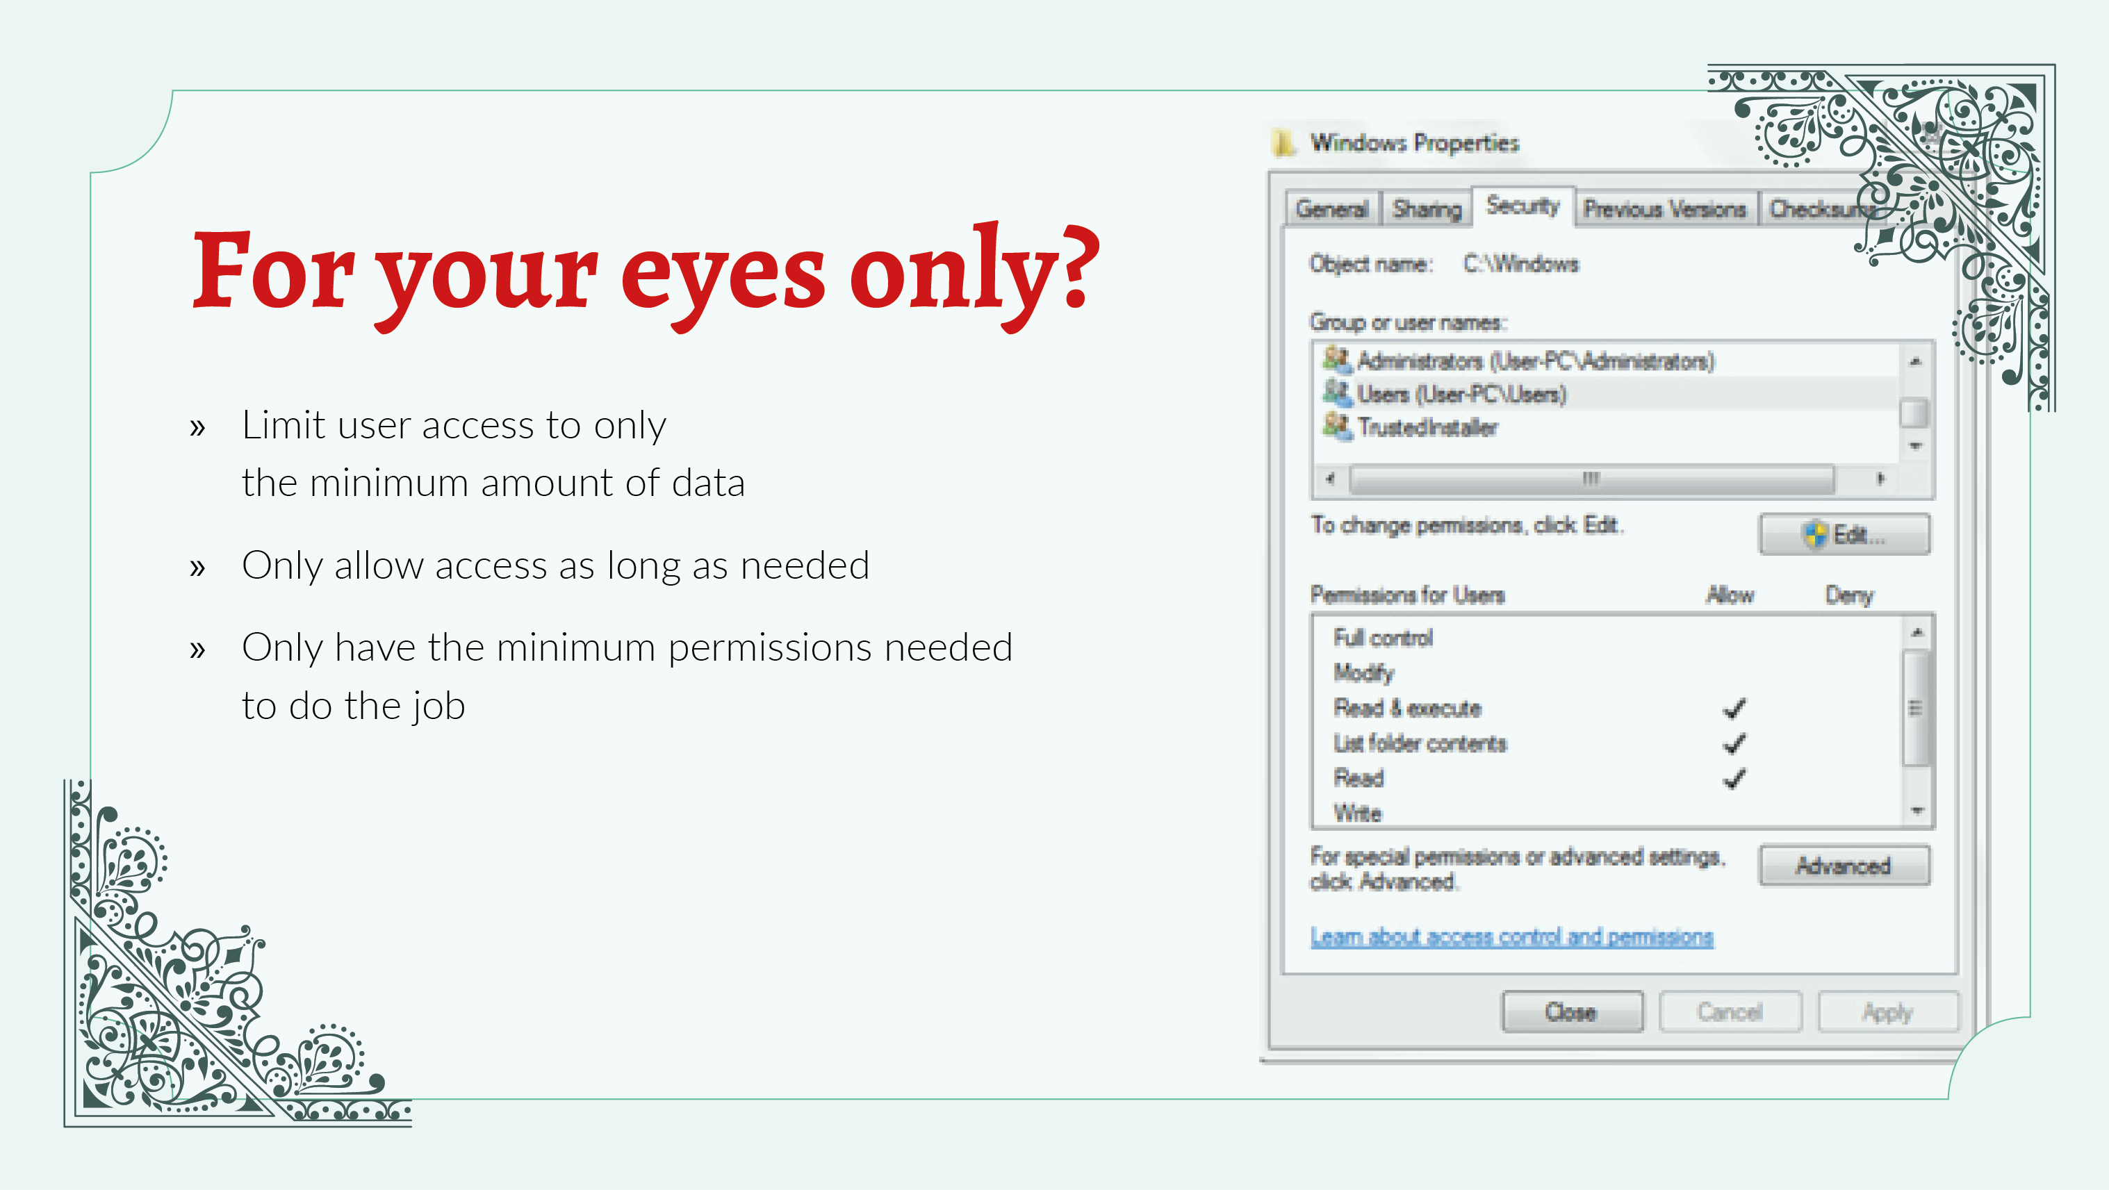
Notes:
Who has access to the data?
Making sure that access to sensitive information happens on a "need-to-know" basis can reduce the risk of someone getting access to data that they shouldn't. This can happen online, through setting appropriate user permissions for a certain person's role, or physically, in terms of only letting trusted or vetted individuals into an office space. Regular audits that check who has access and revisiting user permissions can help make sure that these access levels remain up to date.
But many of us work often on **collaborative projects**, which require different parties having access to the data. Another checklist to consider when setting up access permissions and data infrastructure on collaborative projects is included here, like including **layered access**, or embedding secure practices into the various access points.
Despite all this, though, it is important not to over do the checks and security measures in place; when it comes down to it, the project and the data need to be accessible in times of need, and potentially on a longer-term basis. Some concrete steps for making sure that the data will be available for the right people at the right time and planning for disruption or technical emergencies, are then included.

Slide 5
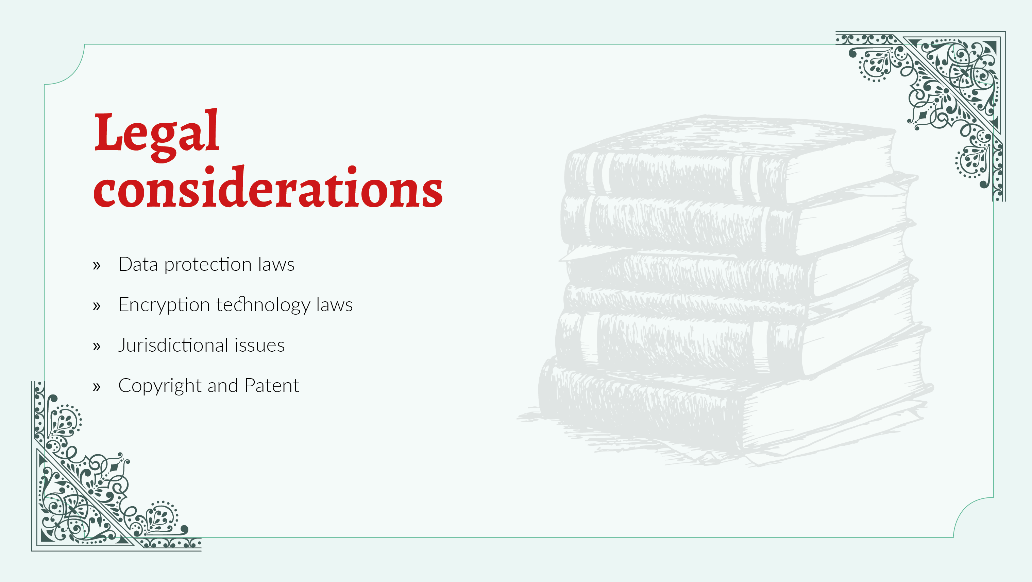
Notes:
Whether it's data protection laws, encryption technology laws, or jurisdictional issues, (or more!)... it is important to think through these different legal considerations
Data protection:
A number of countries have strong data protection laws which place limits on the types of data which may be collected from individuals. They also often include specific legal requirements about the methods used to store such data, along with mandatory reporting and monetary fines for breaches. Individuals about whom data is stored are often granted a number of rights, such as access to their information and the right to have their data correction and/or removed.
Encryption:
Local laws in a number of countries (such as Sudan, Yemen and Pakistan) place limits upon the nature of encryption software allowed for the communication and storage of data.
Jurisdiction:
Organisations should be aware of laws that would give governments access to information stored on servers hosted in their countries. Organisations must also be aware of cross-jurisdictional issues in relation to their data management.
Copyright and patent:
Copyright and patent issues related to the collection, storage and dissemination of your data are important laws to consider. Ensuring you have the correct licensing for your projects and infrastucture can help reduce unexpected restrictions and costs further into your project.

Slide 6
