Slide 1
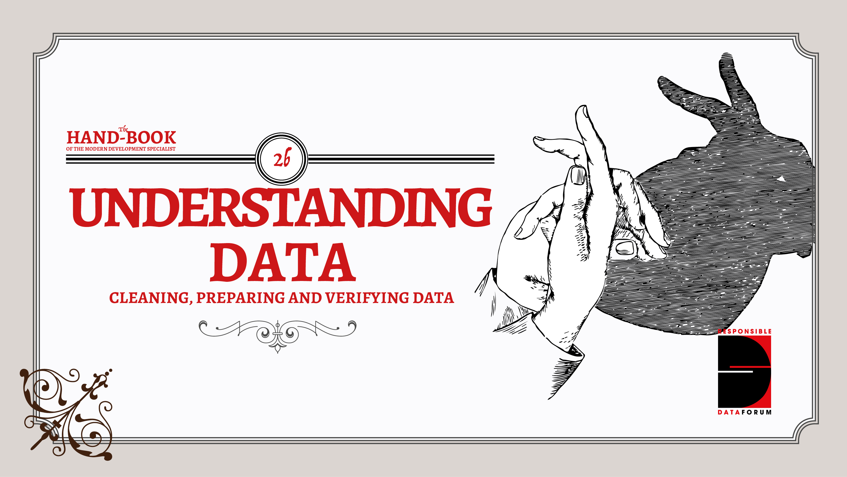

Slide 2
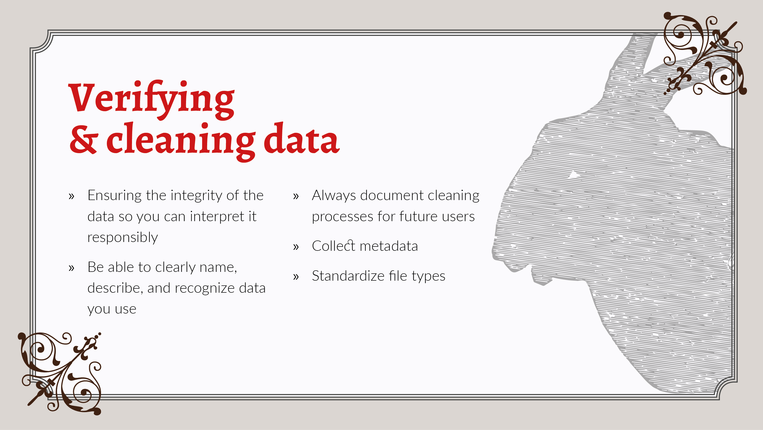
Notes:
Ensuring the data you have collected is properly verified is vital. Without verification, the results cannot be relied upon for decision-making processes, and you risk misrepresenting or doing harm to the populations you aim to help. Whether you have no access at all to the original source of data, ensuring the **integrity** of the data can help make sure it is interpreted in a responsible way.
Messy data may hide harmful information. If we don't make sure that we can clearly name, describe and recognise all the information contained in data sets, we might make improper assumptions about the risks that that data might pose. **cleaning data** might mean anything from making sure dates are in the same format in a spreadsheet, to ensuring that appropriate filters are applied, or simply organising it in a useful way for what we're trying to find out.
Documenting what you're doing, and preparing your data for future use is important to help others use the data, or simply make sure that others in your team or organisation understand what you're showing them.
Collecting appropriate data about the data itself, otherwise known as **metadata**
**standard file types** will make it easier for your data to be interoperable with other datasets, and used within common applications.

Slide 3
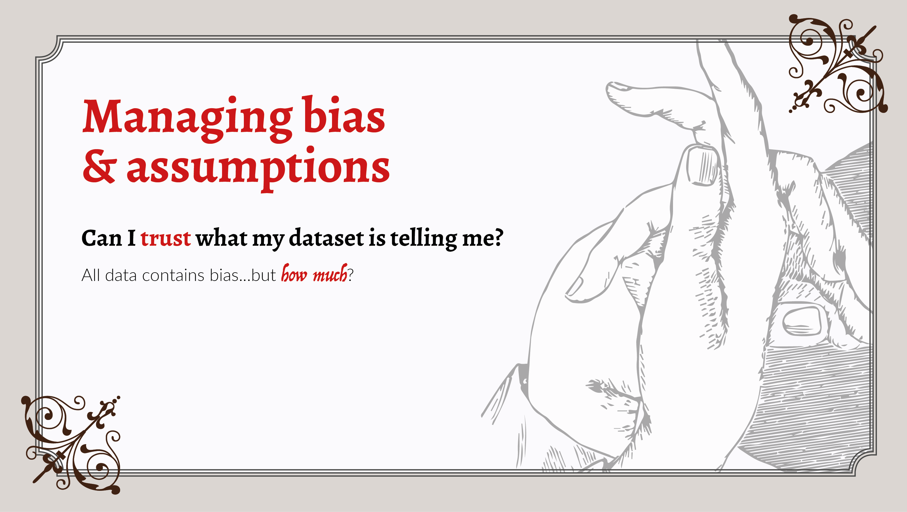
Notes:
At this point, the data you're working with should be ready for analysis; you've collected it or gathered it, cleaned it, and prepared it for further use. But before going straight on to analysis, this is also a good point to stop and question your assumptions.
All data, no matter how it is collected, will contain a certain amount of **bias**, due to, for example, the number of considerations that have gone into collecting the data, the way in which the data is structured, the questions that have been asked, or any number of other considerations.
Specific points that are useful to consider for spotting potential bias include thinking about the **sample** of people from whom data was collected, or cultural biases within the way the collection process was structured. It's good to be on the look out here for any **outliers** within your dataset that might skew your result - that is, datapoints that might represent human or machine errors. Getting expert opinions from those with deeper topical or cultural expertise of where you're working is a good way to verify your findings before moving on, too.

Slide 4
