Slide 1
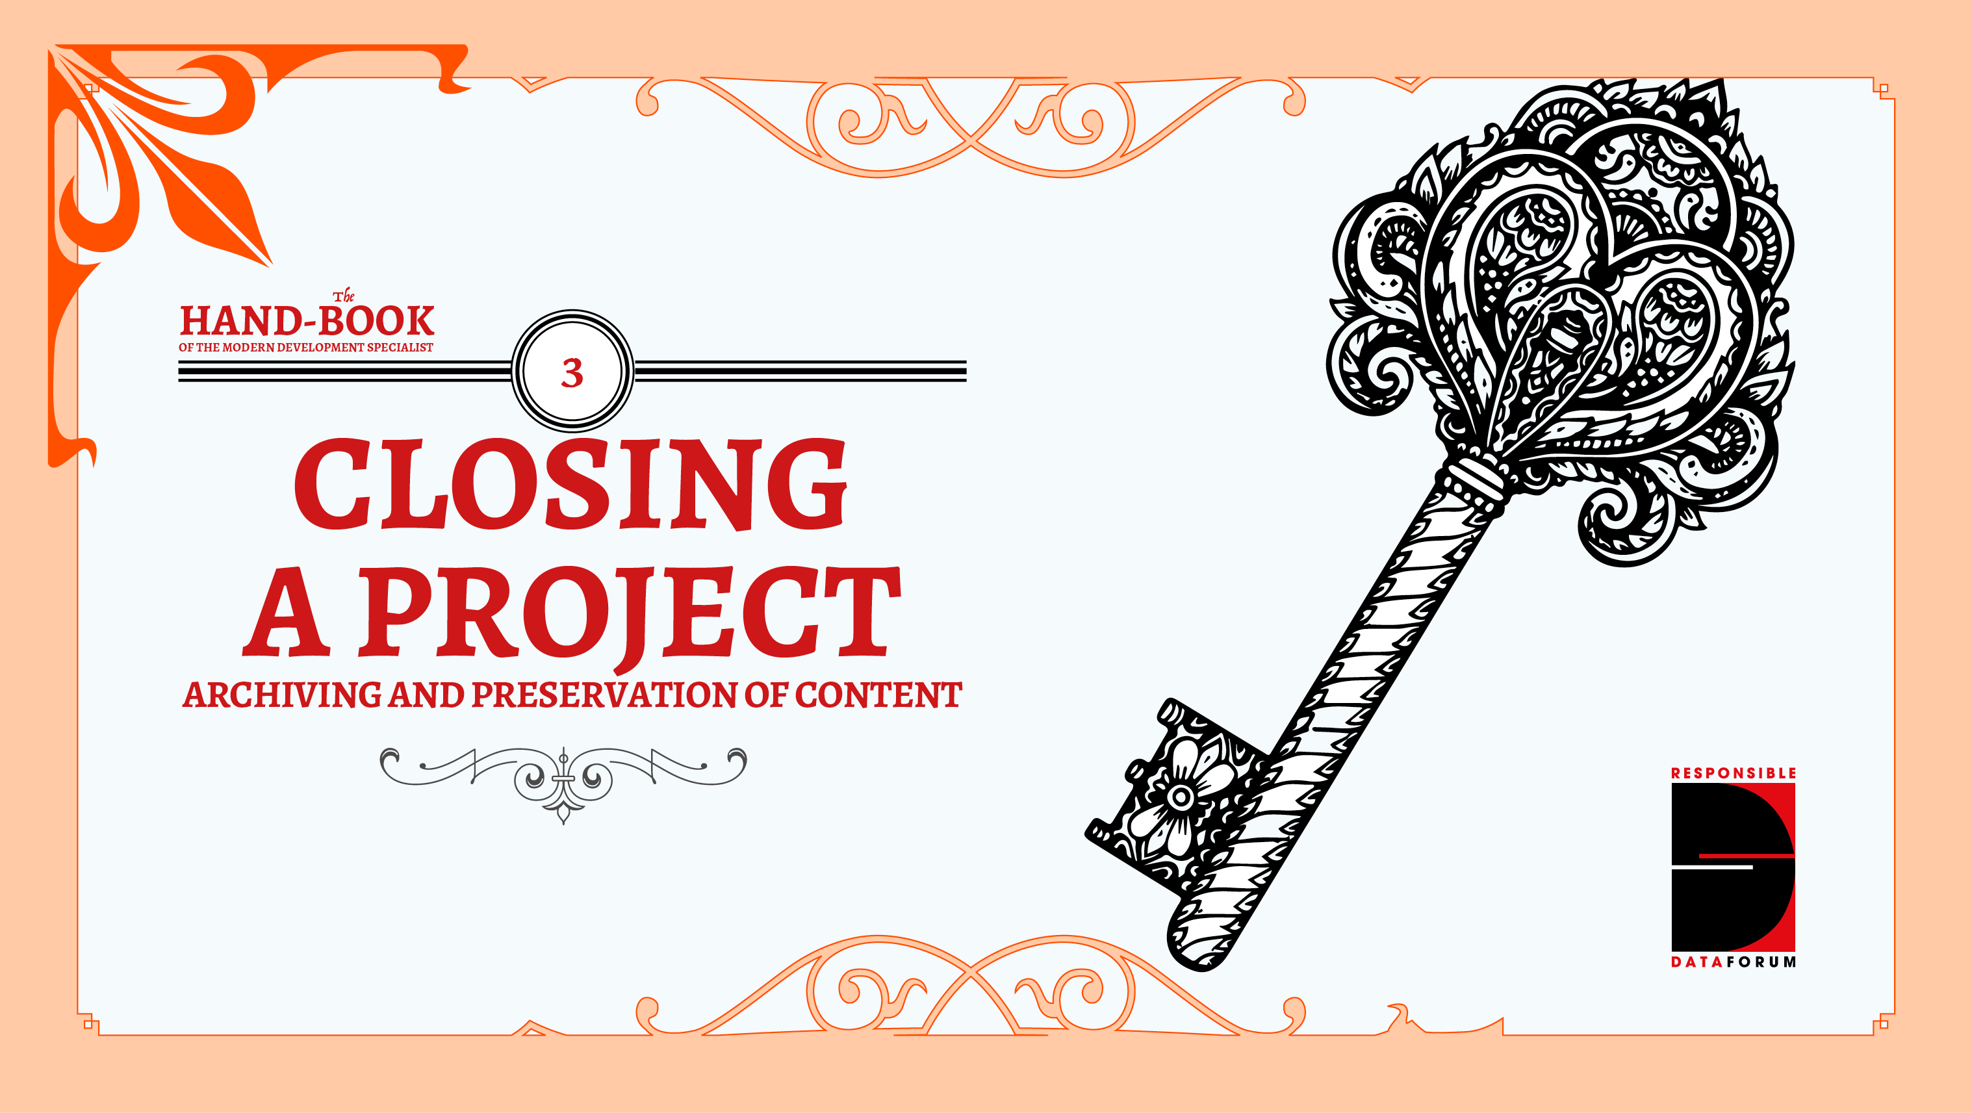

Slide 2
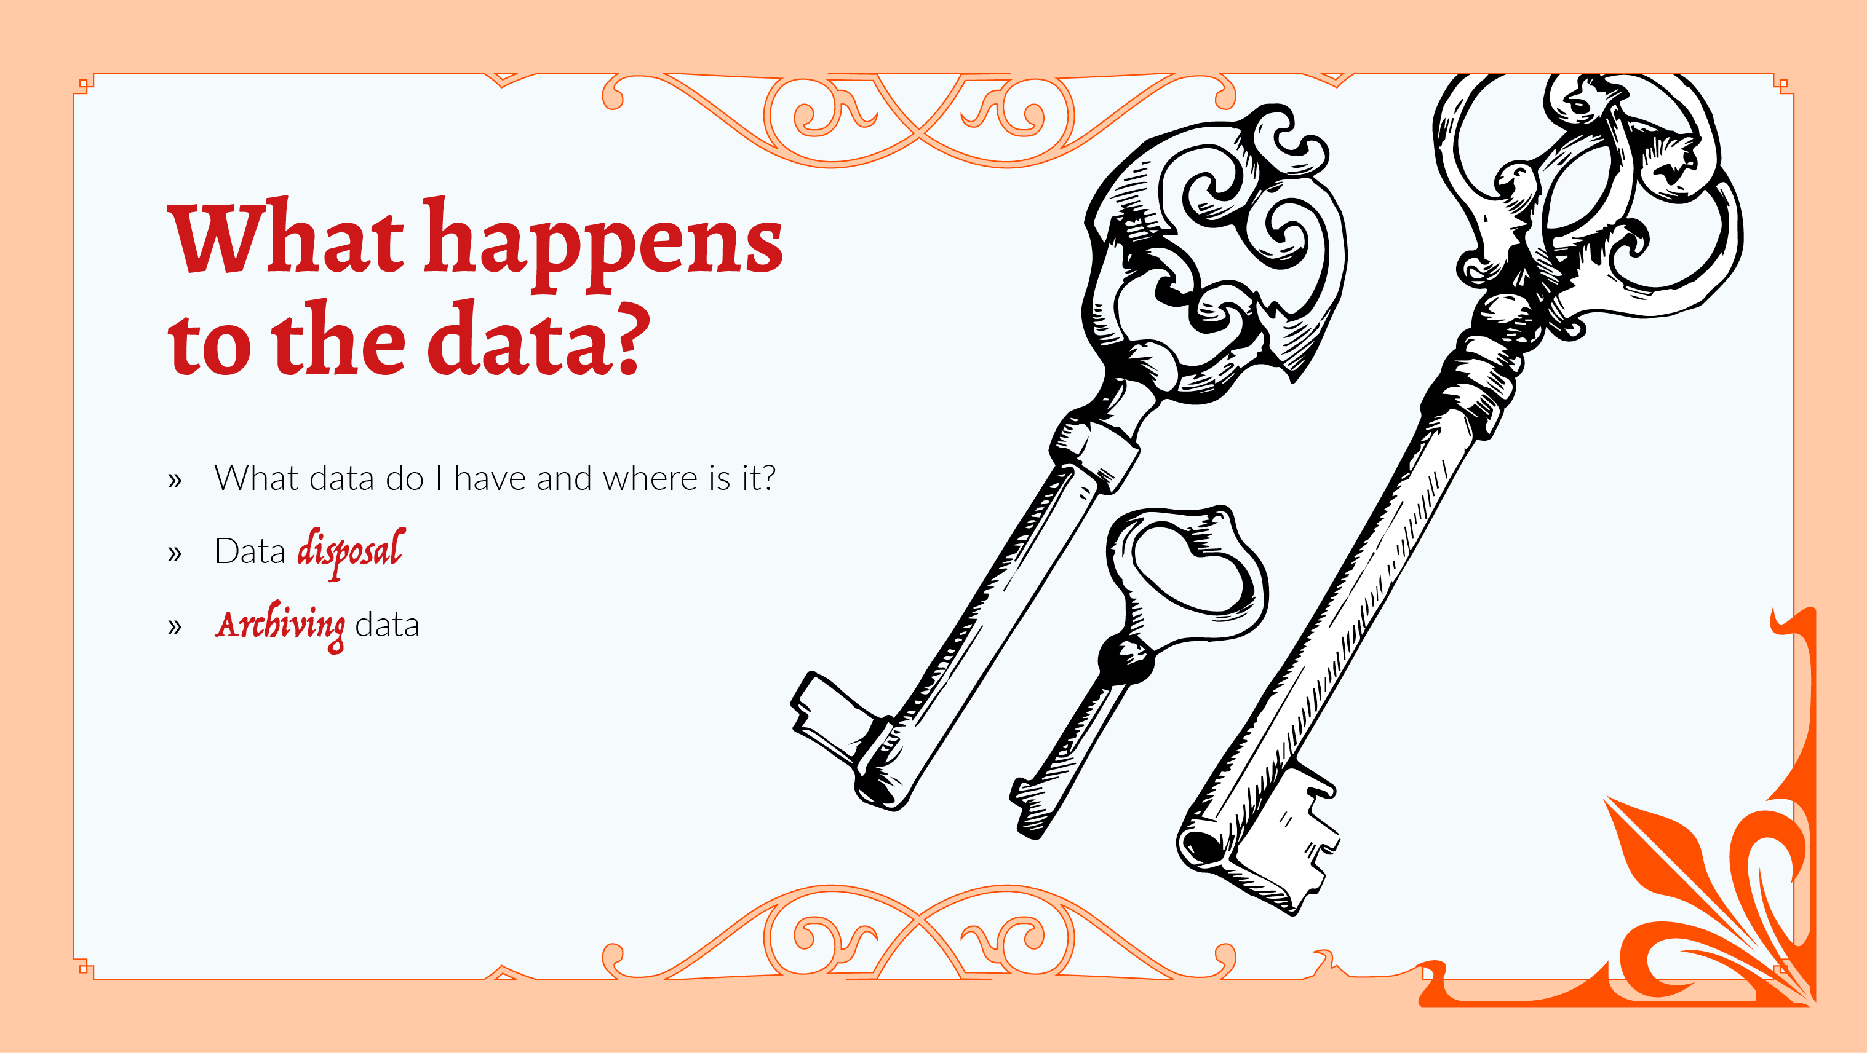
Notes:
Too often, the data that is produced during a project is left to one side during the rush of ending a project. Deciding what to do with the data after it has served its purpose is an integral part of the project design process.
To plan for project closure, start by thinking through the types of data you have, and where it all lives. Then you can decide what to do with it; whether that is **disposing of it** (and making sure that that is really the right decision for you, and that the data isn't being used by others) - or working out a responsible way of **archiving** your data. Preserving your information has the potential to be used by others, as well as bringing historical value.
If the data in question is very large, substantial data infrastructure may well need to be in place to support it being archived. If this is too much of a technical burden, then partnering with an archiving organisation would make this process a little easier.

Slide 3
