Slide 1
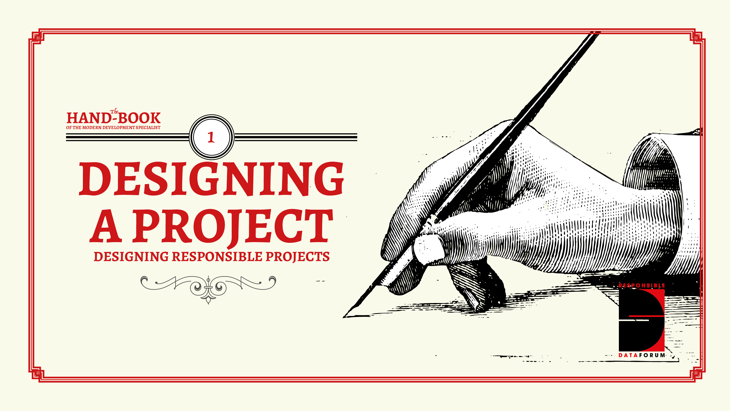

Slide 2
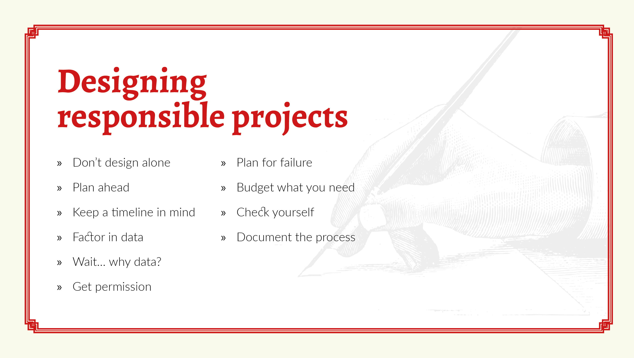
Notes:
Here are some top tips to help you bake responsible data into your project design:.
Don't design alone: Think carefully about who needs to be in the room, and engage the various stakeholders or experts as soon as possible (eg. it's usually a bad idea to bring specialists like techies or lawyers into planning processes after essential components have already been decided and can no longer be refined). Make sure that if you're asking people for their input, there is still space to incorporate said input into the project. Otherwise, you're wasting everyone's time.
Plan ahead: map the lifecycle of the relevant project or system - it might change, but it's good to have a starting point.
Keep a timeline in mind: Consider what a reasonable timespan might be- how long do you want to future proof the practice or the system for? Be realistic here: it's impossible to know what's around the corner, but there are things you can do.
Factor in data: Fill in the points when data may be relevant in this lifecycle and what the design implications are
Wait...why data?: Think through the options for how data can be handled or processed at each point, and - importantly - consider alternatives to the obvious or usual way of doing things before deciding it is in fact the best approach
Get permission: Consider what permissions, consents, policies or principles might dictate or affect the handling of data and the ability of end users to make informed decisions
Plan for failure: Build in backstops, contingency and emergency plans for when things go horribly wrong (including a resource list for troubleshooting issues)
Budget what you need: Ensure that the financial budgeting and the allocation of human resources are "fit for purpose" and adequate to achieve all of these objectives
Check yourself: give yourself opportunities for monitoring and calibrating, and don't wait for the project to be shut down before learning lessons and parsing failures. Periodically check whether you are staying true to the responsible data standards and ethical framework that you set for yourself up front.
Document the process: track both the small and big picture approach to have a clear, organisational baseline that can be relied upon as people come and go and the project evolves. This will also make it much easier for you to draw out lessons learned from the project.

Slide 3
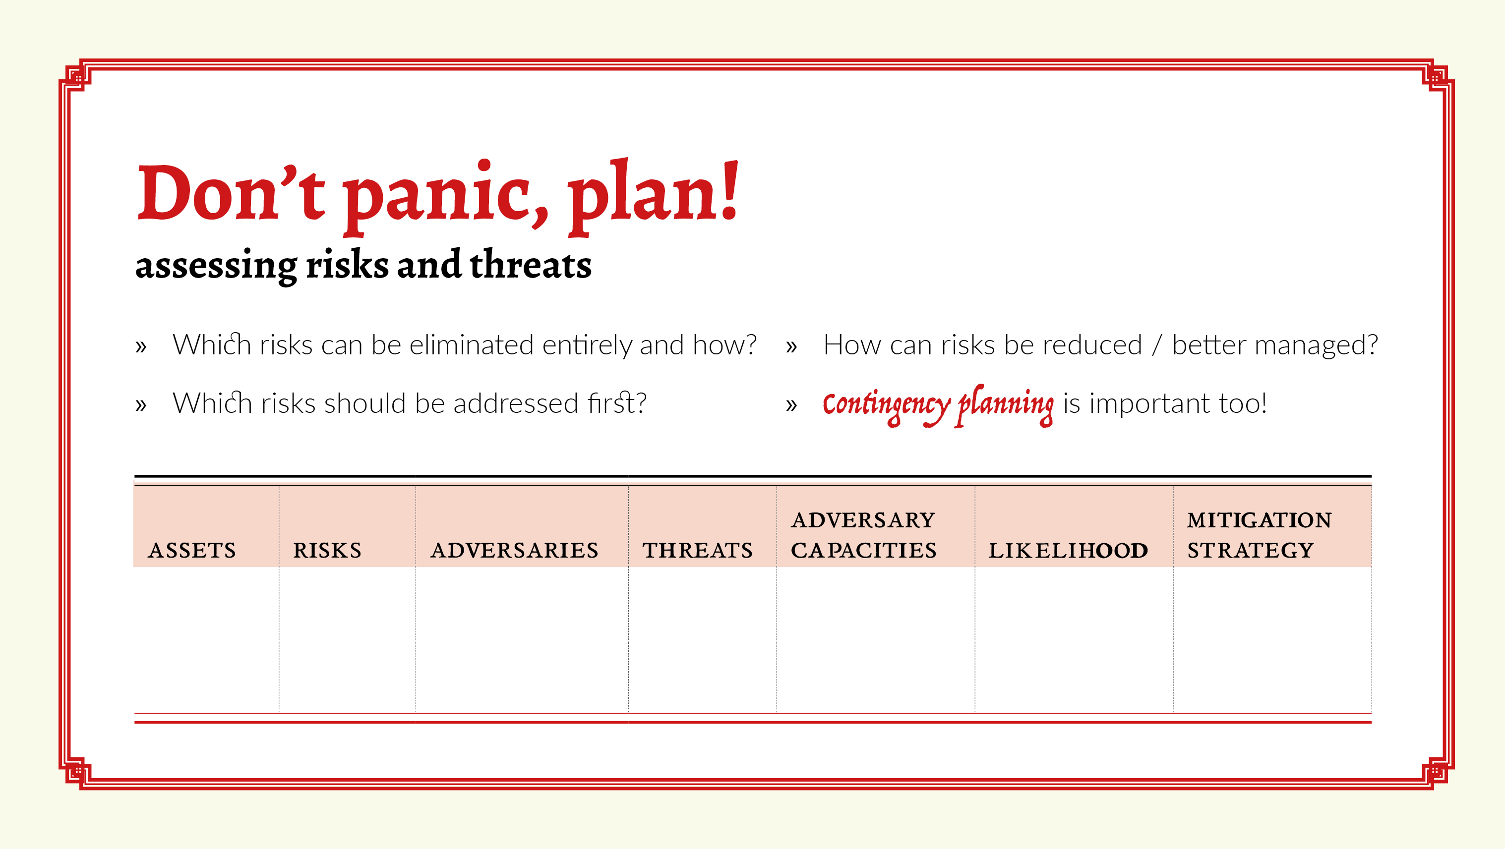
Notes:
Responsible data practices also require safety planning. This identifies actions you can take to address the threats. Questions that may help formulate your plan include:
What risks can be eliminated entirely and how? Based on their likelihood and significance, which risks should be addressed first? How can risks be reduced or better managed? It is assumed that practitioners and managers won’t be able to address all threats at once. They should be prepared to schedule work on project risk assessment and safety planning, alongside project design, implementation, and monitoring and evaluation activities.
The threat model can be organized into a matrix such as the one here.
Contingency planning:
Prevention is only half of what you can do. There will always be residual risk and threats you cannot foresee. This is why it is important to prepare for incidents to happen, so you can contain them or mitigate their impact.
Talk through the different kinds of risks, and make sure there is a clear, step-by-step plan of action to highlight incidents to the relevant people within the organisation if or when they happen.
Encourage a culture of openness and learning from mistakes, not blame; reporting incidents within your project team should be seen as a positive, not a negative.
Stress that the consequences of covering up or hiding in-house mistakes will always be much more serious than coming clean: mistakes happen, and it's good to learn from them.
Keep a list of people to call in times of emergency in areas in which you lack internal expertise - for example, lawyers, crisis communications, data forensics. Building those connections before you really need them will save you time if/when a crisis hits.
For all projects, have an emergency plan of action to prepare for immediate shutdown or project termination.

Slide 4
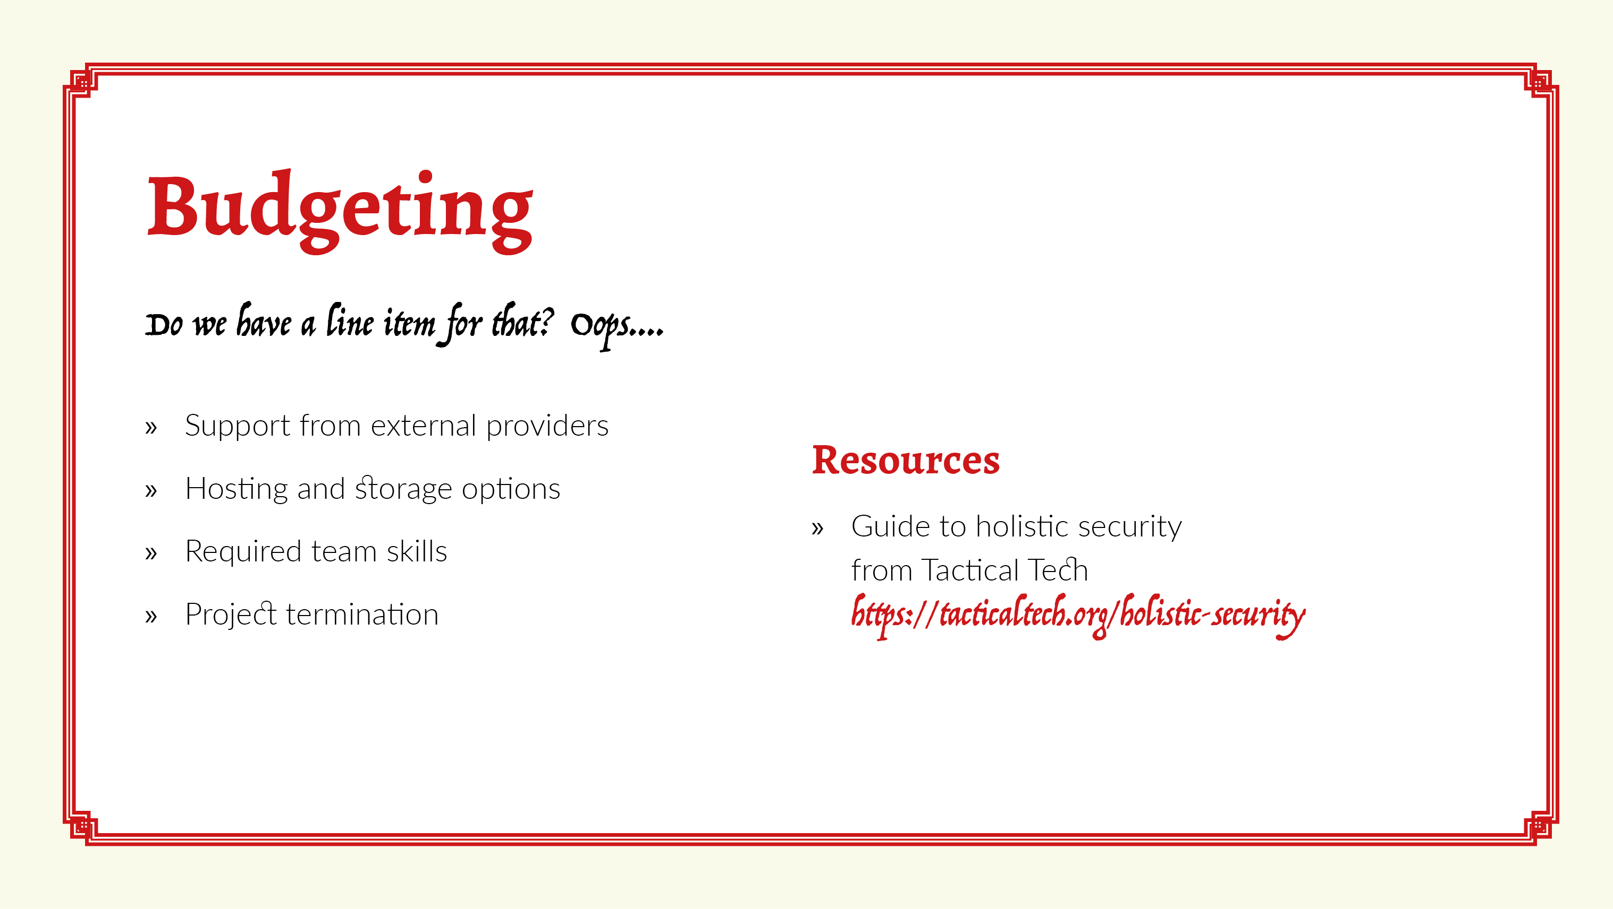
Notes:
Often, budget constraints are one of the major reasons that responsible data is pushed to the sidelines. This can be countered with a well-thought out budget from the very beginning. Oft-forgotten items include:
the responsible data concerns that come with relying upon external providers for tech support;
thinking through hosting and storage in a way that is most appropriate to the data that you are collecting;
skills required in a team; back up planning and emergency support, and crucially,
project termination. Ending a project well is one of the most often forgotten concerns around a project that might have collected or used a lot of data, whether this means actually archiving the data, making sure that those reflected in the data can have continued access to it, or making sure it is securely taken offline if necessary.

