Slide 1
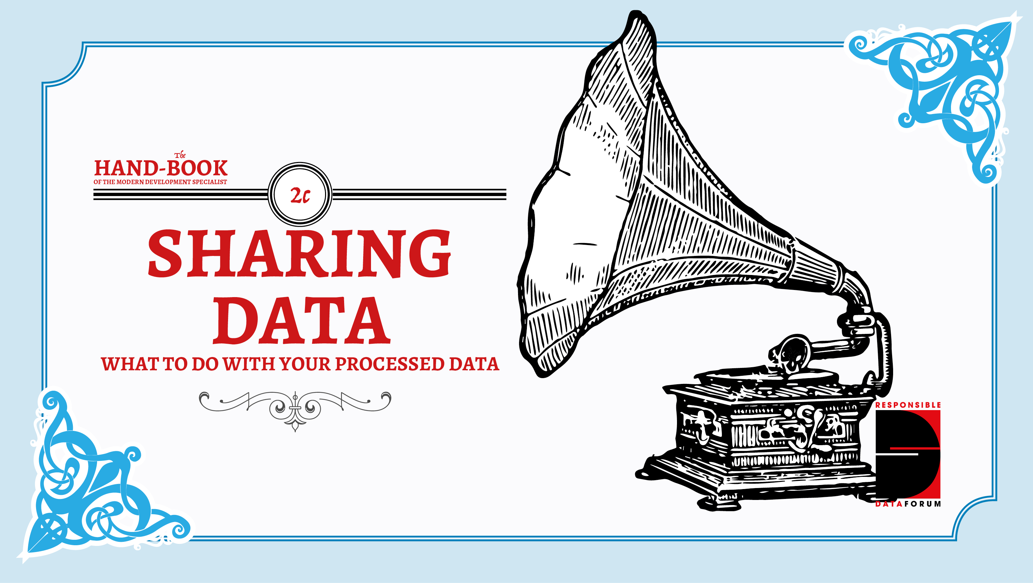

Slide 2
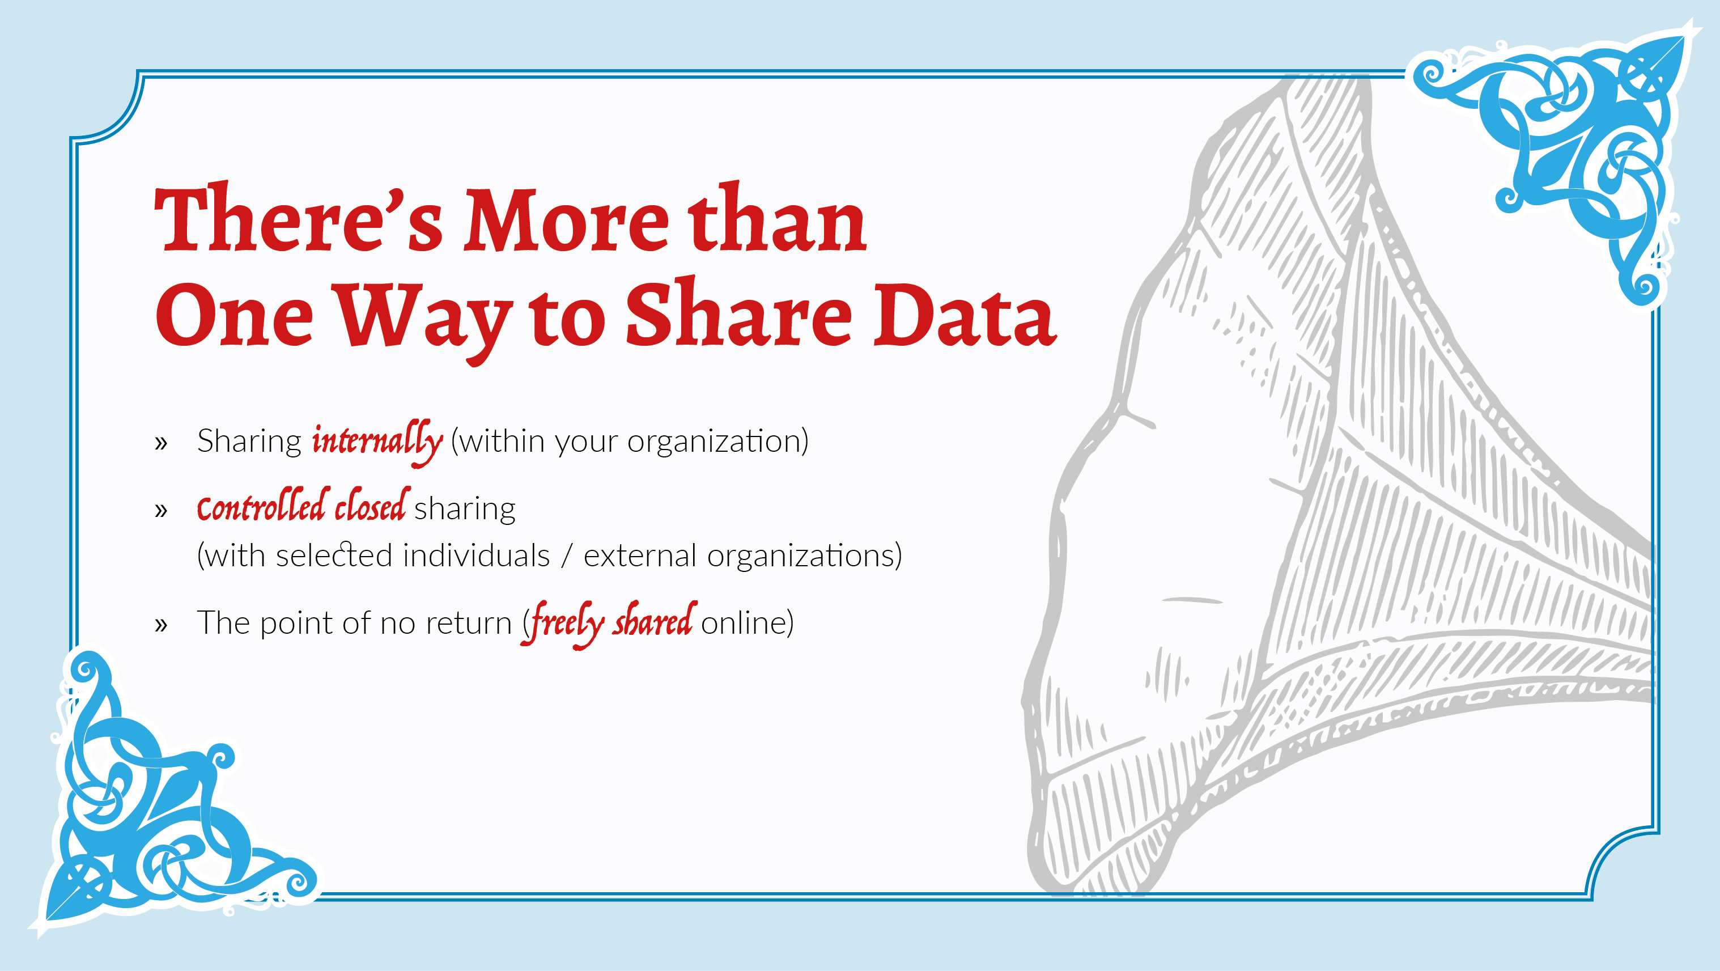
Notes:
Sharing can happen on different levels; within an organisation, within a closed but controlled set of actors, or - the point of no return - freely shared online. What are the pros, cons and considerations for each of these three groups?
An important aspect of this level of sharing is the presence of an organisational security policy: a set of rules and guidelines providing you with a framework that you can safely assume your colleagues, partners or co-workers, will follow when dealing with the data.
sharing your data with unusual suspects will provide you with opinions that are outside of the echo chamber you are used to, and can help to expand the dimensions of your project. You could, for example, share the data back with the people reflected in the data, and see what they think of what it reveals. Often, doing this is a responsible thing to do anyway.
Once the data set is shared publicly, the proverbial cat is out of the bag. Any weak point in the information, any personally identifiable information that hasn't been properly addressed, will be impossible to mitigate because someone might have already made a copy. The sections above offer a strong validation and checkup process; however, a final risk assessment of the data is more than warranted.

Slide 3
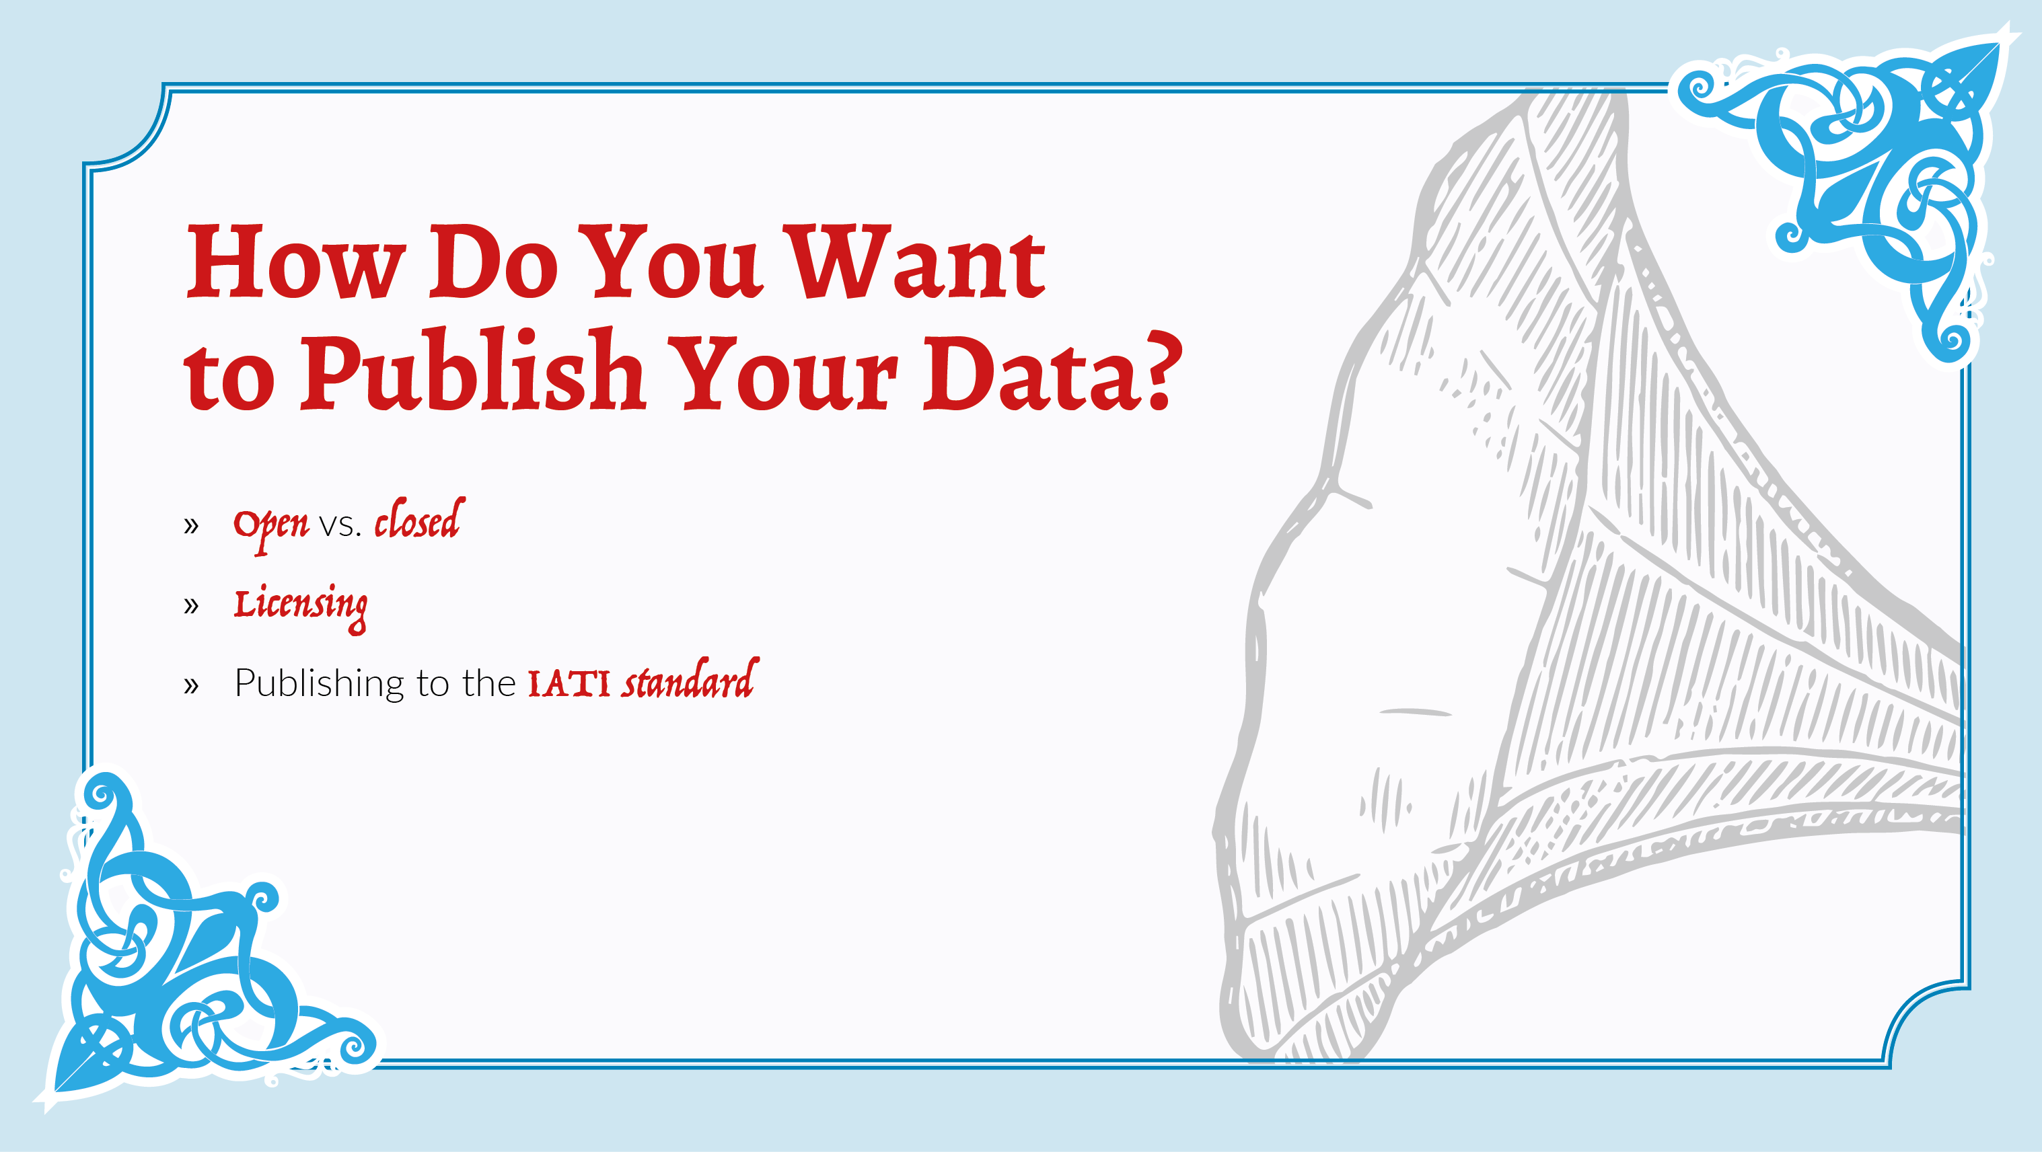
Notes:
If you decide to share it online, there are a number of further things to consider; do you want it to be **open** or **closed**? Chances are that if the data is suitable to be online, it's suitable to be used by others - but this isn't always the case.
If you want to make your data **open** you can:
give your data an **open** license
make it fit within the **open definition**
publish it to the internationally-recognised transparency standard, the International Aid Transparency Initiative.

Slide 4
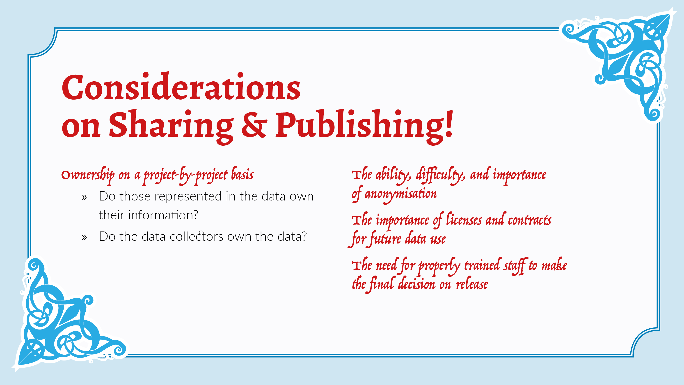
Notes:
Being 'open by default' might be useful in some situations, but when working with sensitive data, it's better to err on the side of prudence before making absolutely sure that no sensitive or potentially harmful data is being released into the open.
The issue of **data ownership** is a tricky one; to whom does the data belong? Those who are represented in the data, or those who have collected the data? There's no easy answer to this question, so thinking it through carefully on a project-by-project basis is necessary to make sure you come to an appropriate answer.
If you do decide to share it, making sure it has an appropriate license which represents well what you want the data to be used for can help clear up any uncertainties or potential misuses of the data. If you're sharing it with a specific group of actors, a legal or contractual framework might help to clearly outline what the data can and can't be used for by other parties.

Slide 5
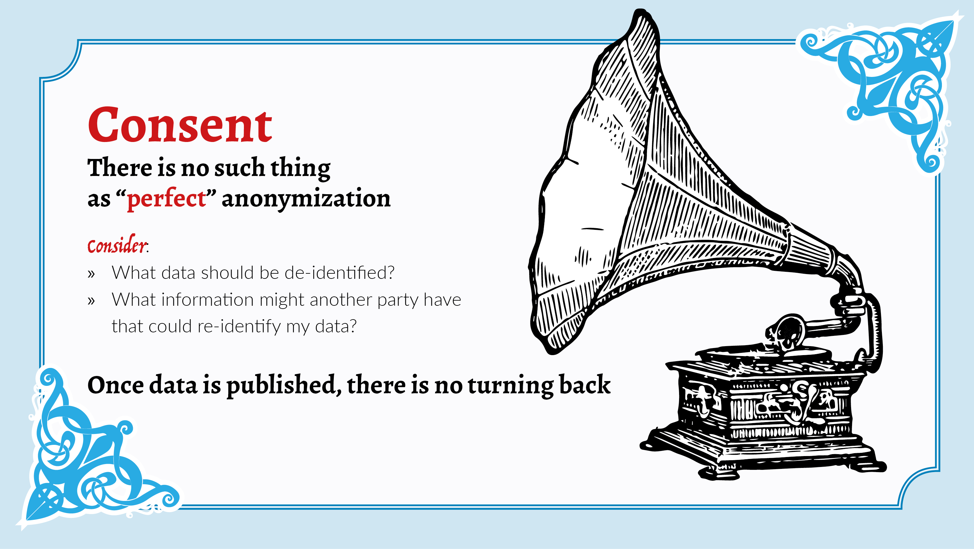
Notes:
Before publishing though, you might want to make sure that individuals are taken out of the data - but this isn't always so easy. A section discussing **anonymisation** - and various strategies for **de-identification** of data are included next. Anonymisation and identification is a particularly difficult responsible data issue, as 'perfect' anonymisation is difficult if not impossible. Releasing personally-identifiable information can be harmful to the people to whom the data pertains, but it can also be hard to remove and make sure that at no point in the future it will be re-attributable.
If you're particularly worried about identification of your data before publishing, it might be most useful to simply get help from those with more experience in anonymization and de-identification.

Slide 6
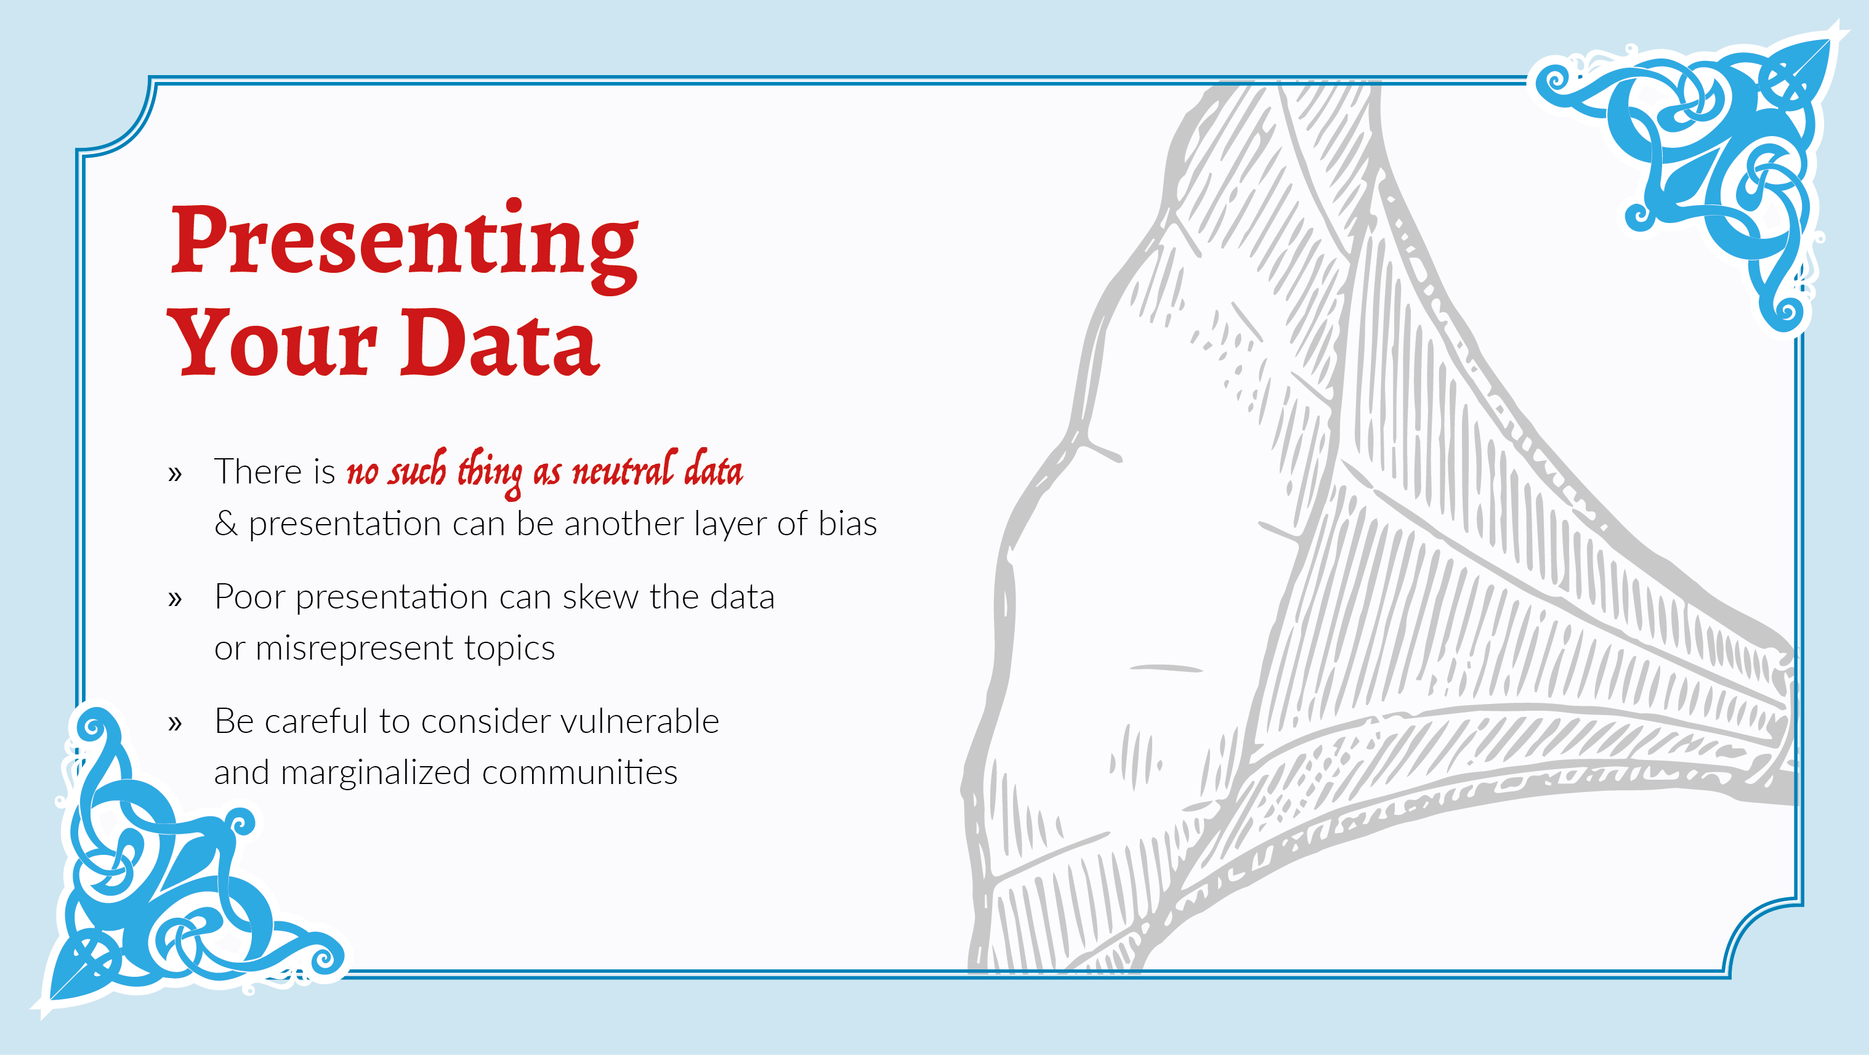
Notes:
No data is neutral, and normally when you present data you want to convey a specific narrative. Doing this in a way that doesn't skew the data or misrepresent the topics in question is important not just for the reputation of your organisation, but also as an ethical responsibility to the people who are reflected in the data itself.
Diving into the details around ethically and responsibly visualising data lies way beyond the scope of this book. For more on this topic, we suggest referring to the accompanying suggested resources.

Slide 7
